Slide 1
Age of Exploration The Explorers

Slide 2
Reasons for Exploration
The fall of Constantinople in 1453 led to a search for new trade routes by the Europeans. This led to the Age of Exploration.
Developments in technology helped make exploration possible.
The caravel was a new type of ship-studier, new sails, more sails
The astrolabe could calculate latitude made sailing easier both day and night

Slide 3
Europeans were looking for places to gain wealth through the trade of spices and other goods.
Europeans wanted to spread Christianity to parts of the globe.
3 Gs: God , Gold, Glory
The first Europeans to arrive in the “New World” were the Vikings under the leadership of Leif Erikson in 1000.

Slide 4
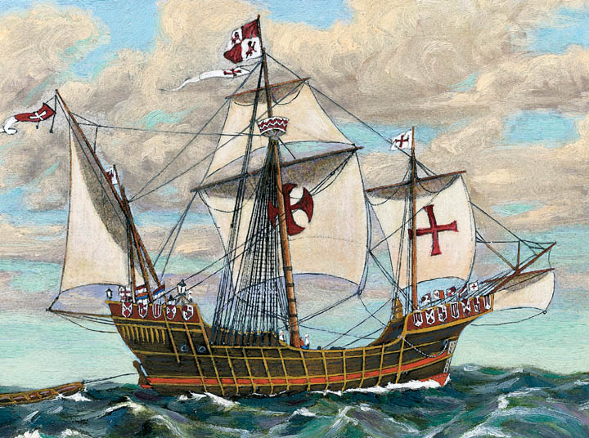
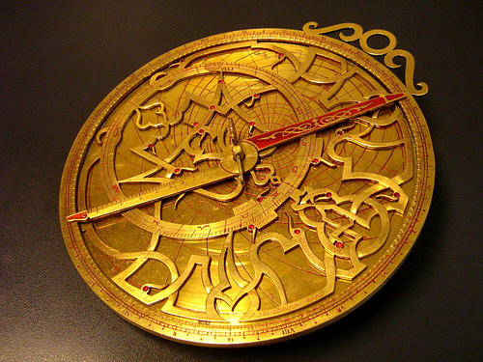
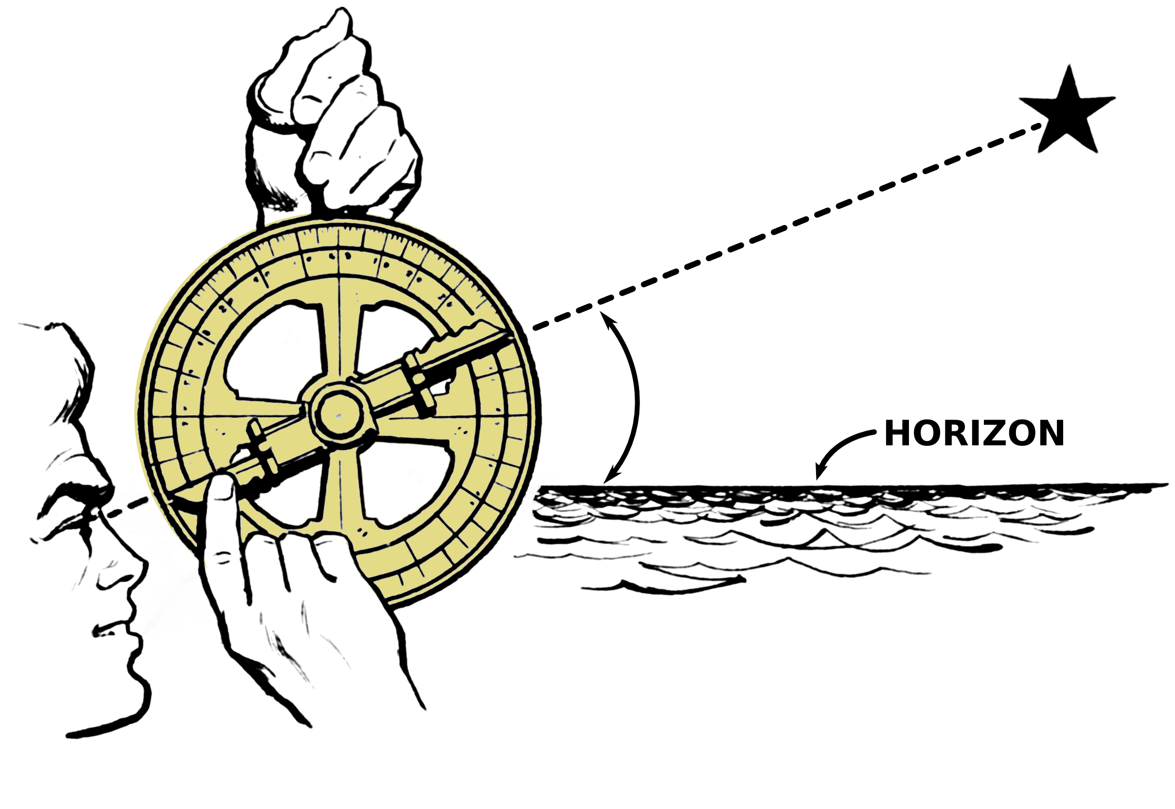
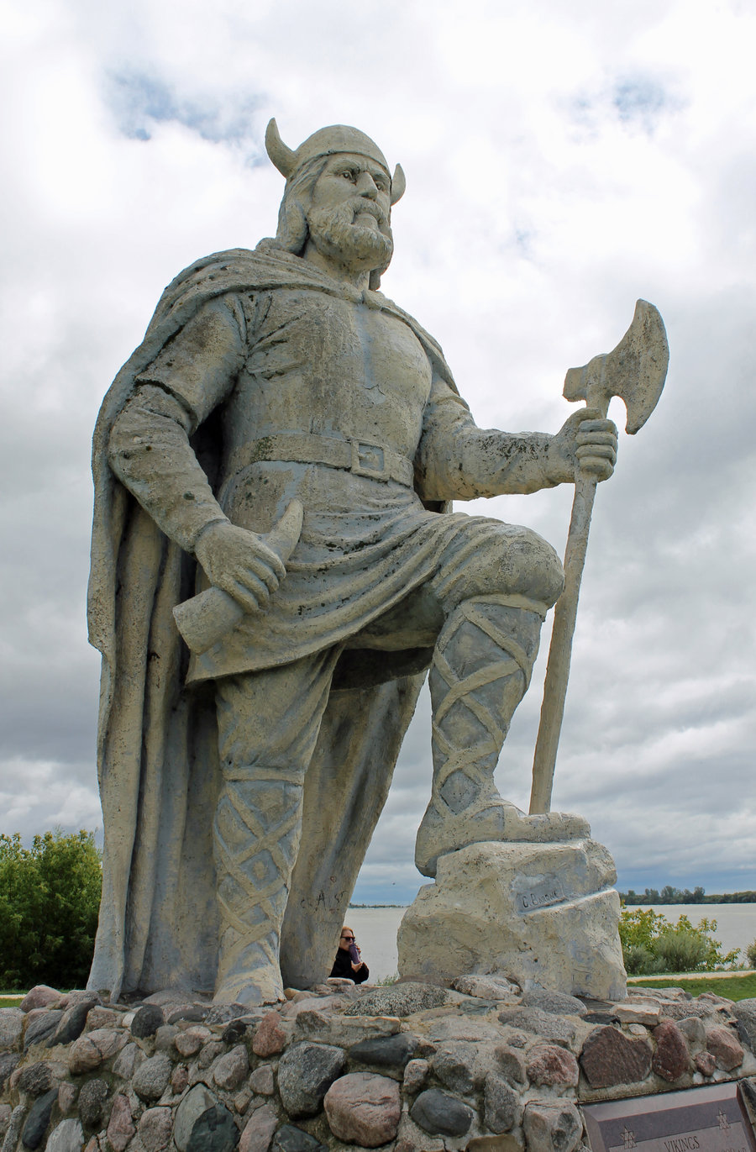

Slide 5
The Portuguese Lead the Way
The Portuguese began to explore the western coast of Africa under the leadership of Prince Henry “The Navigator”.
Prince Henry founded a sailing school to teach others about sailing.
By 1460 the Portuguese had established trading post along the west African coast
In 1488 Bartolomeu Dias and his crew became the first Europeans to travel around the southern tip of Africa.
In 1497 Vasco da Gama reached India and found spices such as pepper, cinnamon, rare silks, and precious gems.
This voyage gave the Portuguese a direct sea route to India

Slide 6
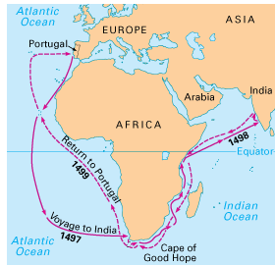
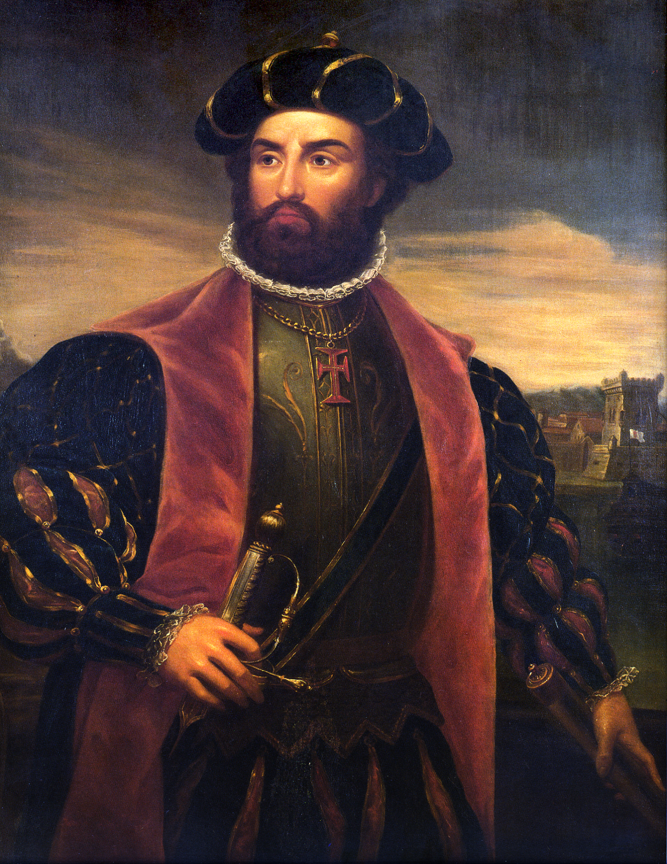
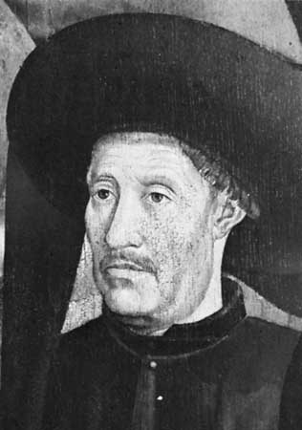

Slide 7
Spain Makes Claims
Spain had grown envious of the amount of wealth Portugal was gaining through its route to India.
In 1492 an Italian named Christopher Columbus convinced the Spanish Queen Isabella I that he could find a quicker route to Asia.
In October he reached the West Indies (somewhere in the present day Bahamas). He thought he had reached India so he called the natives indians.
Columbus made 3 more voyages to the new world. His exploration opened the new world to Spanish conquest.

Slide 8
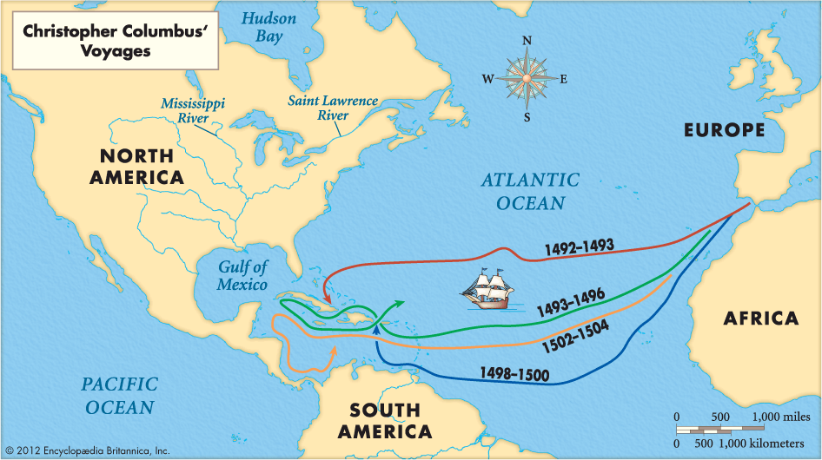
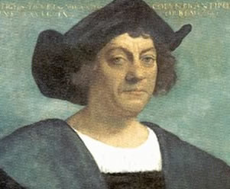

Slide 9
Conflict between Spain and Portugal
By 1493 Spain and Portugal were rivals competing for the dominance of the world.
In 1493 Pope Alexander VI decided to divide the world in two in order to make peace between the two nations.
The Pope suggested an imaginary line drawn through the Atlantic. This is known as the Line of Demarcation.
All the lands to west of the line belonged to Spain and the lands to the east to Portugal.
In 1494 both Spain and Portugal signed the Treaty of Tordesilla.

Slide 10
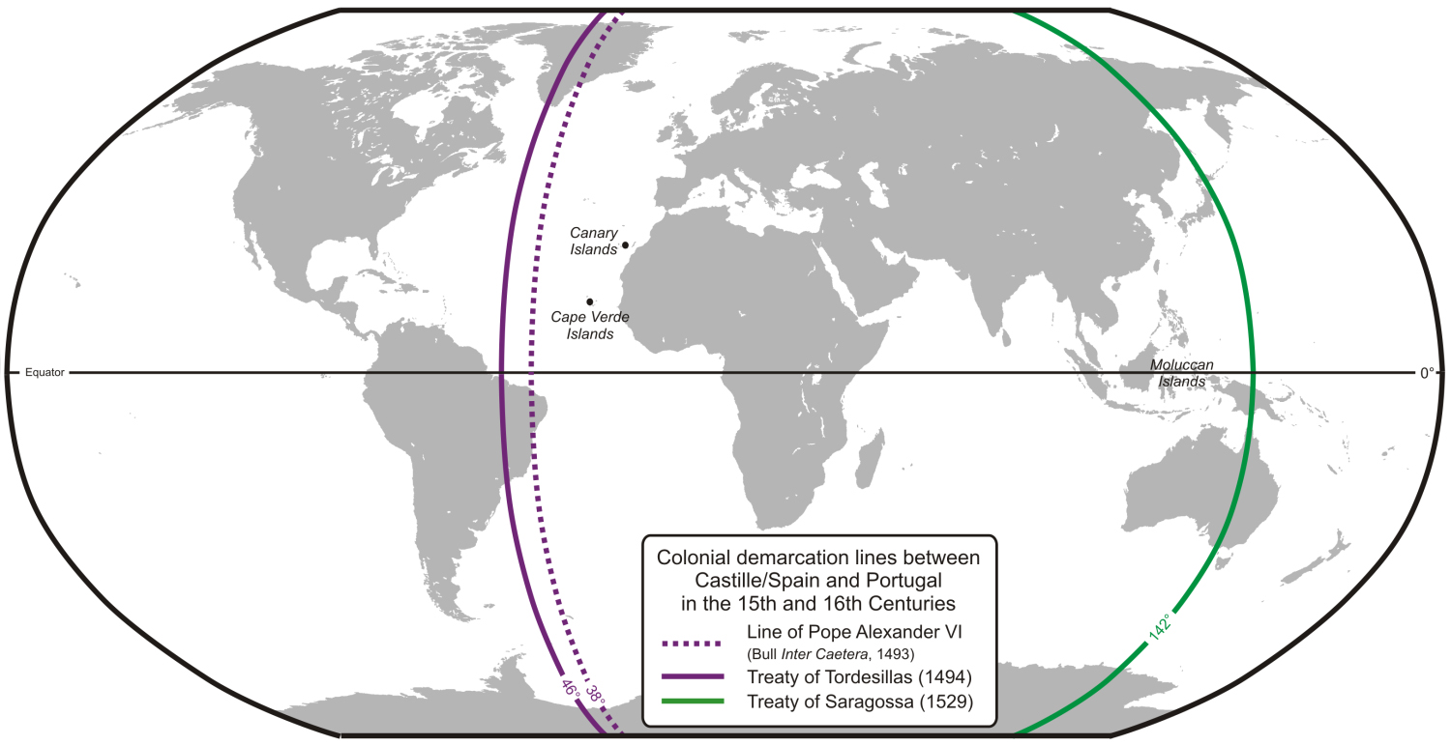

Slide 11
Challenges to Spain and Portugal
Portugal dominated European trade with Asia for more than a century.
By 1600 other nations began to make claims to Asia.
The Dutch (Netherlands) became a leading sea power with 20,000 ships.
The Dutch and English both established companies to direct trade in Asia. The Dutch East India Company was more powerful and soon became the dominate force in Asia.
However all the European powers were limited to the coasts.

Slide 12
Shifting Focus
By the 1600s European powers were not only focused on Asian but the Americas too.
The Spanish conquistador Hernando Crotes had defeated the Aztecs in 1521 while searching for gold.
The conquistador Francisco Pizarro defeated the Inca empire after capturing the ruler Atahualpa in 1533.
The Portuguese settled Brazil and the Spanish pushed north into what is now the United States.

Slide 13
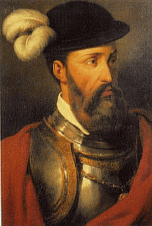
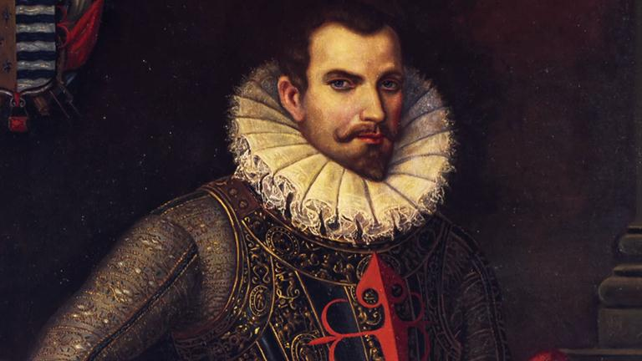

Slide 14
Other Explorers
1510 – 13 Vasco de Gama, Panama and the Pacific Ocean
1511 Juan Ponce de Leon reaches Florida searching for the fountain of youth
1519 Ferdinand Magellan, sailed (circumnavigated) around the world. He dies on the voyage.
1524 Giovanni da Verrazzano, New York Harbor
1534 Jacques Cartier, Lake Champlain Montreal
1540 Francisco de Coronado, Southwestern U.S.

Slide 15
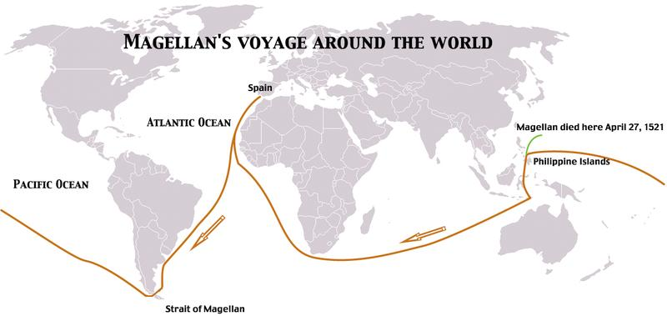

Slide 17
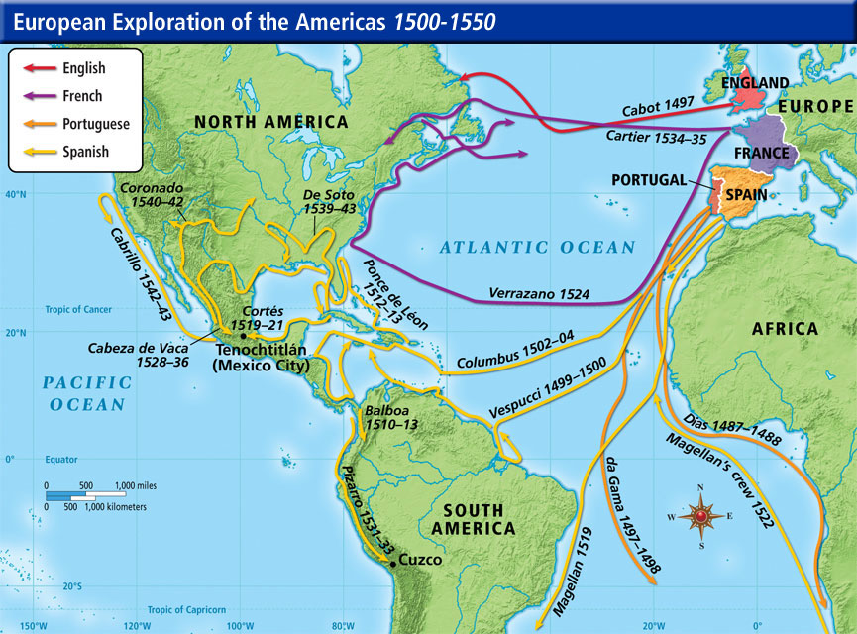

Slide 18
1540s Hernando de Soto explores the Southeastern U.S. He dies on the journey.
1600 Henry Hudson, New York area and Hudson River
1609 Pedro de Peralta, Santa Fe
1608 Samuel de Champlain, Quebec New France
1673 Marquette and Joliet, Great Lakes, Upper Mississippi River
1683 La Salle, Lower Mississippi River

Slide 19
