Slide 1
What are political cartoons?
An editorial cartoon, also known as a political cartoon, is an illustration or comic strip containing a political or social message, that usually relates to current events or personalities

Slide 2
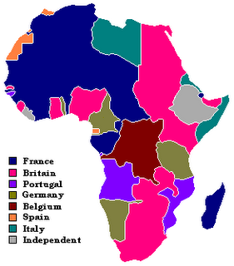

Slide 3
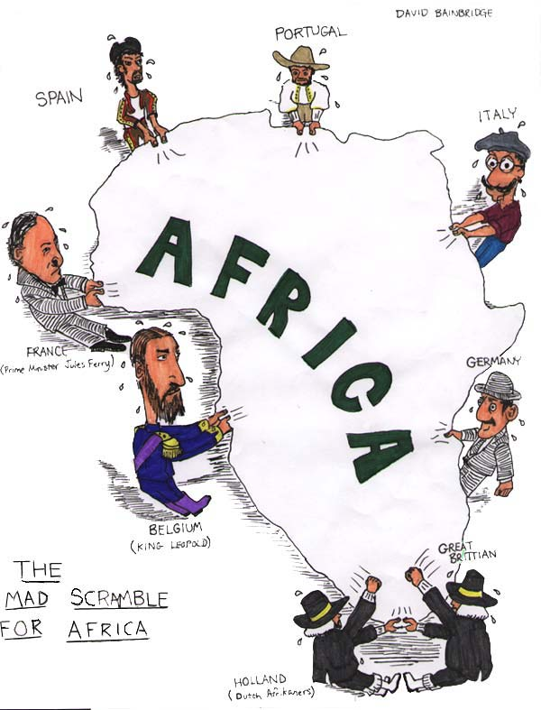

Slide 4
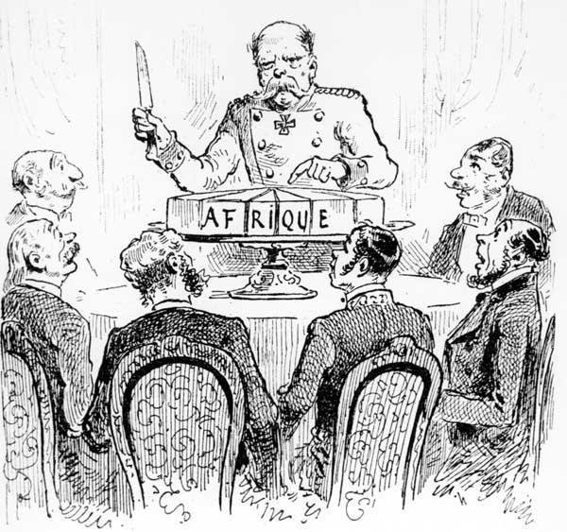
Cutting up the pie

Slide 5
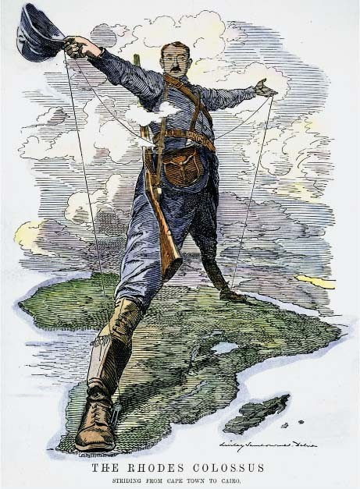
“The Rhodes Colossus, Striding
From Cape Town to Cairo,” 1892

Slide 6
