Slide 1
Between the Wars
Russian Revolution, Weimar Republic, Economic Collapse

Slide 2
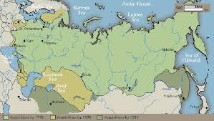
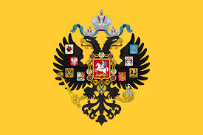
Prelude to Revolution
Russia had been ruled by the Romanov family for 300 years. The king was called a Tsar.
The Russian Revolution has roots that begin in the Industrial Revolution.
The country had been slow to industrialize but from 1863-1900 the number of factories more than doubled.
Rapid industrialization brought many problems such as bad working conditions, low wages, and child labor

Slide 3
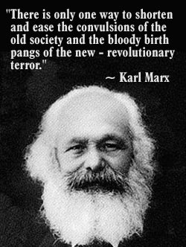
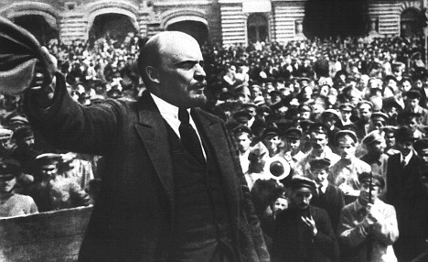
The discontent that grew because of the problems gave rise to many revolutionary groups of which the strongest was a group that followed the teachings of Karl Marx.
The groups believed the proletariat, working class, should rule
In 1903 the Marxist groups split into two groups
Mensheviks- wanted broad popular support for the revolution
Bolsheviks- wanted a small committed group that would sacrifice anything and everything
The Bolsheviks were led by Vladimir Ilyich Lenin.

Slide 4
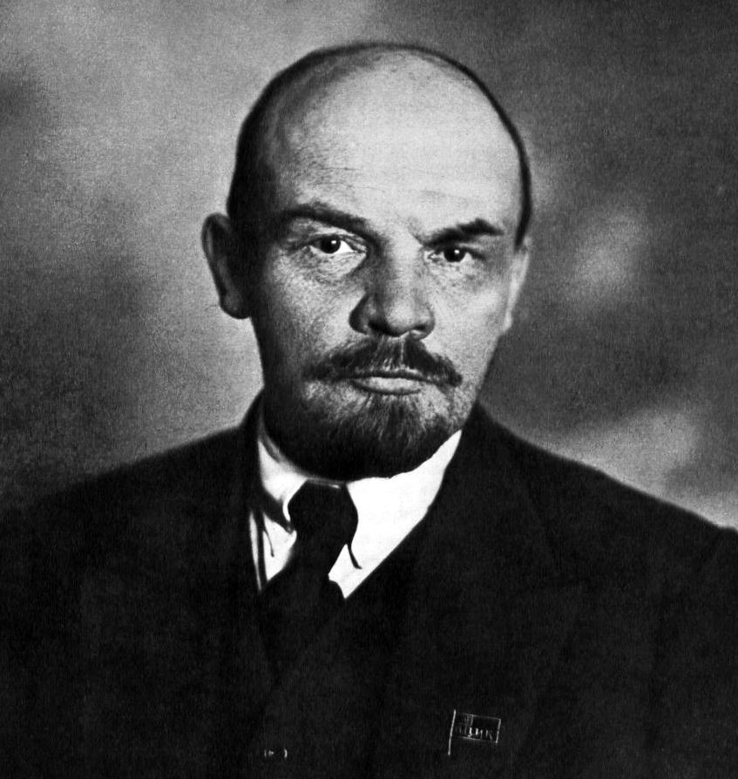
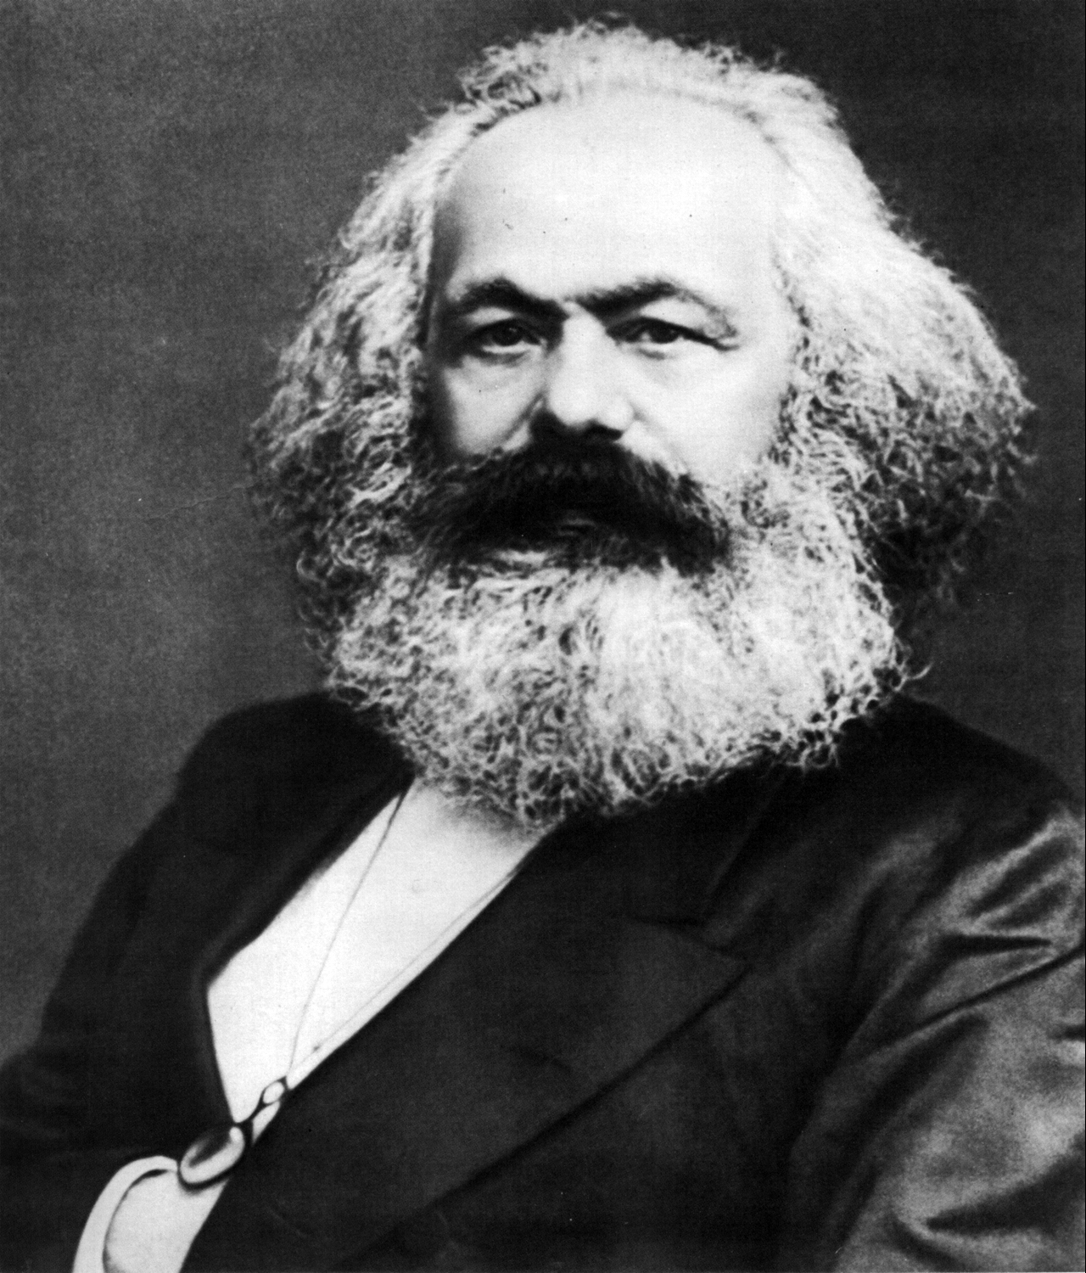

Slide 5
Dominos Begin to Fall
Between 1904-1917 Russia faced several crises that showed the weakness of the tsar
In 1904 Russia went to war with Japan (Russo-Japanese War) over the control of Korea and Manchuria. Russia lost .
In 1905 200,000 workers protested outside the Winter Palace demanding a representative government but instead 1,000 were either killed or wounded.
1914- Tsar Nicholas II dragged Russia into WWI. Russia was not prepared and was easily defeated by the Germans. Within in the first year 4 million were either dead or wounded.

Slide 6
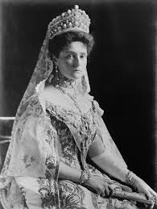
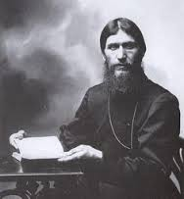
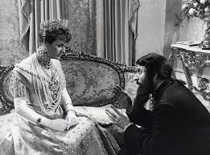
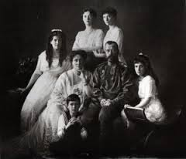
At home Nicholas left his wife Tsarina Alexandra in charge. She fell under the “spell” of and adviser named Rasputin who was said to have healing powers.
Rasputin did not favor reform and he was killed by nobles in 1916.
By 1918 Russia was out of the war

Slide 7
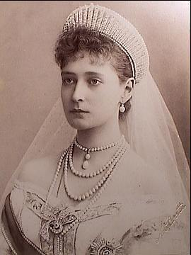
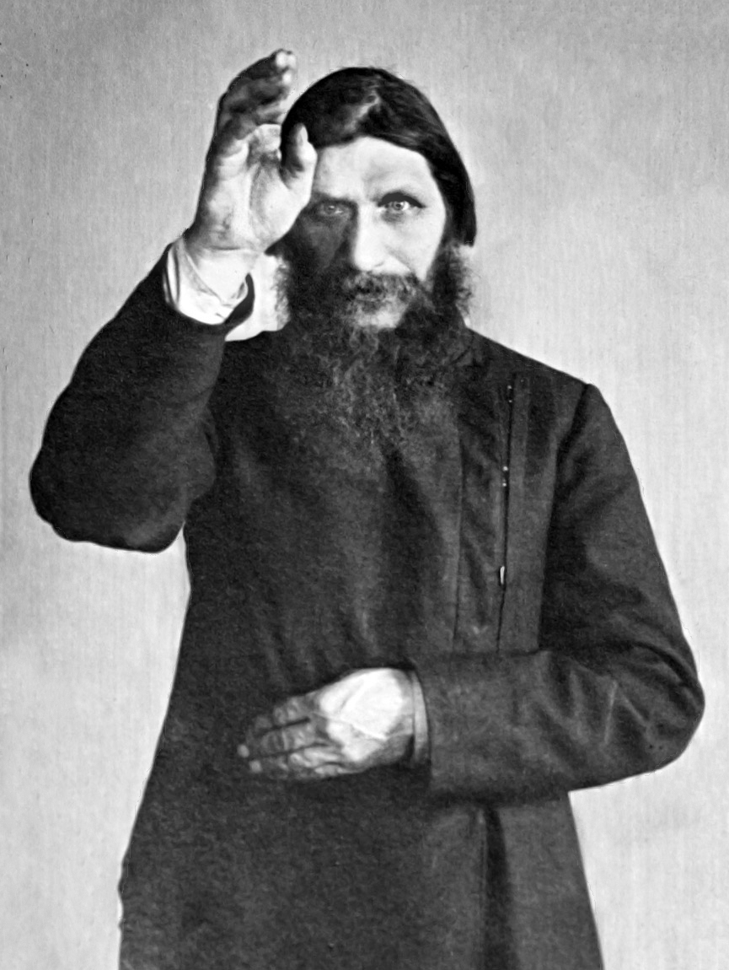
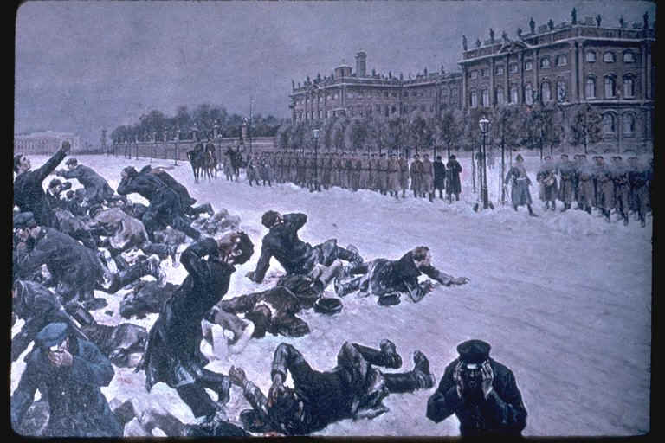
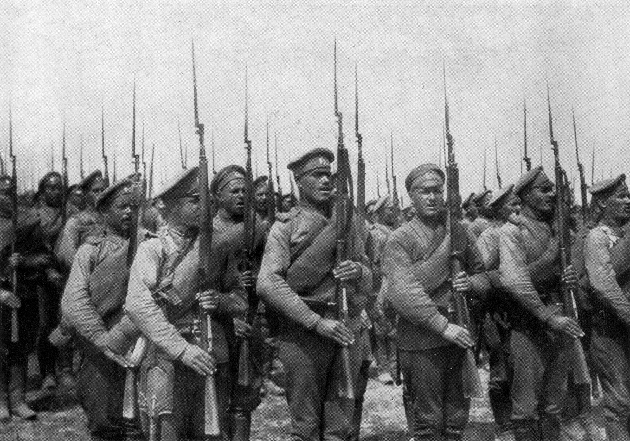
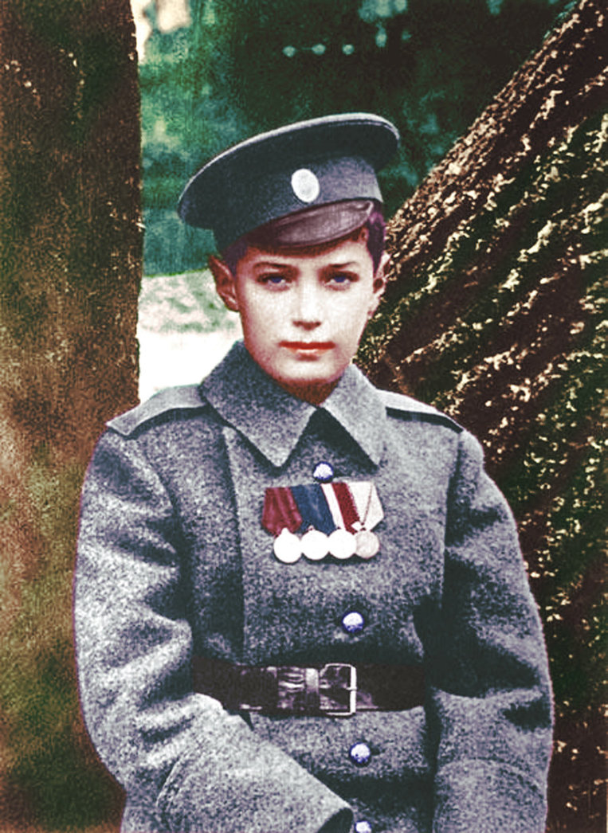

Slide 8
March Revolution
March of 1917 many workers called for the end of the monarchy.
The riots that ensued forced Nicholas to abdicate, give up, the throne. One year later Nicholas II and his entire family were executed.
During this time Lenin, who had been exile in Germany, returned to Russia.
A provisional government and soviets, small local councils, were created

Slide 9
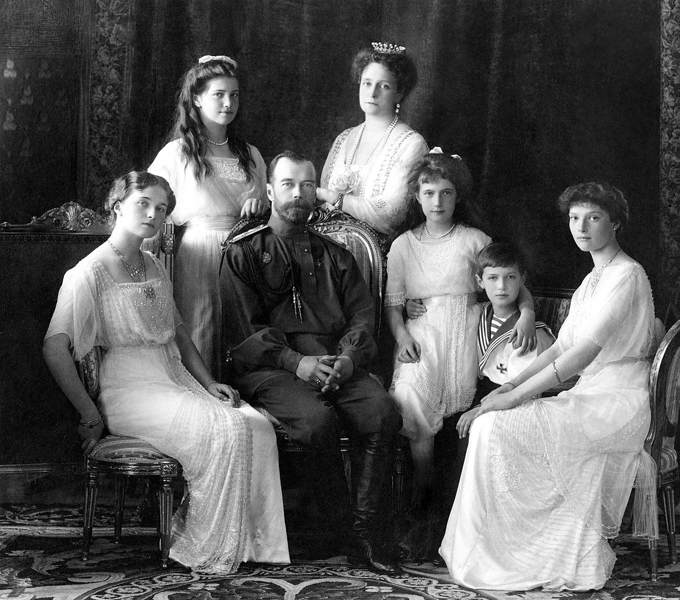

Slide 10
Bolshevik Revolution
Lenin and the Bolsheviks soon gained control of the most powerful councils and amassed a large following.
In November of 1917 a group of armed workers stormed the Winter Palace and took control of the government.
Within days Lenin and the Bolsheviks distributed all farmland amongst the peasants.

Slide 11
Civil War
By late 1918 a civil war broke out in Russia between the Bolsheviks (Reds) and the Whites, those opposed to the Bolsheviks.
Several western nations sent troops to help the Whites including the United States.
The Whites were defeated by 1920 but at the cost of 14 million Russian lives.
By 1922 Lenin and the ruling government renamed Russia the Union of Soviet Socialist Republics (USSR)
They also renamed the Bolsheviks to the Communist Party
By 1928 Lenin was dead and Joseph Stalin had control.

Slide 12
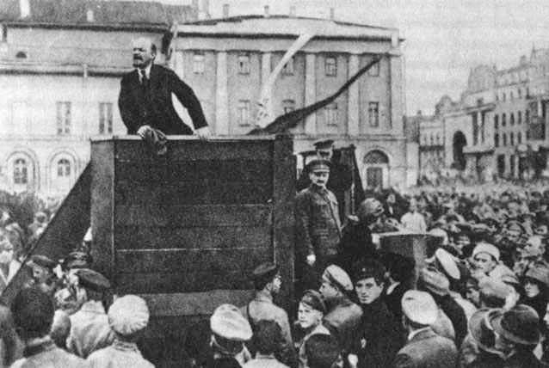
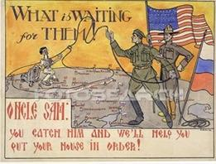

Slide 13
Germany’s New Republic
The new government in Germany was called the Weimar Republic
The government had several weakness which included a lake of a strong democratic tradition
Many Germans blamed the new government for the defeat and humiliation at the Treaty of Versailles
Germany also faced a financial crisis post WWI. During the war the government printed money to pay for the war but did not raise taxes.

Slide 14
In order to pay the war reparations the Germans printed even more money leading to sever inflation.
In the early 1920s the German mark had decreased in value.
This lead many to question the effectiveness of the Weimar Republic.
The economy was stabilized by a US banker named Charles Dawes. He provided a $200 million loan to help prop up Germany’s economy
The Dawes Plan, as it was known, also attracted investments from others and by 1929 German factories were producing as much as they did before WWI.

Slide 15
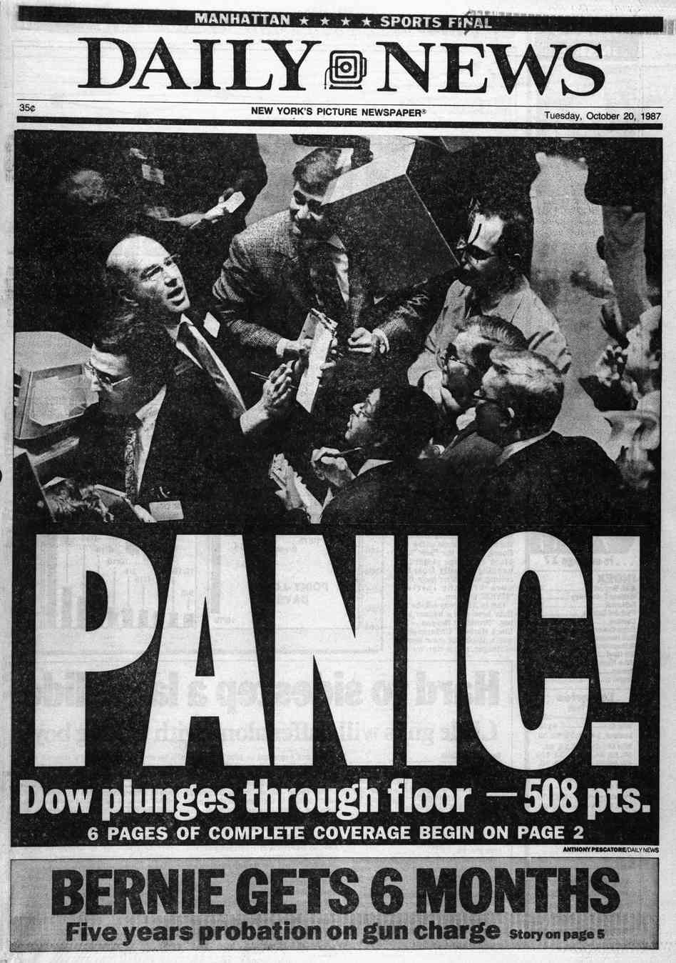
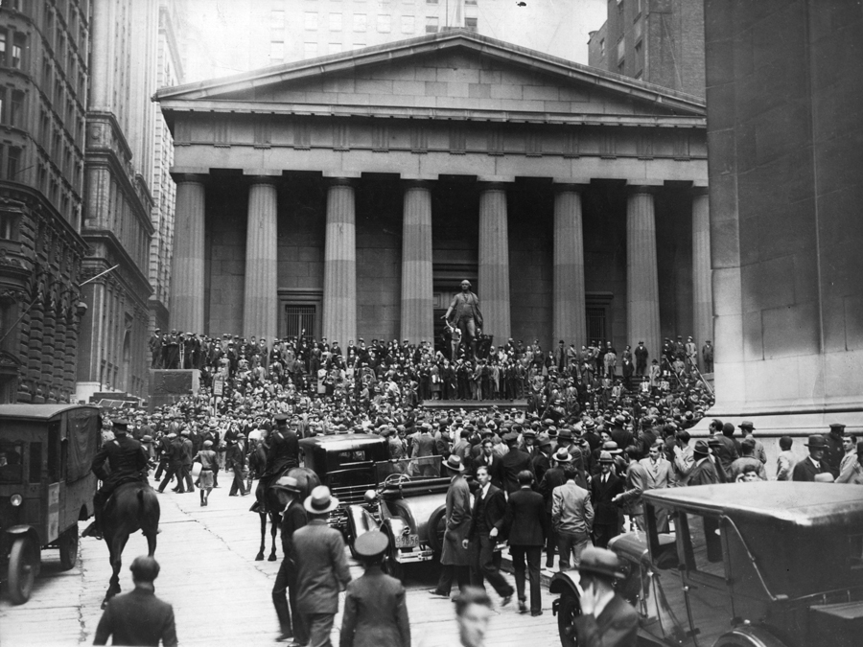
Worldwide Financial Collapse
The world economy was largely dependent on the economy of the United States.
By the late 1920s many Americans were practicing bad economics.
It was easy to obtain a loan, many people bought stocks on the margin.
This means they paid only a percent of the real worth of the stock.
In September of 1929 some investors believed that stocks were artificially high and began to sell the stock.

Slide 16
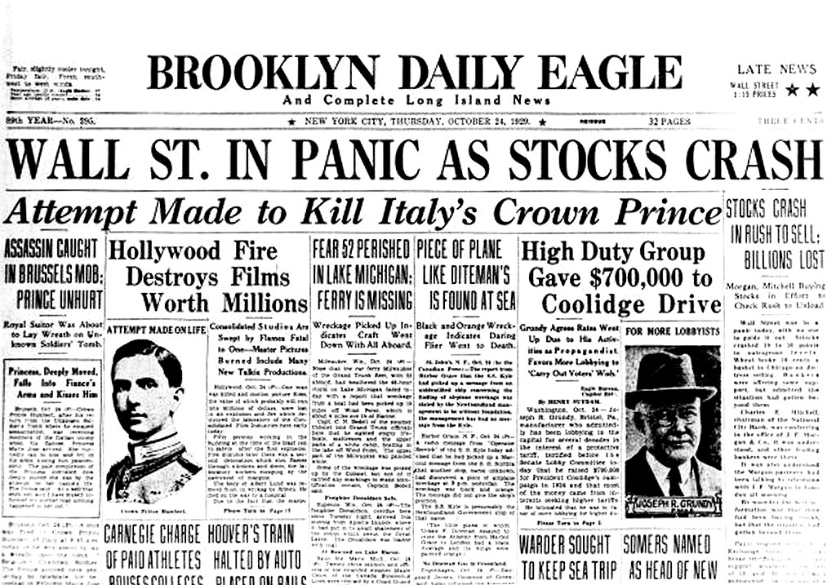

Slide 17
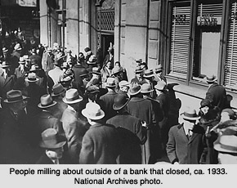
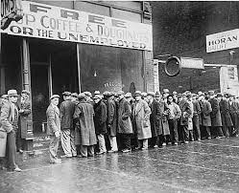
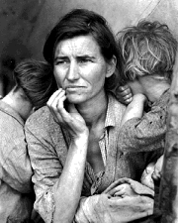
By October the lowering prices became a landslide and a panic followed.
On October 29, 1929 the stock market hit its all-time low.
On that day $14 billion was lost and by the weeks end $30 billion was gone.
This collapse triggered a worldwide depression that lasted more than a decade.

