Slide 1
Causes of WWII

Slide 2
Post War Uncertainty
The decades that followed World War I saw numerous changes throughout the world
Germany was devastated and the economy was in ruins
The Allied powers continued to divide up the world amongst themselves
The United States became a major world power but no longer cared for the problems of Europe.
Russia experienced a revolution and civil war that brought about the rise of communism.
In 1929 a world wide economic depression began.
All of these changes posed a threat to democratic societies the world over.

Slide 3
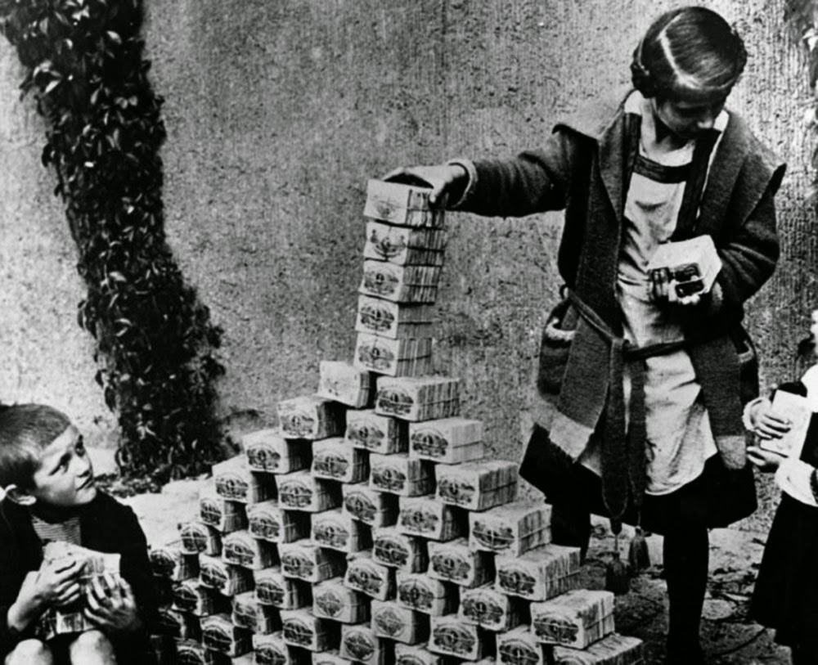
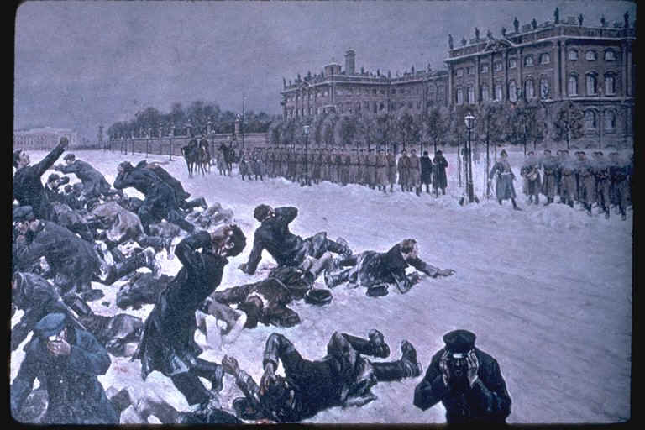
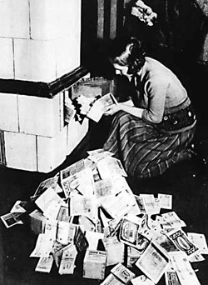
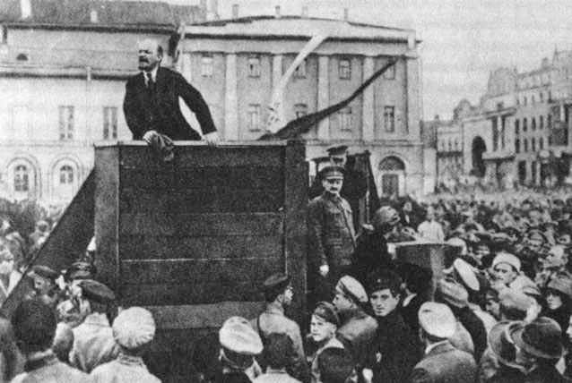

Slide 4
Fascism in Italy
Fascism was a new type of militant/political movement that place emphasis on loyalty to the state and obedience to its leader.

Slide 5
Mussolini Gaines Power in Italy
After Italy failed to gain more territory at the 1919 Paris Peace Conference many people called for change
Rising inflation and unemployment also contributed to the unrest
A newspaper editor and politician named Benito Mussolini founded the Fascist Party in 1919.
As unrest grew Mussolini’s popularity grew and he became an outspoken opponent of the government.
Groups of fascist wearing black shirts attacked communist and socialist and raised fears of a workers revolt
Many middle class individuals were drawn to Mussolini’s cause.
In October of 1922 30,000 fascist marched on Rome and demanded that king put Mussolini in charge of the government and he did.
Mussolini outlawed democracy and abolished all political parties except fascism

Slide 6
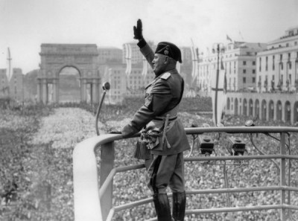
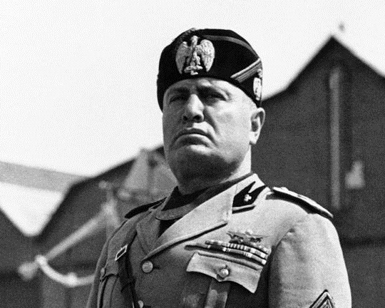
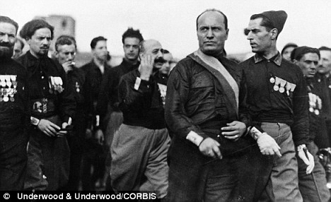

Slide 7
Rise of Nazism and Adolf Hitler
After WWI a young German politician named Adolf Hitler joined a small fascist political grouped named the National Socialist German Worker’s Party (Nazi).
Inspired by Mussolini, Adolf Hitler and his followers tried to take over Munich, Germany but failed.
Hitler was placed in jail
While there he wrote Mein Kampf(My Struggle).
He argued that the Germans were the superior race and that Jews, Slavs, and Gypsies were inferior.
The book also placed the blame for Germany’s troubles on the Jewish people.

Slide 8
He also argued that the Germans needed lebensraum or living space and that the Treaty of Versailles had to be repealed.
In 1932 Hitler became the Reichschabncellor and immediately called for new elections hoping to gain a majority of the legislative seats for the Nazi Party.
After gaining control of the Reich Hitler and his followers eliminated his political opponents
Hitler wanted control of all aspects of German life. Books were burned that did not conform to Nazi teachings.
School children joined the Hitler Youth and League of German Girls.
Hitler continued his war on the Jews and on November 9, 1938 mobs attacked Jewish homes and businesses. This night became known as Kristallnacht (Night of the Broken Glass)

Slide 9
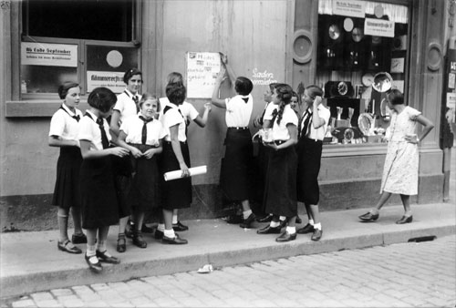
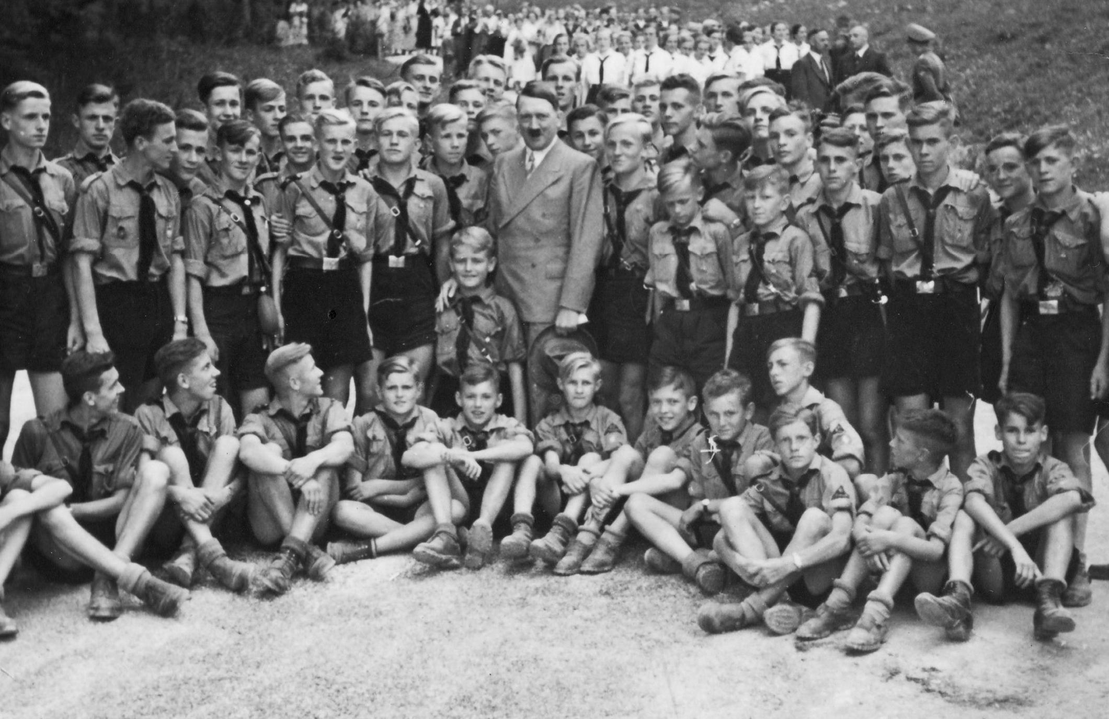
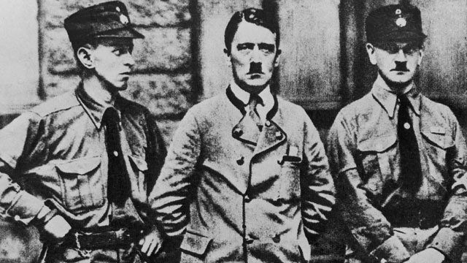
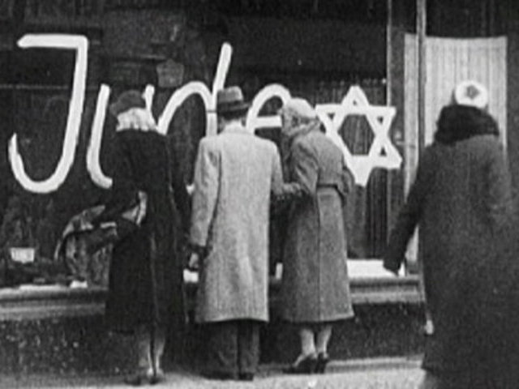
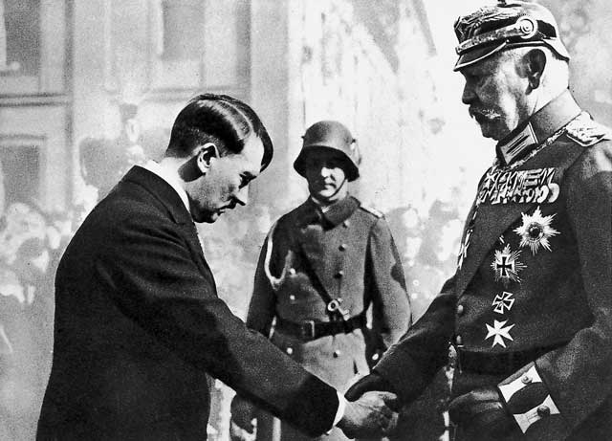
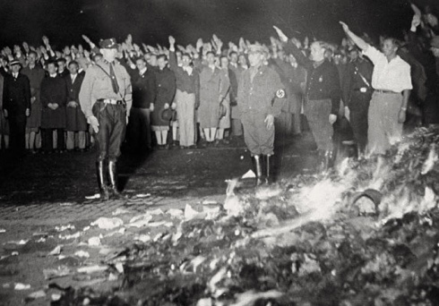
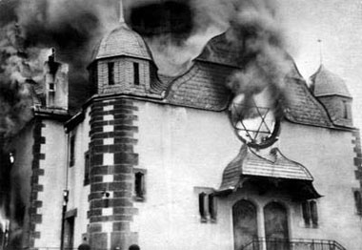
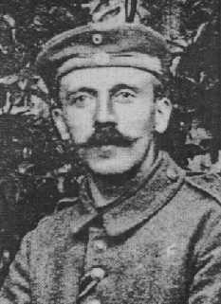
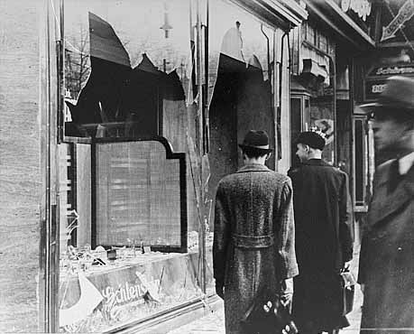
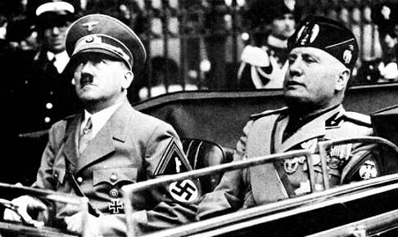
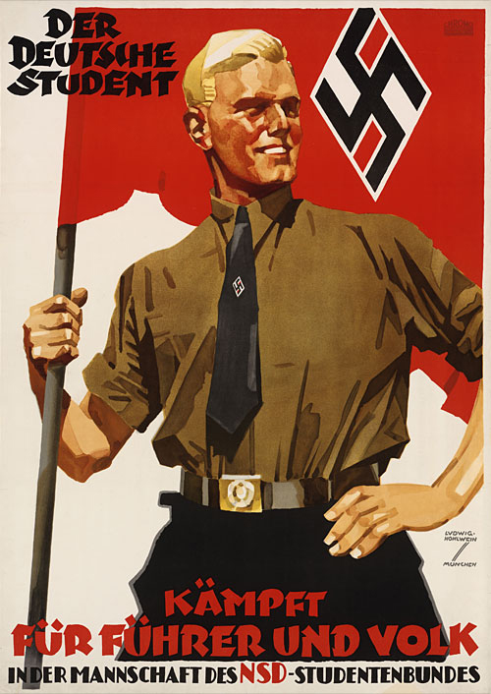

Slide 10
Aggressors Invade Timeline
Use the book to fill in the timeline at the bottom of you notes

Slide 11
1931: Japan invades Manchuria
(northern China)
1935: Japan invaded lower China and touched off a full scale war
1935: In October Italy attacked Ethiopia
March 1936: Germany occupies Rhineland and British urge appeasement (giving into the aggressor in order to maintain peace)
October of 1936: Mussolini and Hitler agree to become allies
1937: Japan invades China
March 1938: Germany annexes Austria

Slide 12
September 1938: Germany takes the Sudetenland. France and Britain meet with Germany at the Munich Conference and again choose appeasement
March 1939: Germany seizes Czechoslovakia
April 1939: Italy conquers Albania
August 1939: Germany and the Soviet Union Agree to non aggression pact
September 1, 1939: Germany invades Poland. France and Britain declare war on Germany.

