Slide 1
Egypt

Slide 2
Geography of Egypt
Egypt is situated along the Mediterranean coast in North Africa.
The Red Sea forms the border to the East.
The Nile river flows northward from mountains and plateaus in present-day Burundi, Tanzania, Uganda, and Ethiopia.
A thin strip of land along the Nile River provides enough fertile soil to grow crops.
Each July the river floods and deposits nutrients along the banks.

Slide 3
Beyond the river is the Sahara Desert.
There are two regions within Egypt: the Upper and Lower.
Upper Egypt begins where the first cataract (or rapid) appears.
Lower Egypt begins where the river fans out into many branches and forms the Nile Delta.

Slide 4
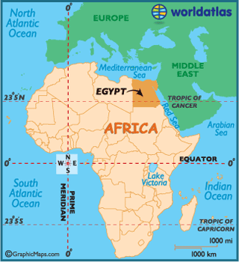

Slide 5
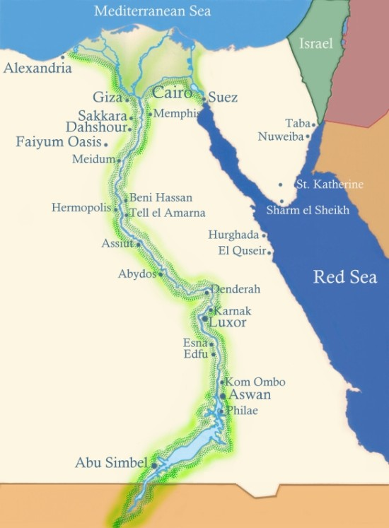

Slide 6
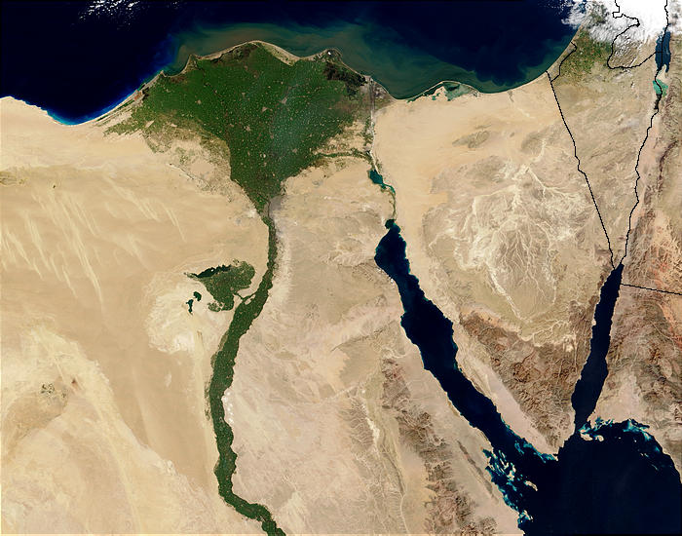

Slide 7
Egypt Unites
Prior to unification Egypt was split into two kingdoms; Upper and Lower.
Around 3000 B.C. a king named Narmer is believed to have united the two Egyptian Kingdoms.
A palette showing Narmer wearing both the white crown of Upper Egypt and the red crown of Lower Egypt is believed to celebrate the unification.
He created the first Egyptian dynasty. There would be 31 total dynasties. From 2600- 2180 B.C. was known as the Old Kingdom.

Slide 8
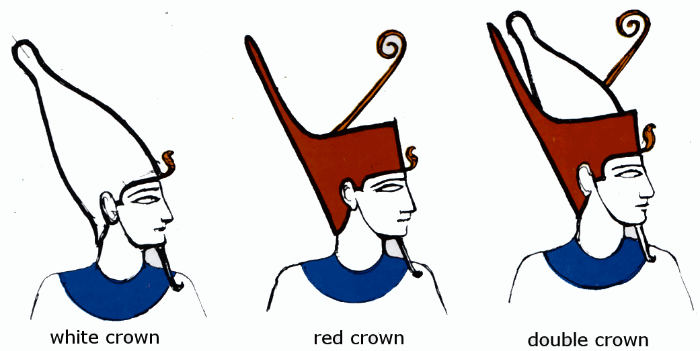

Slide 9
Pharaohs
A king in Egypt was called a pharaoh.
The pharaohs were believed to be living gods. This differed from Mesopotamia were kings were seen as representatives of the gods.
Pharaohs were the center of both Egyptian religion and politics (government).
This is known as a theocracy. The ruler has both religious and political authority.

Slide 10
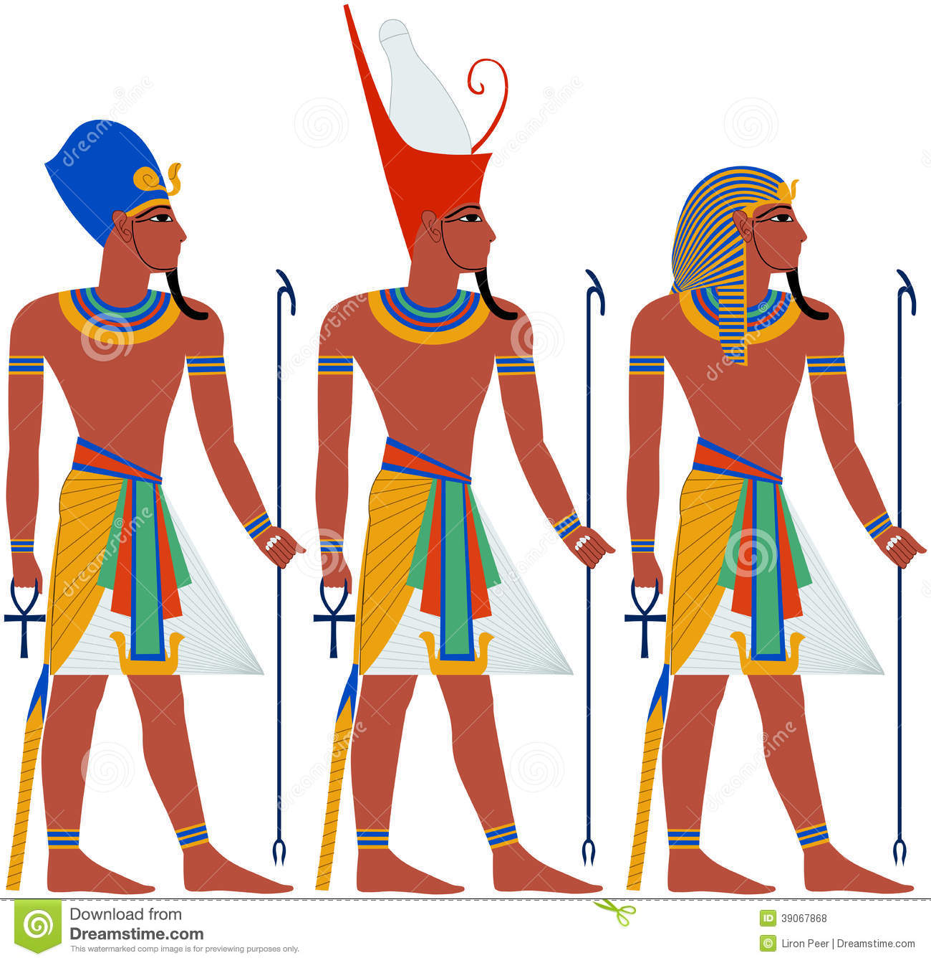

Slide 11
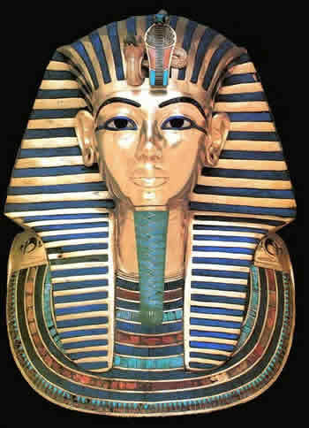

Slide 12
Pyramid Builders
Egyptians believed in an afterlife. The Pharaoh possessed an eternal life force known as ka. He was meant to rule forever.
The pyramid was the tomb for the Pharaohs.
Inside of the tomb the Pharaoh would be accompanied by all that he would need in the afterlife.
The greatest of all the pyramids is the Pyramid of Giza.
Some of the stones used to build the structure weighed from 2 ½ tons to 15 tons!
The structure covers 13 acres.

Slide 13
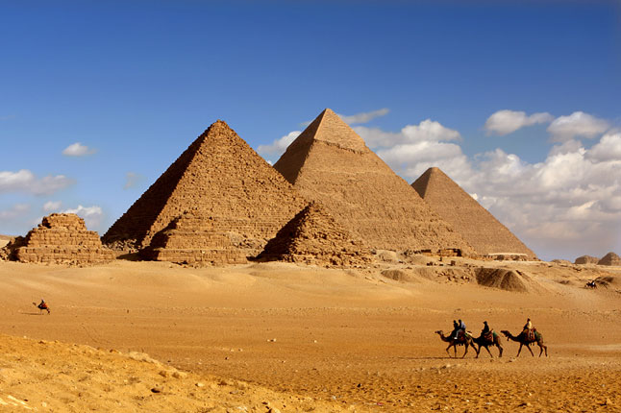

Slide 14
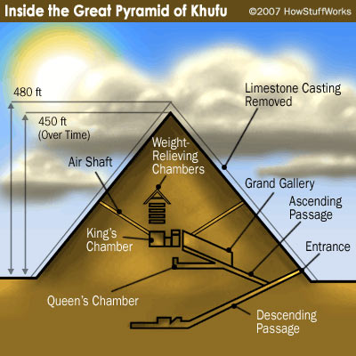

Slide 15
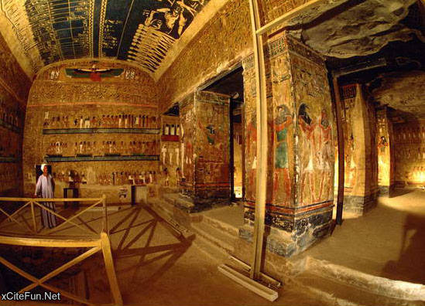

Slide 16
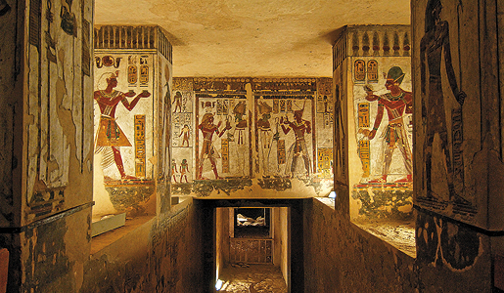

Slide 17
Culture
Religion played a key role in Egyptian culture.
The Egyptians were polytheistic. They worshiped more than 2000 different gods. The most important were Re (sun god), Osiris ( god of the dead), and Isis ( goddess of the ideal mother and wife).
Because Egyptians believed in an afterlife the royals and elite had their body’s mummified to preserve them and keep them from decaying.
Society was divided into social classes with the royals and wealthy landowners at the top, followed by the middle class made up of merchants, and at the bottom were the peasants.

Slide 18
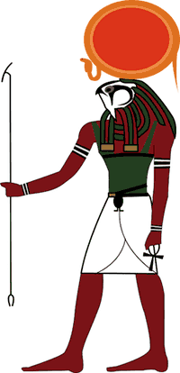
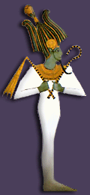
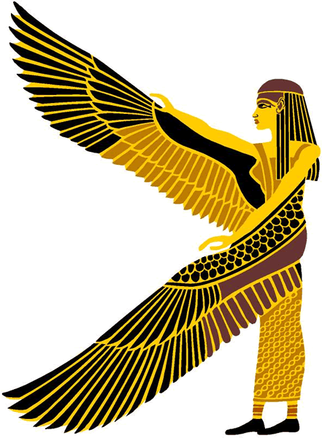

Slide 19
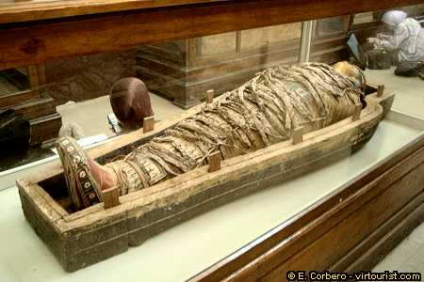

Slide 20
Egyptian Advances
Egyptians invented a calendar based the number of days between the sighting of the star Sirius. This is called a solar year.
This number of days was 365. They dived the days into 12 months with 30 days and added 5 days for holidays.
This was so accurate they were only 6 hours off the actual solar year.
Egyptians created advancements in math and engineering.
Egyptian medicine was known throughout the ancient world.

Slide 21
Egyptian Writing
Egyptian scribes developed a system of writing called hieroglyphics.
In this system a picture stands for either the picture shown or for the sound of a letter.
Hieroglyphics were first written on stone and then later on sheets of papyrus.

Slide 22
In 1799 AD French soldiers found a black stone near the village of Rosetta in the Nile Delta.
Known as the Rosetta Stone
On the stone were three languages; Egyptian Hieroglyphics, in both a complex an simple form, and ancient Greek. This gave clues as to the meanings of the hieroglyphics.
It was not until 1822 AD when a French scholar named Jean François Champollion broke the code.

Slide 23
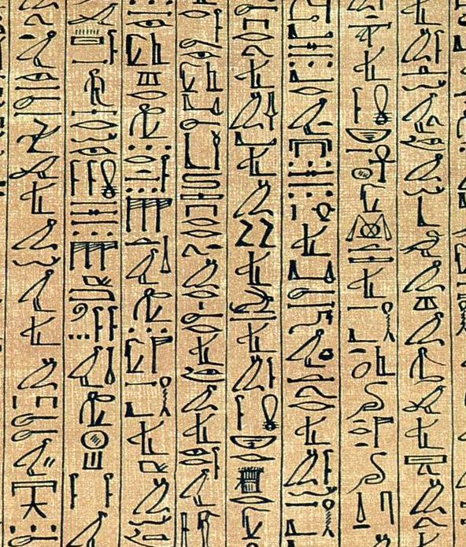

Slide 24
