Slide 1
Impact of the Age of Exploration

Slide 2
Goals of European Exploration
European set out to discover riches and wealth of all kinds
Once the new world was discovered they began to search for these riches by establishing colonies.
The Spanish were the first European settlers in the Americas
The main goal of these colonies is to act as a source of wealth for the mother country.

Slide 3
Spanish Conquest in Mexico
In 1519 Hernando Cortes landed in what is today Mexico.
He was searching for new lands to claim for Spain. He and his followers were called conquistadors.
Cortes and his men quickly reached the Aztec capital Tenochtitlan and met the Aztec leader Montezuma II.
They demanded gold and they were given half of what the Aztecs had.

Slide 4
In 1520 a few of Cortes men killed several Aztecs and the Spanish were kicked out.
Cortes fought back using other native groups that did not like the Aztec.
The Spanish also had superior weaponry
They also had a silent killer, disease, which killed hundreds of thousands.
By 1521 the Aztec empire was gone.

Slide 5
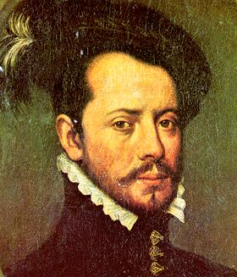
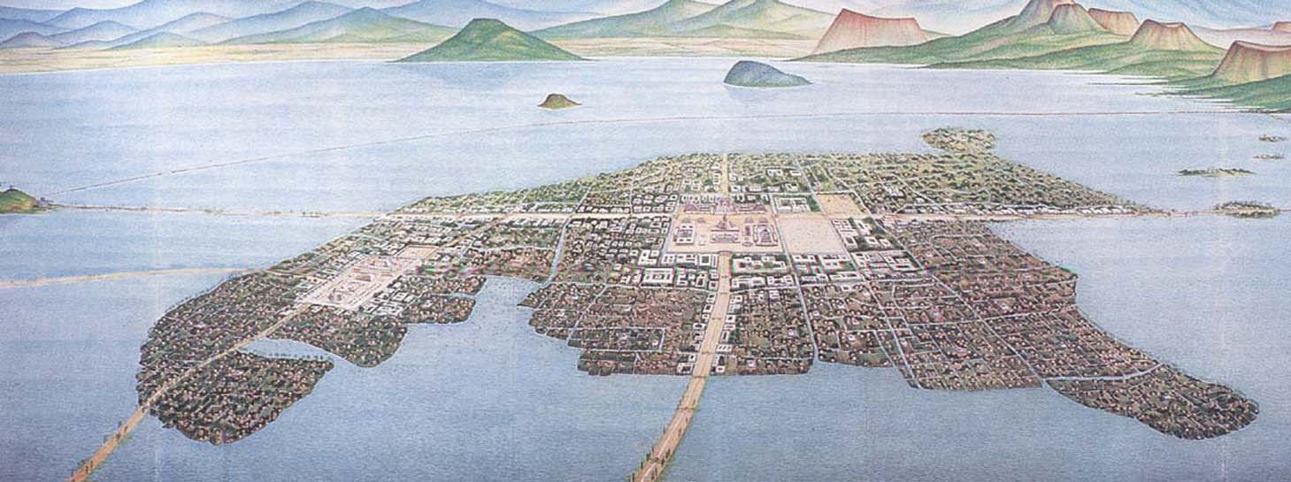
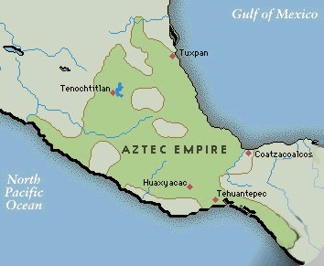
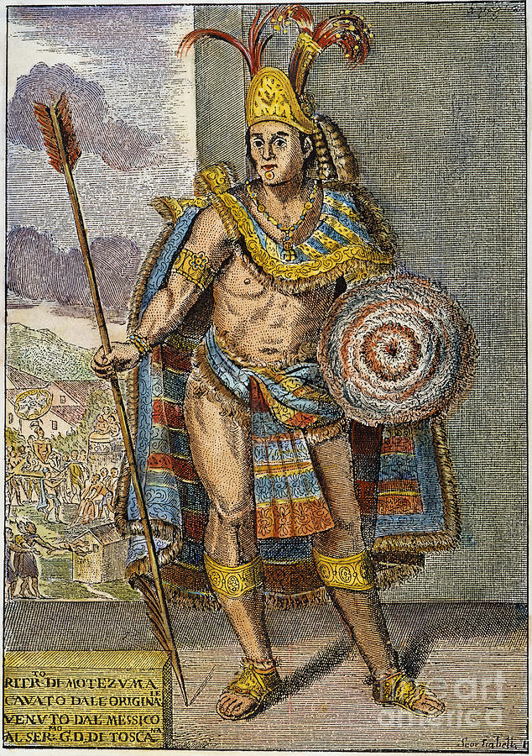

Slide 6
Spanish Conquest in Peru
In 1532 a Spanish conquistador named Francisco Pizarro met the Incan emperor Atahualpa and took him prisoner.
He too demanded gold was given several rooms full of gold and silver.
After receiving the gold Pizarro’s men killed Atahualpa and then were able to conquer all of the Inca by 1533.

Slide 7
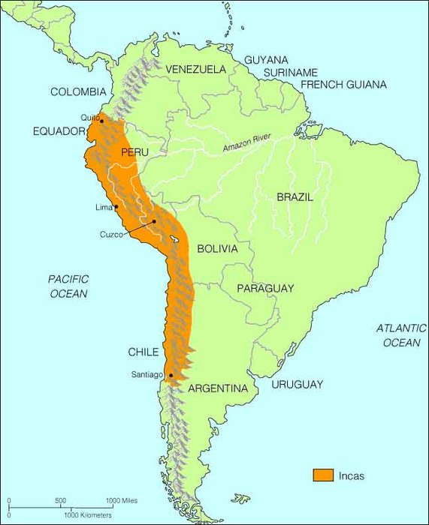
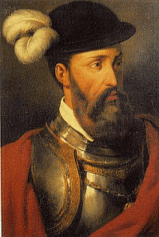
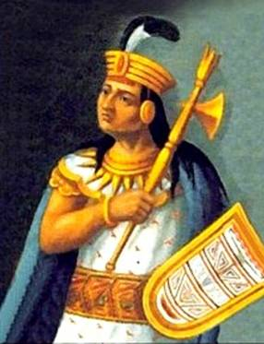

Slide 8
Impact of Spanish Colonies
After conquering the natives the Spanish would force them to work in the system of encomienda.
As part of this system the natives farmed, ranched, or mined for the Spanish landlords.
Many were worked to death.

Slide 9
Other Europeans
By the early 1600s other European nations had established colonies in the New World.
The British and French established colonies in North America.
The Dutch settled in the Caribbean.
Just as the Spanish had in Central and South America other European nations conquered and killed many natives.
Diseases devastated native tribes. One tribe had 24,000 people at the time of colonization and by 1631 only 750 people remained.

Slide 10
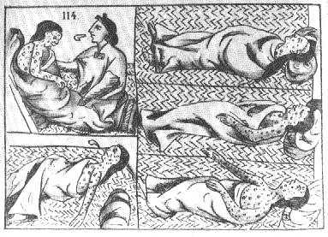
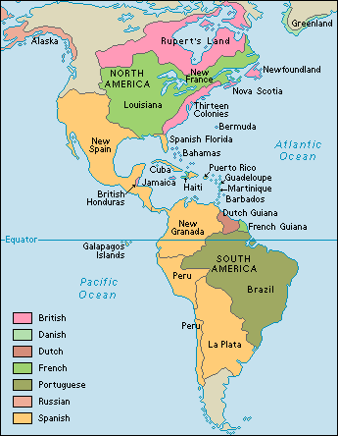

Slide 11
The Atlantic Slave Trade
The discovery of the new world not only effected the native populations in the Americas but also groups of people in Africa.
Spanish and Portugal began the Atlantic slave trade as early as the 1400s.
By 1650 more than 300,000 African slaves worked on plantations throughout Spanish America.
The British came to dominate the slave trade and by 1690. In all the British transported 1.7 million Africans to their colonies in the West Indies.
The Atlantic slave trade was part of a larger system known as Triangular Trade.
In this system raw materials left the Americans and when to Europe. Finished goods then went from Europe to the Americas and Africa. In Africa they were exchanged for slaves.

Slide 12
The transportation of the slaves was known as the Middle Passage.
The slaves were placed aboard ships and were subject of beatings and all manners of cruelty. 20% that were shipped did not survive the journey.
The largest portion of slaves went to Central and South America. A large portion of those ended up in Brazil.
In all 400,000 slaves were sold to British North America.

Slide 13
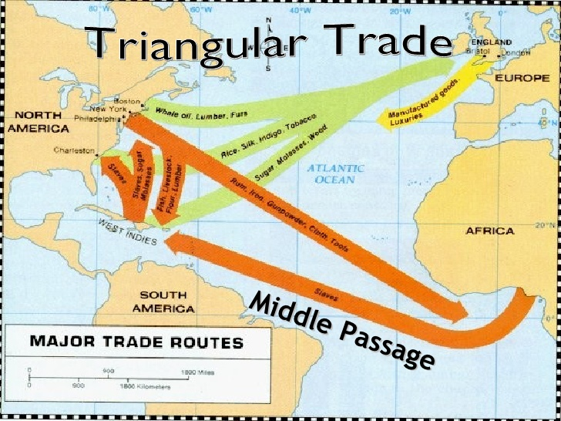
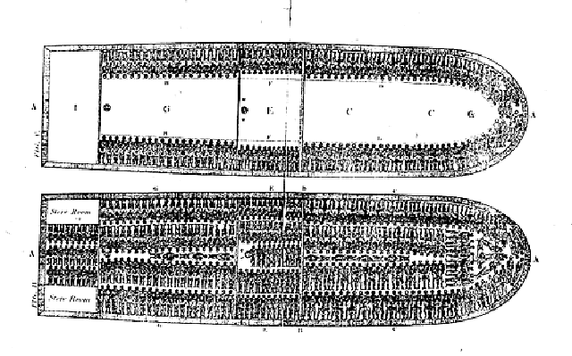
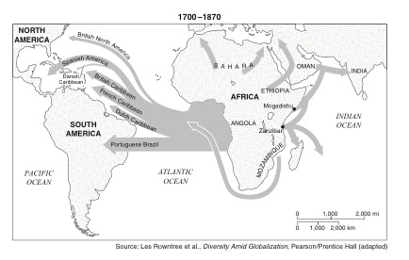

Slide 14
The Columbian Exchange
The global transfer of foods, plants, and animals during the colonization period.
The Columbian exchange gave rise to the system of capitalism. This made many individuals as well as nations wealthy.
The system of mercantilism grew. In this system the colonies act as sources of wealth that feed the mother country.
A merchant class began to develop in Europe because of the economic outcomes of the Columbian exchange.

Slide 15
