Slide 1
Mesopotamia

Slide 2
Civilization
A complex culture with 5 distinct characteristics.

Slide 3
Cuneiform
wedge-shaped characters used in the ancient writing systems of Mesopotamia. Usually found on clay tablets.

Slide 4
Bronze Age
a time period characterized by the use of bronze, proto-writing, and other early features of urban civilization.

Slide 5
Ziggurat
rectangular stepped tower, sometimes surmounted by a temple.

Slide 6
Villages to Cities
As villages grew more land was needed to cultivate crops. Larger villages developed irrigation systems
This allowed some people to pursue other occupations for the first time and develop other skills.
These people developed into craftsman that created new elaborate products such as pottery, metal objects , and woven clothe.
The wheel and sail allowed traders to move goods over greater distances.
The social structure of villages changed too. Now there were those with wealth and more influence in the villages.
Religion changed too to include more complex rituals.

Slide 7
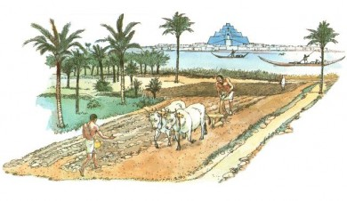

Slide 8
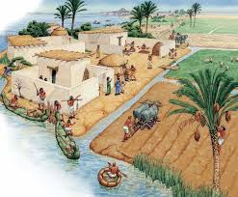

Slide 9
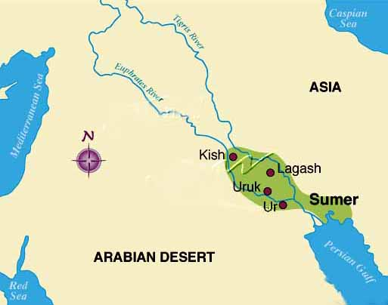
Five Characteristics of Civilizations: (CAARS)
It is believed that the first true civilization was in Sumer. Located in northern Iraq.

Slide 10
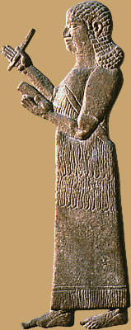
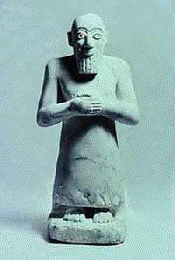
Complex Institutions
Government with officials and laws
Priests with both religious and political power
Education system for training scribes.

Slide 11
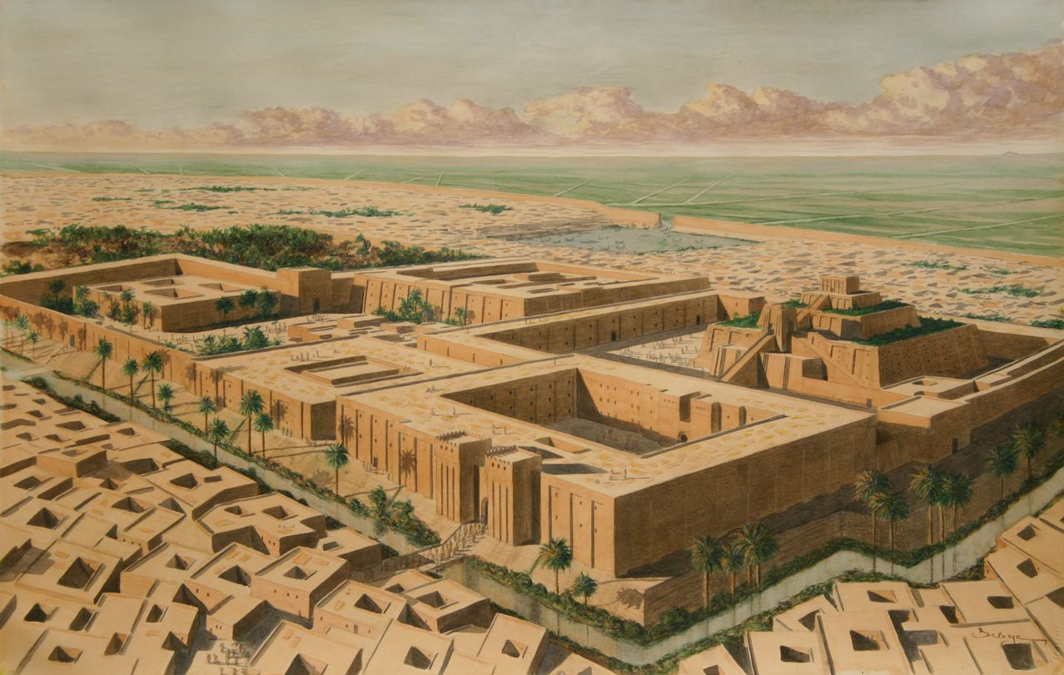
Advanced Cities
Centers for trade .
Tended to have larger populations.

Slide 12
Advanced Technology
Improved methods of farming such as the use of beast of burden (ox-drawn plows).
The inventions of the wheel and sail boat.
Wide spread use of Bronze for tools and weaponry.

Slide 13
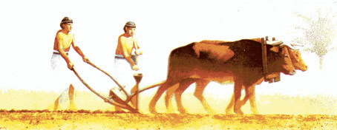
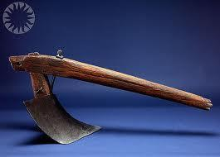
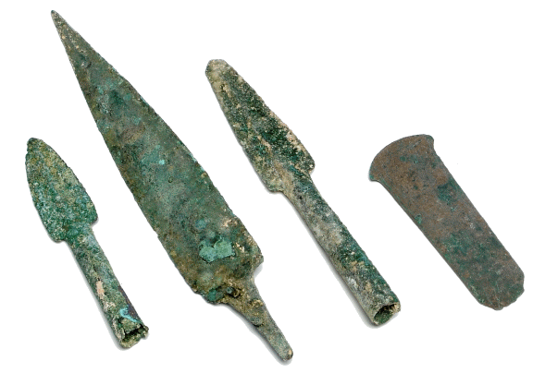
454 × 176 - goldenageproject.org.uk

Slide 14
Record Keeping
Advancements in writing such as the development of cuneiform.
Used for to record banking transactions, historical events, customs and traditions.

Slide 15
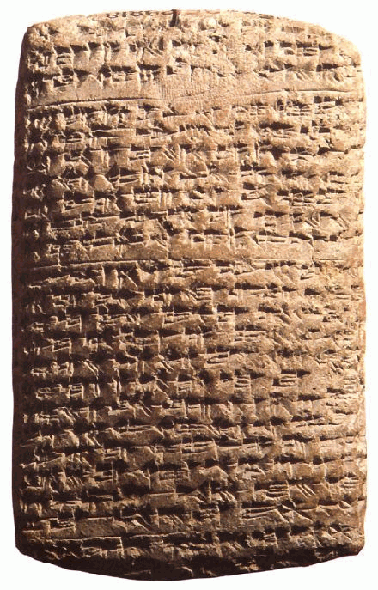
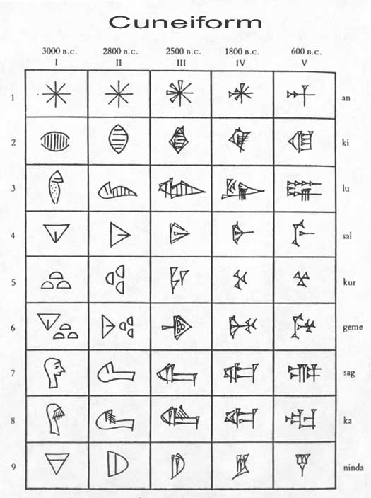

Slide 16
Specialized Workers
People began to specialize in different jobs and occupations.
Many became artisans: skilled workers that make goods by hand.

Slide 17
River Valley Civilizations: Mesopotamia
The earliest civilizations developed along rivers. The region known as Mesopotamia (Middle East today) developed along the Tigris and Euphrates rivers.
The area is also known as the Fertile Crescent.
The region was prone to flooding and little rain fall. The area also had very few natural resources.

Slide 18
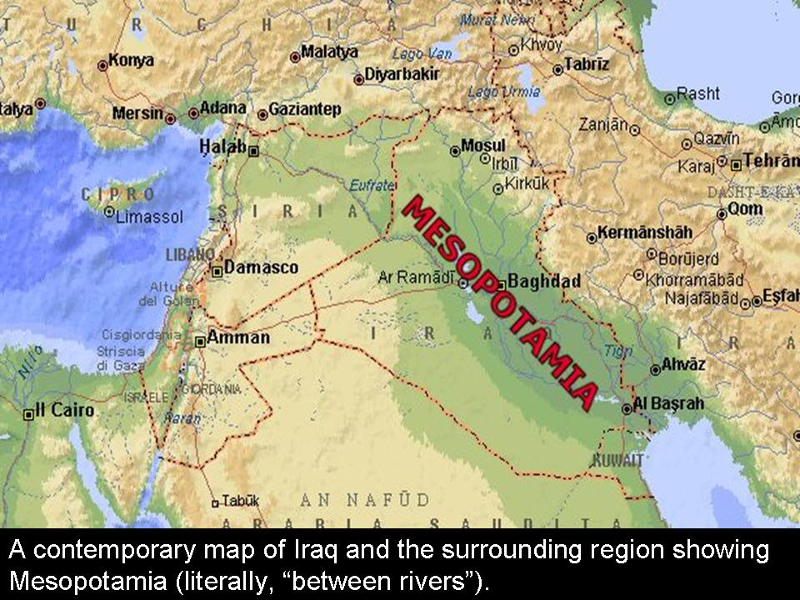

Slide 19
What Do You Think?
Why would civilization start in a area that had very little resources?

Slide 20
Sumer
The first great civilization in the region was Sumer.
The Sumerians developed city-states.
Each had its own government and rulers.
The greatest of all these city-states was Ur. Life in Ur revolved around the ziggurat. A temple that acted as both a religious and political center.
The Sumerians were polytheistic or believed in many gods. Social classes also emerged in Sumer.

Slide 21
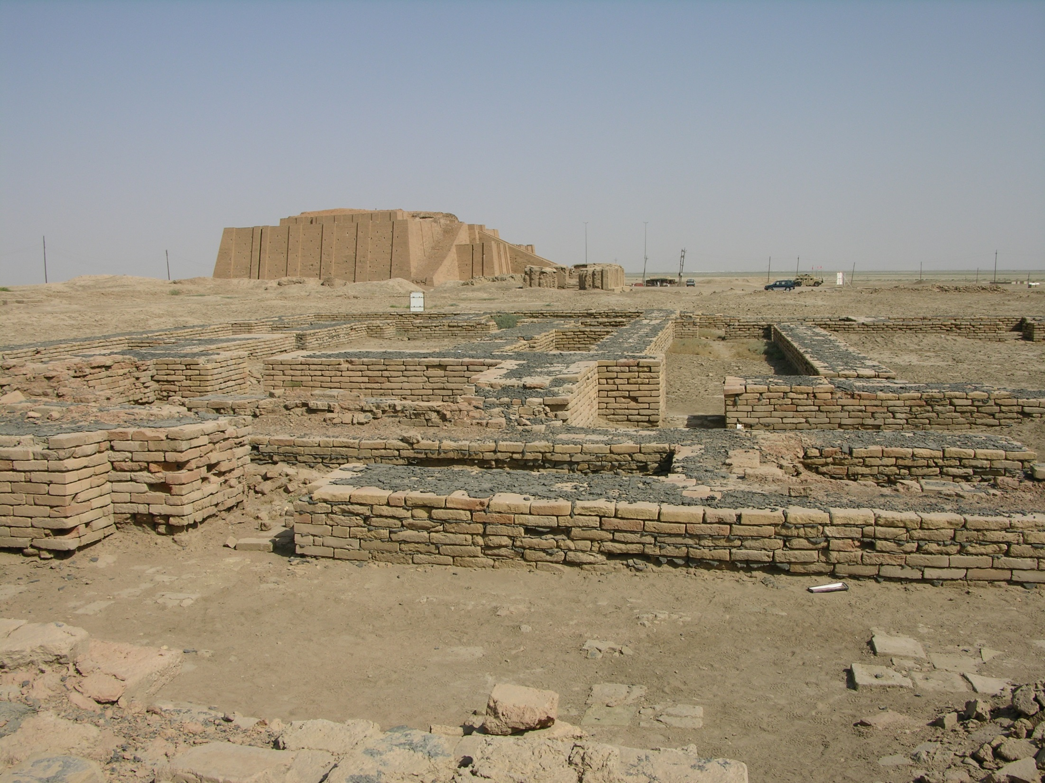

Slide 22
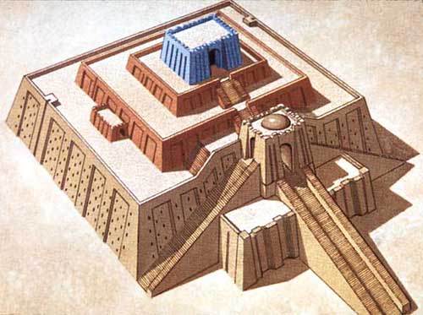

Slide 23
The Sumerians made many advancements in science and technology such as:
Advanced arithmetic and geometry
Architectural innovations such as arches, columns, and ramps.
Cuneiform

Slide 24
Empires
After the decline of Sumer several new civilizations emerged and built the first empire.
The first group was led by Sargon of Akkad. He established the Akkadian Empire in 2350 B.C.
The empire spread the culture created by Sumer beyond the Fertile Crescent.
In 2000 B.C. a warrior group known as the Amorites invaded Mesopotamia and gradually established a new empire.
The capital of this new empire was the city-state of Babylon. The new empire became known as the Babylonian Empire.
The Babylonian Empire reached its peak during the reign of Hammurabi (1792 B.C.- 1750 B.C.)

Slide 25
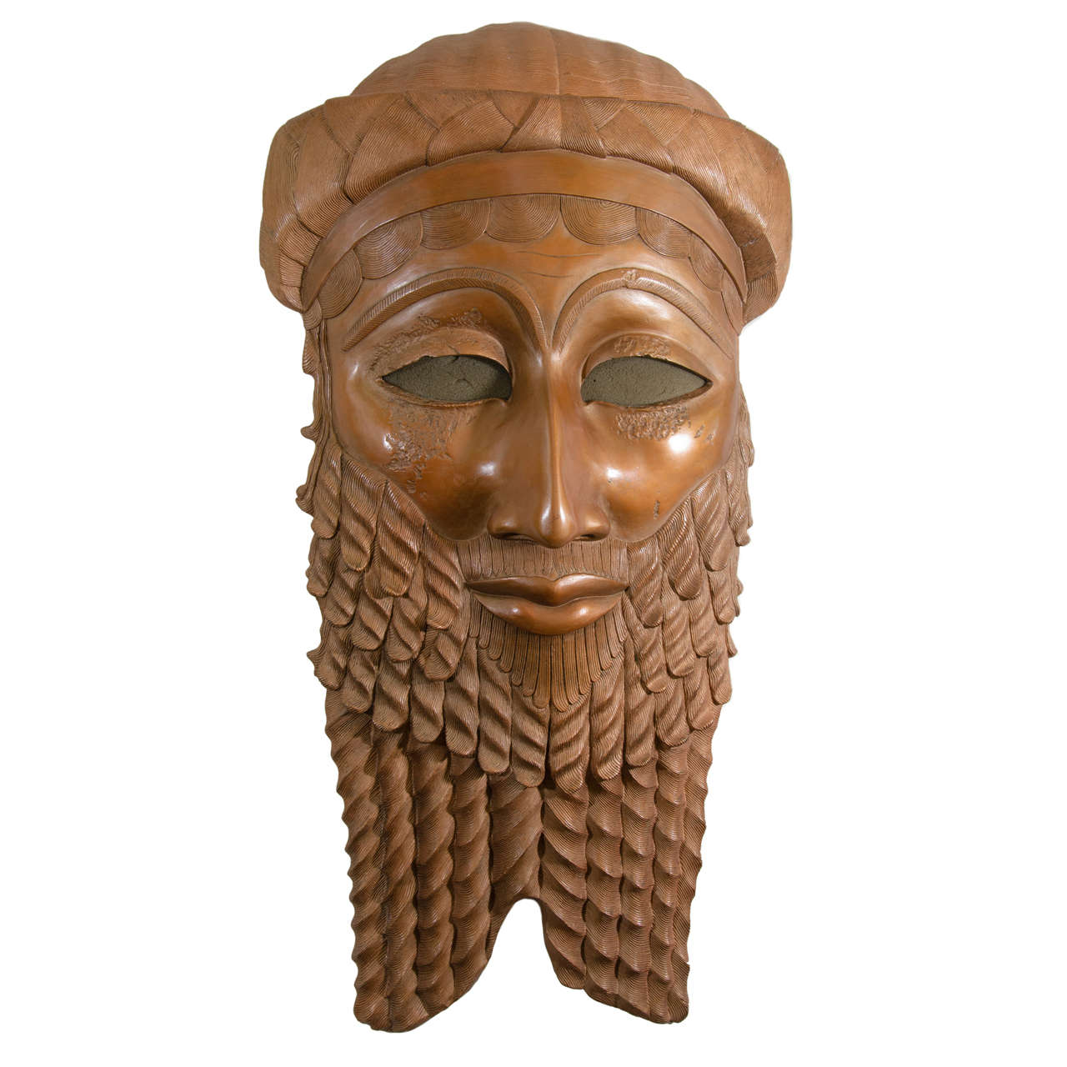

Slide 26
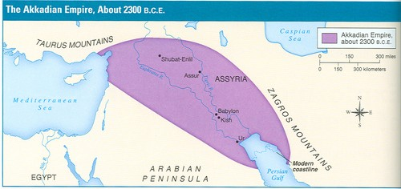

Slide 27
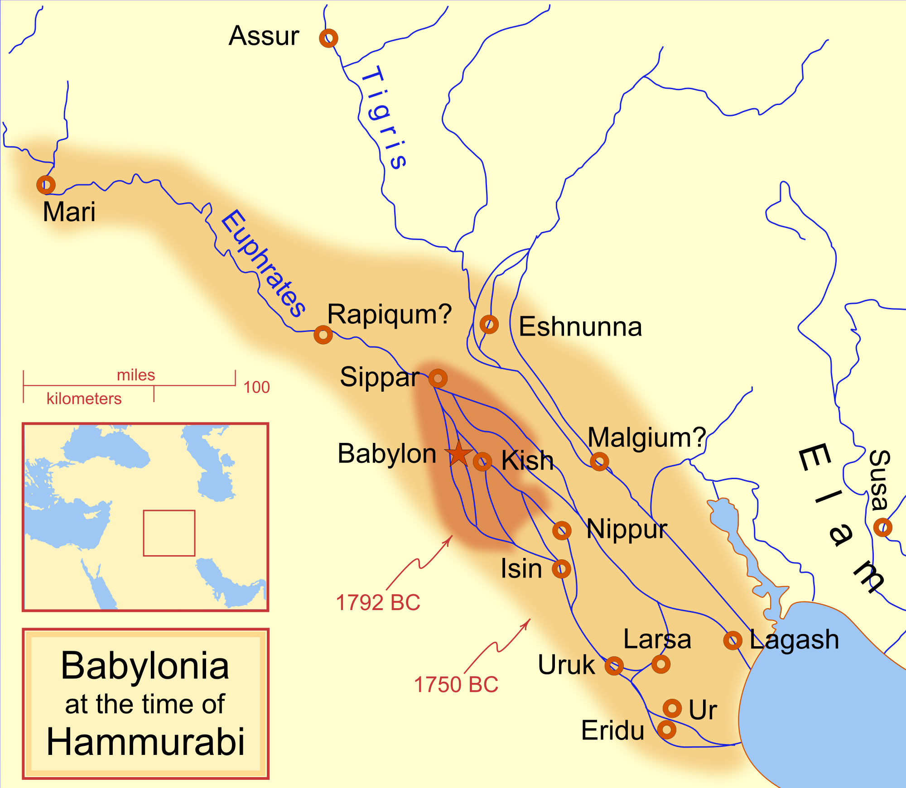

Slide 28
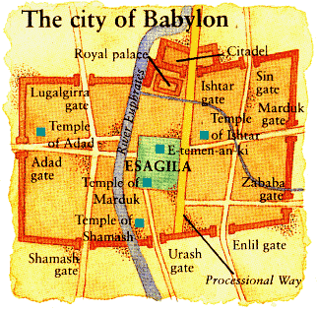

Slide 29
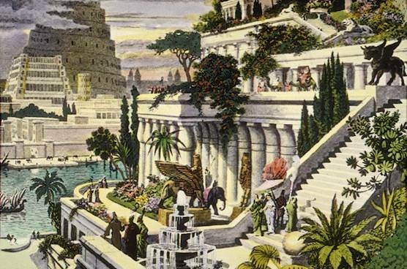

Slide 30
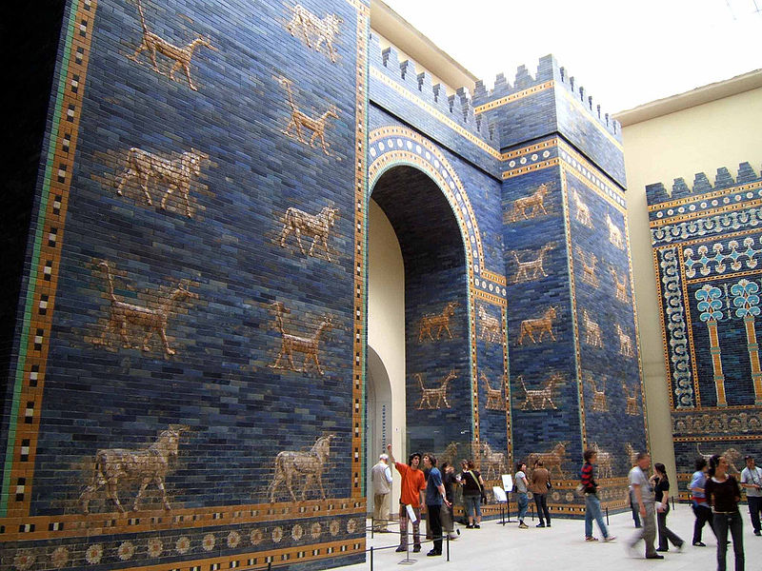

Slide 31
He developed a uniform code a law known as the Hammurabi’s Code.
The code was engraved in stone and placed throughout the empire.
The code had 282 specific laws dealing with issues ranging from family relations, business, and crime.
The punishments were harsh: “an eye for an eye” policy.
After the fall of the Babylonian Empire many groups including the Assyrians, Phoenicians, and Hebrews built upon and adopt the ideas of the Sumerians and civilizations before them.

Slide 32
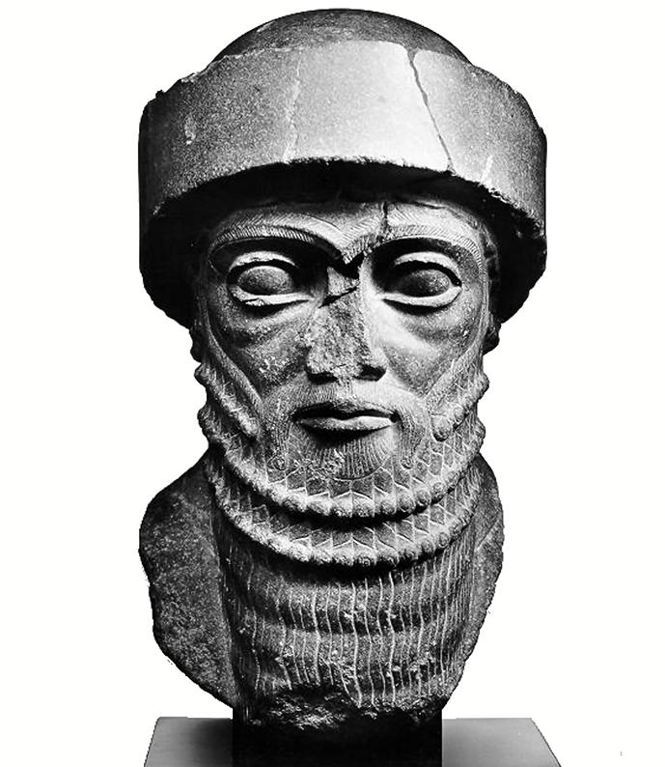
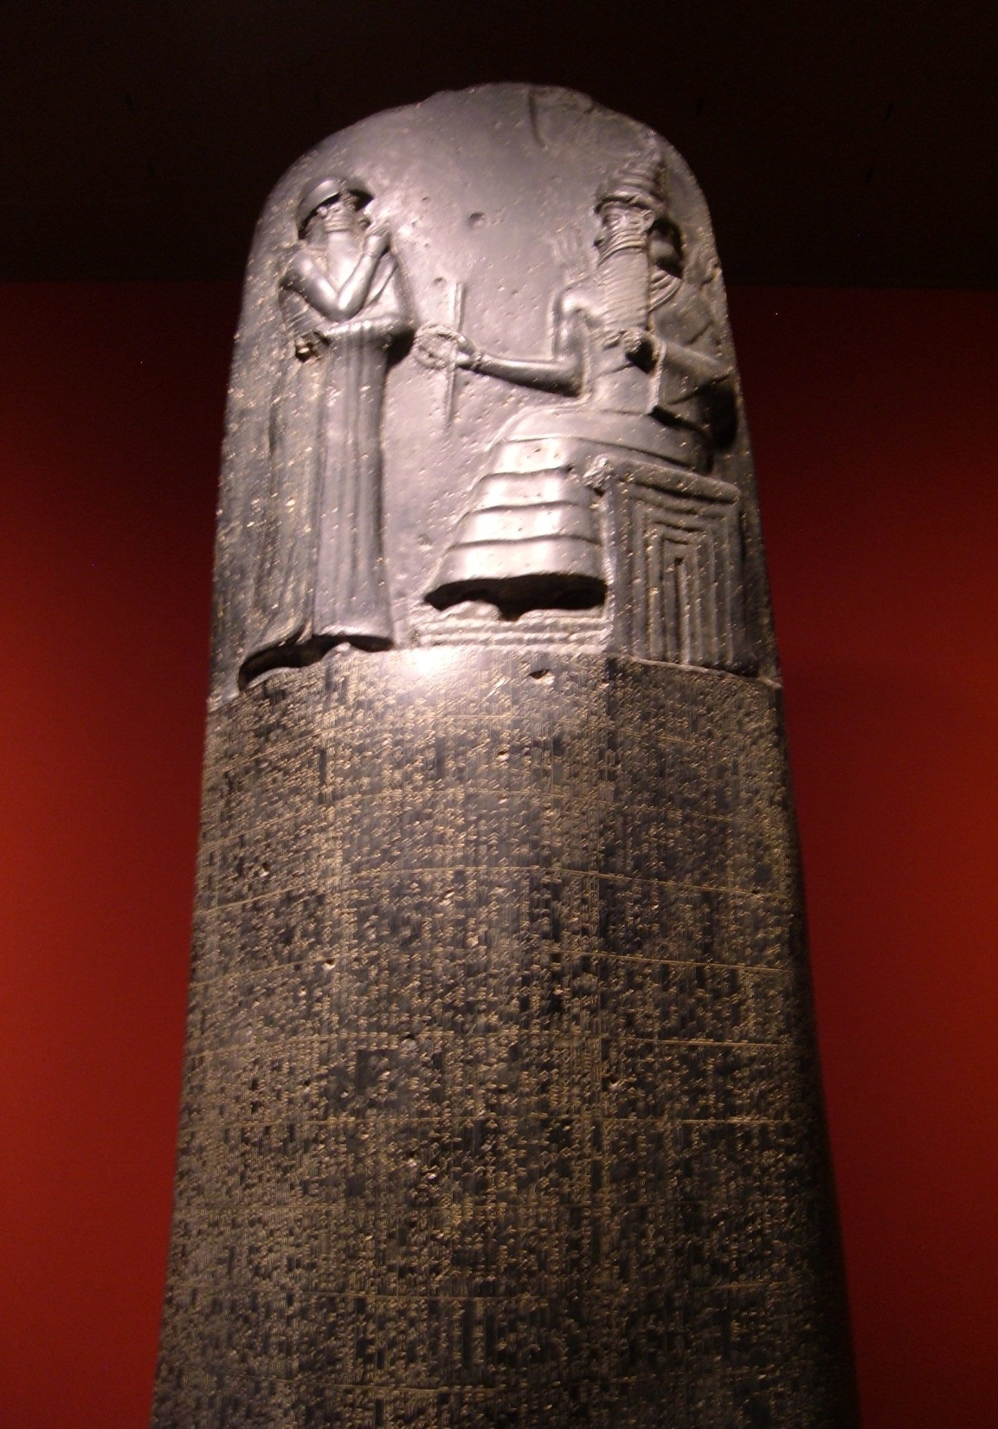

Slide 33
