Slide 1
Origin of Humans

Slide 2
BC/ BCE
BC- the designation for history prior to the birth of Christ.
BCE- alternative designation for the same time period. (Before Common Era)

Slide 3
Artifact
Human made objects such as pottery and jewelry. Usually found at archeological dig sites.

Slide 4
Culture
The unique behaviors and beliefs characteristic of a particular social, ethnic, or age group.

Slide 5
Hominid
Any primate that walks up right on two legs including modern humans and ancestors.

Slide 6
Searching for Human Origins
There are three main groups of scientists that search for and study the origins of humans.
Archeologist: study artifacts left by prehistoric peoples. They do this by digging in different sites in the hopes of finding items such as jewelry, pottery, weapons or even art.
Anthropologists: study prehistoric culture. These scientists study artifacts found at archeological dig sites and try to re-create a picture of prehistoric people’s culture.
Paleontologists: study fossils. Theses scientists search for bones in attempt to understand how humans developed and even what early humans ate.

Slide 7
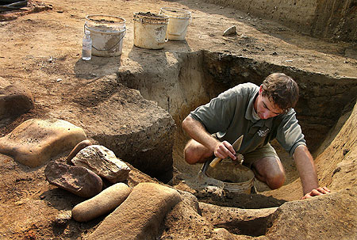

Slide 8
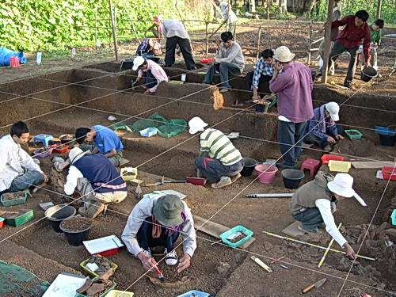

Slide 9
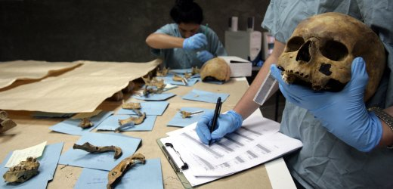

Slide 10
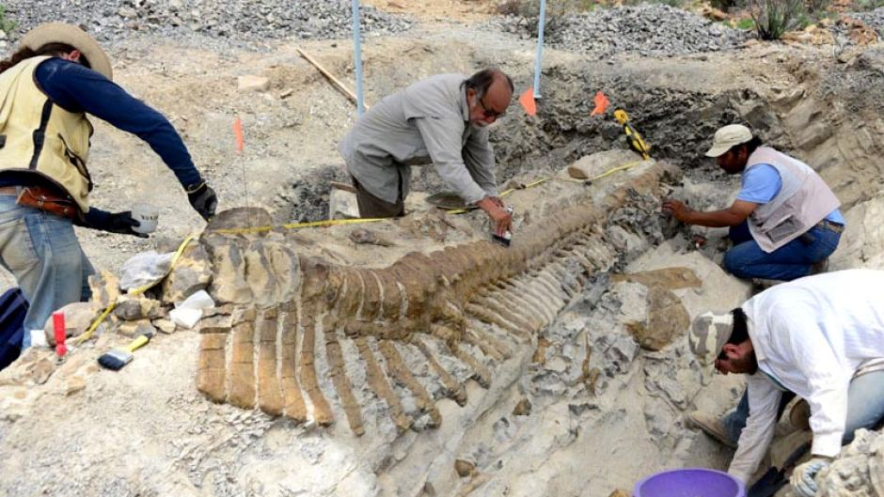

Slide 11
Evidence of Early Hominids
For several hundred years people have tried to understand prehistoric people. The greatest breakthroughs in understanding occurred in the late 20th century.
Mary Leakey- in the 1970s led an archeological team in search of hominids in Tanzania in East Africa. Her team discovered foot prints belonging to a hominid called an australopithecine.
Donald Johanson- His team in 1974 discovered a complete skeleton of the same hominid in Ethiopia. They named the skeleton “Lucy”. She was dated to have lived 3.5 million years ago.

Slide 12
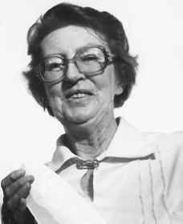
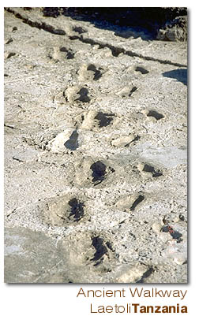

Slide 13
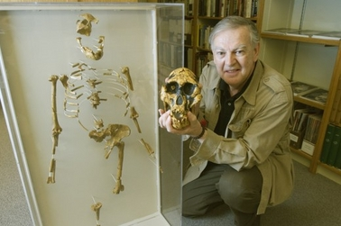

Slide 14
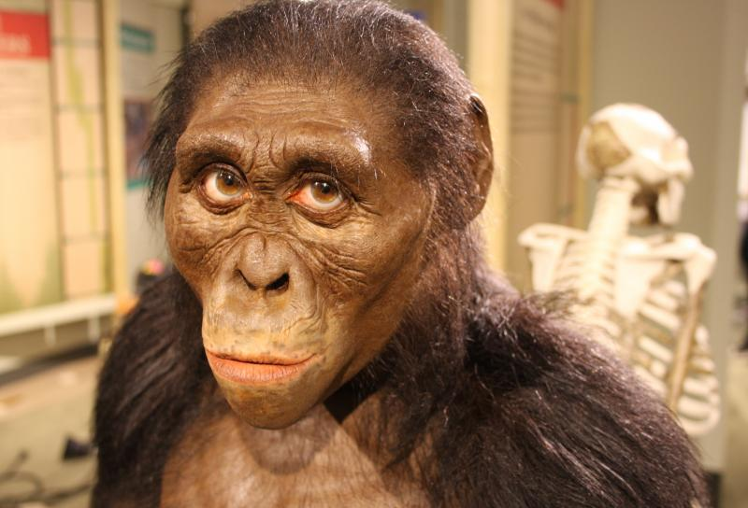

Slide 15
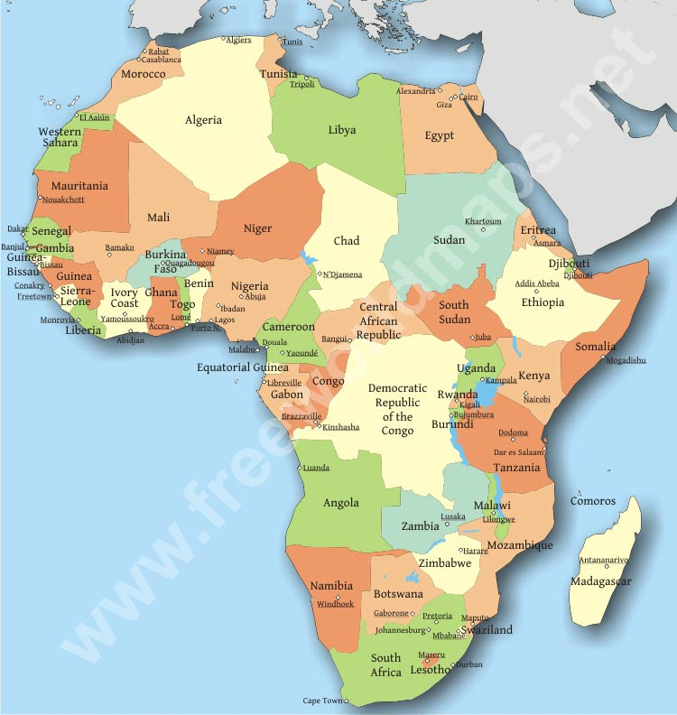

Slide 16
Stone Age
Scientists call the period in which early humans began to create tools, use fire, and develop early language as the Stone Age. This period is split in to two smaller time periods:
Paleolithic Age: “Old stone age”. Lasted from 2.5 million to 8000 B.C.
Neolithic Age: “New stone age”. Lasted from 8000- 3000 B.C. (Lithic- means rock)
This age is known for pottery, agriculture, and domestication of animals.

Slide 17
What Do you Think?
Why do scientist and historians call it the Stone Age?

Slide 18
Beginning of Modern Humans
It is believed that a group of hominids known as Homo erectus developed into modern man, Homo sapiens.
Neanderthals- discovered in 1856 in Germany . Believed to of developed funeral rituals.
Cro-Magnon- emerged around 40,000 years ago. Identical to modern humans. Were skilled hunters.
All of these groups, including Homo sapiens (modern man), spread around the world, beginning in Africa, over millions of years.

Slide 19
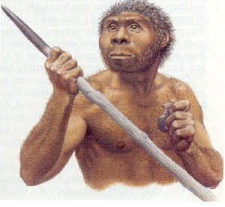
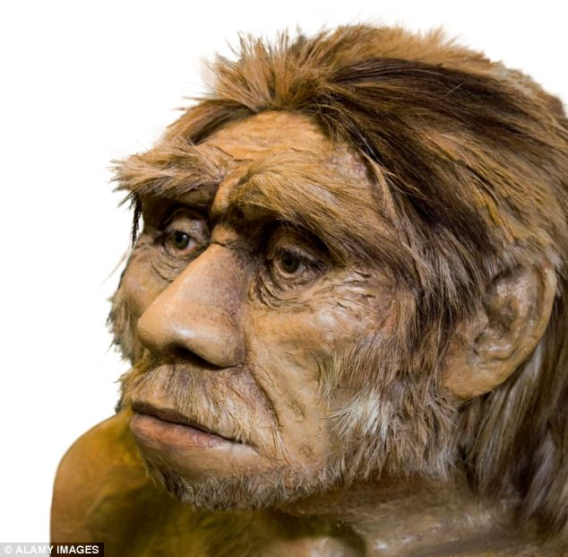
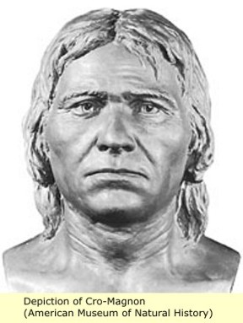

Slide 20
Advances in Technology
For tens of thousands of years people of the Old Stone Age were nomads.
People that move from place to place in search of food sources.
Groups that collected both plants and hunted animals were known as hunter-gatherers.
In order to hunt they had to create specialized tools such as spears, hooks, knives, and harpoons. They made these out stone, bone, and wood.
We know some of what they hunted by the cave paintings they created.

Slide 21
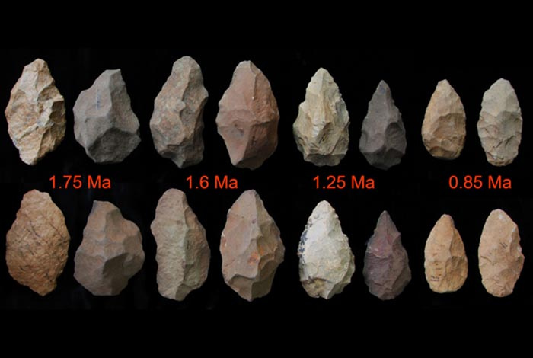

Slide 22
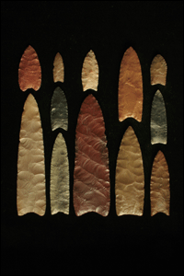

Slide 23
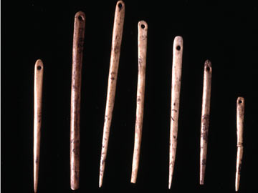

Slide 25
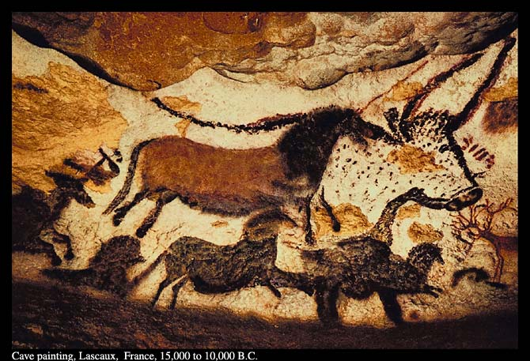

Slide 26
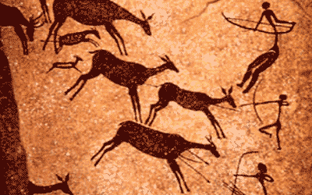

Slide 27
What Do You think?
Are there other ways to determine what early humans hunted other than by studying the cave paintings?

Slide 28
Beginnings of Agriculture
Neolithic Revolution: the period that changed human lives because of farming.
Many of the early crops grown were grains such as wheat, barley, and oats.
By growing crops humans had a more reliable source of food.
Humans also began to domesticate animals. Humans domesticated horses, sheep, goats, pigs, and dogs.
Within a few thousand years farming techniques had spread to other parts of the world including Africa, China, Mexico and Central America, and Peru.

Slide 30
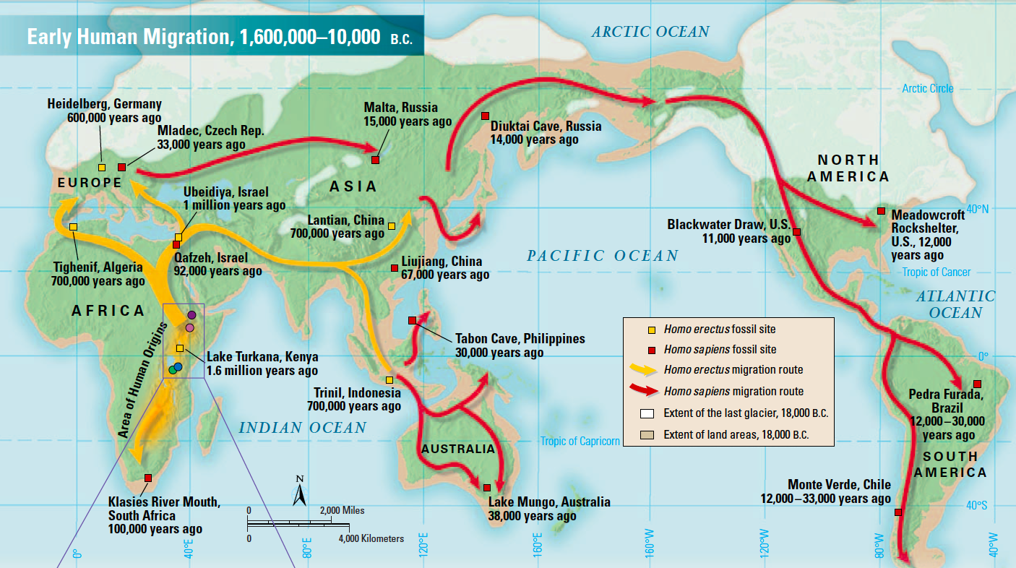

Slide 31
What Do You Think?
What do you think began to develop as a result of many people no longer being nomadic but instead growing crops and living on farms?

