Slide 1
WWII

Slide 2
Axis and Allies
Axis Powers: Germany, Italy, and Japan
Allied Powers: Great Britain, USA, Soviet Union, France

Slide 3
1942
Japan controlled the Pacific Ocean
Japan controlled Hong Kong & the Malay peninsula
Rommel controlled most of North Africa
German army was winning in Russia

Slide 4
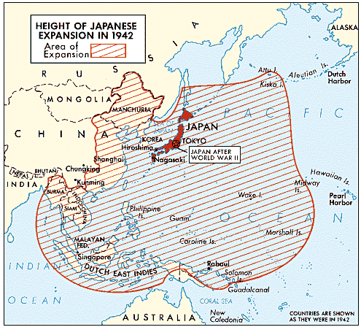
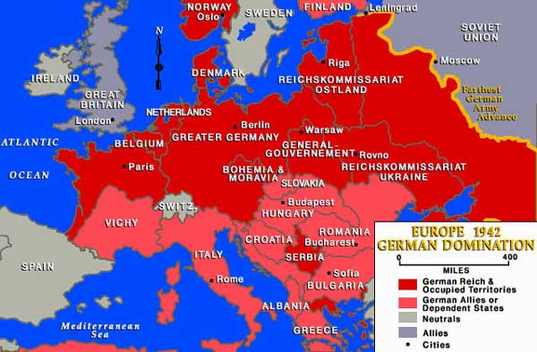

Slide 5
December 7, 1941
Japan attacks the U.S. at Pearl Harbor.
"I fear all we have done is to awaken a sleeping giant and fill him with a terrible resolve." – Yamamoto (probably fake)
"I can run wild for six months … after that, I have no expectation of success." – Yamamoto (known to be true)
U.S. Declares war the next day. (December 8, 1941)
Germany declares war on U.S. on December 11, 1941

Slide 6
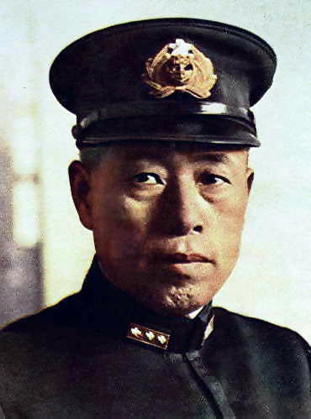
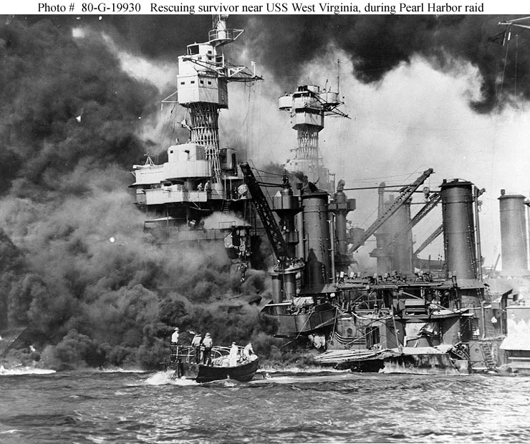
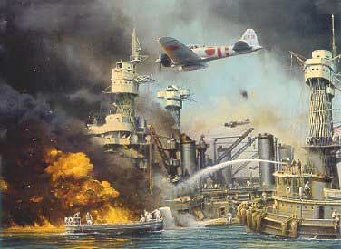
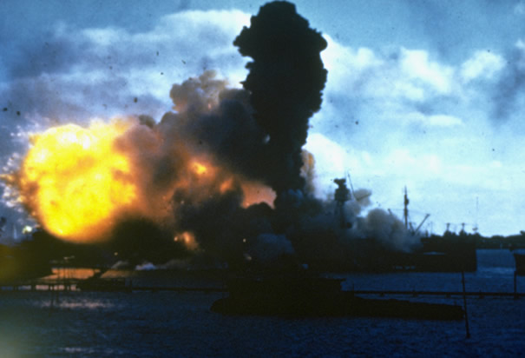
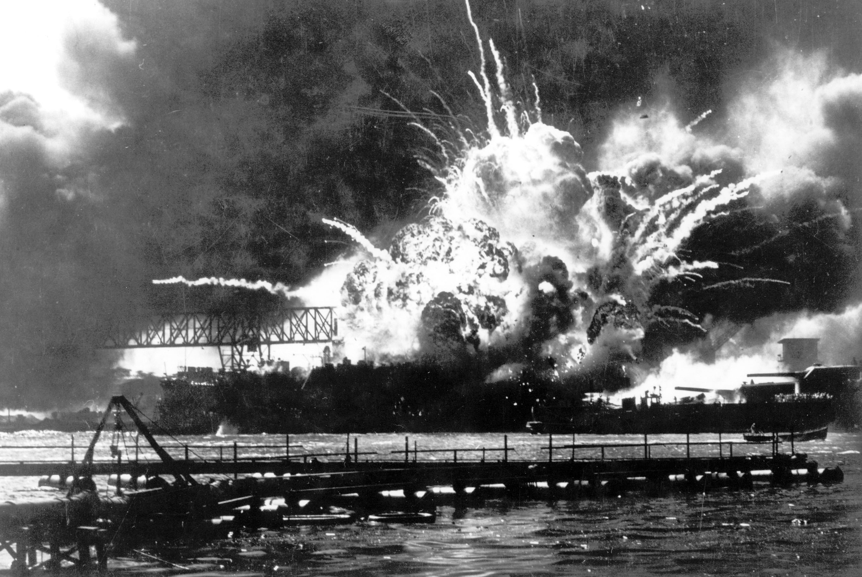
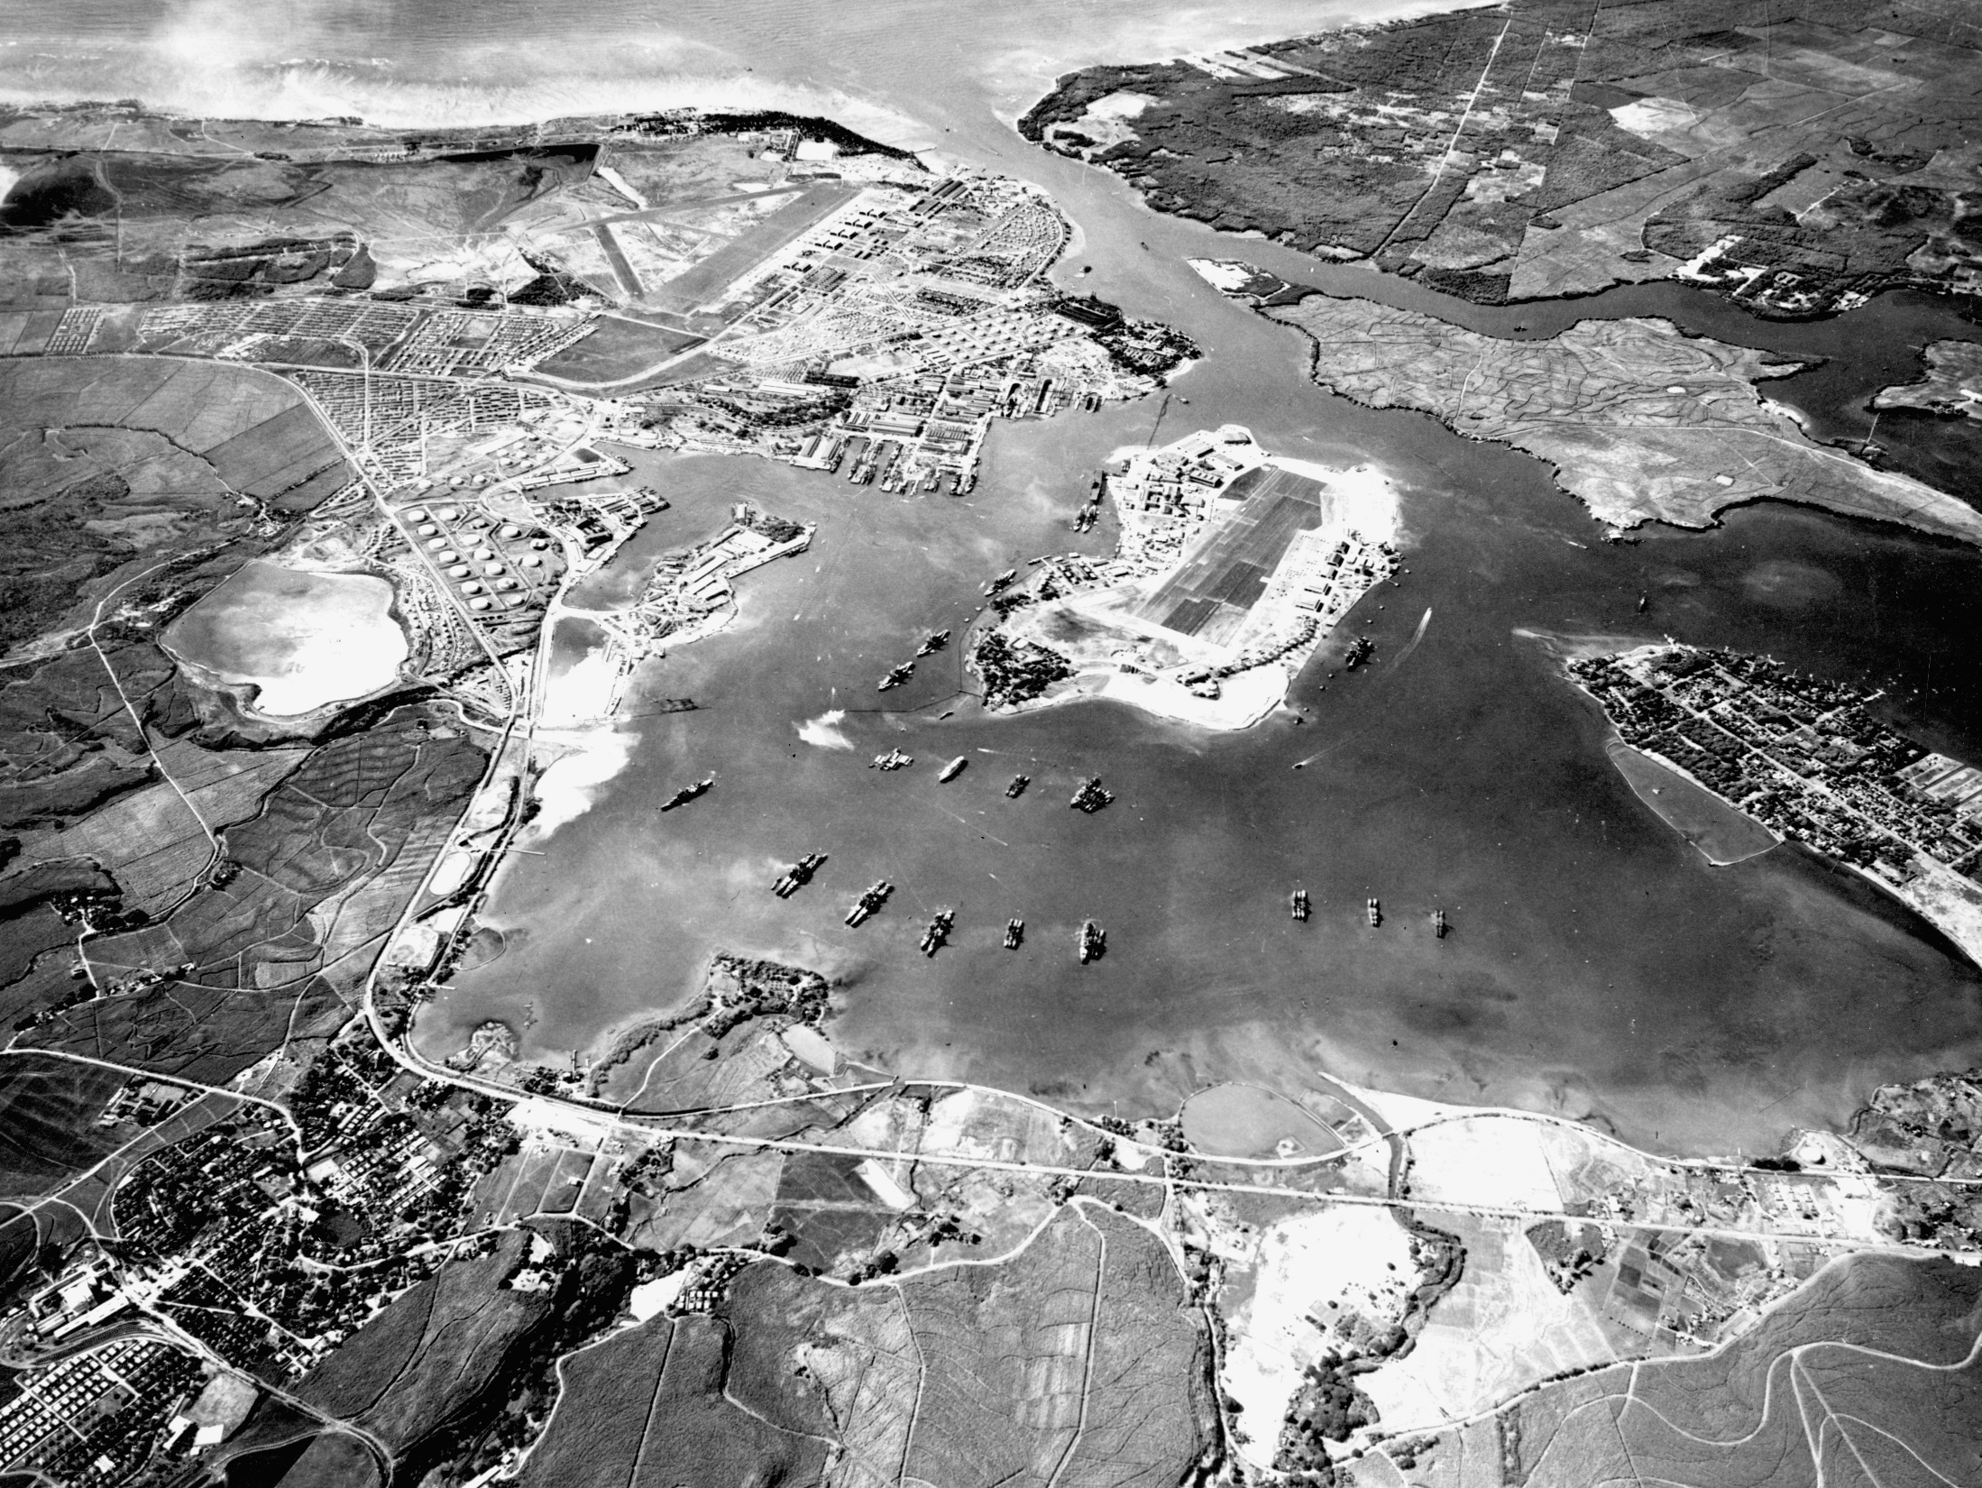

Slide 7
Sea & Air Battles
German u-boats threatened shipping
German battleship ‘Bismarck’ was hunted down and sunk by the allies
Allies were winning the battle for the Atlantic
Allied air offensive directed at German industry weakened the will of German civilians

Slide 8
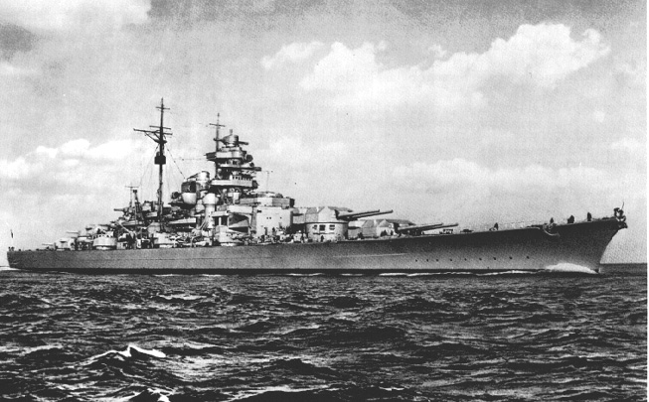
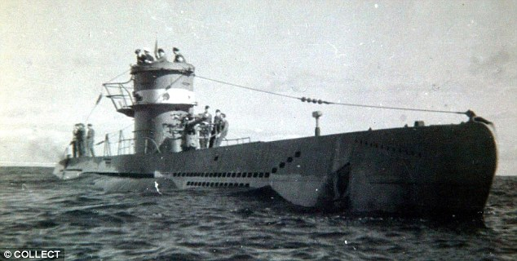

Slide 9
Stalingrad
July 1942 Soviet army in full retreat
By November Germany occupied 9/10 of Stalingrad
Stalin wanted a second front
Churchill said “No”
Soviets reinforced
Nov. 19, 1942 Soviets counterattack
German supply lines were cut
German troops not prepared for Russian winter(-50 degrees)
Hitler refused to allow his troops to retreat

Slide 10
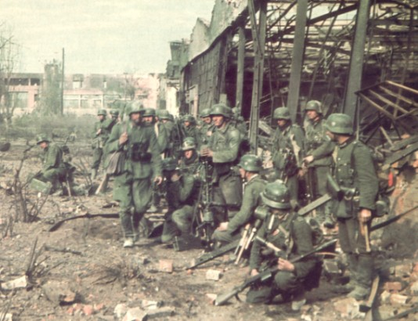
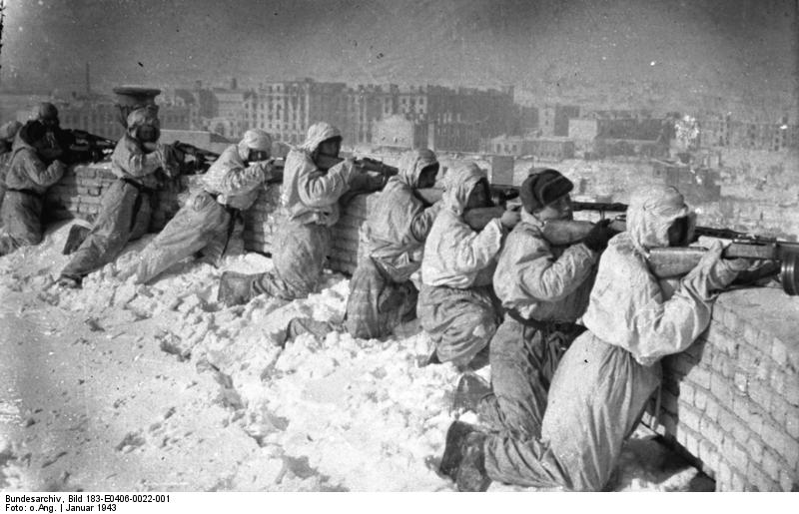

Slide 11
War in the Desert
Rommel and his Afrika Korps
General Bernard Montgomery (UK)
German advance stopped at El Alamein
600 British tanks vs. 100 German tanks (largest tank battle of the war)
Nov. 1942 British launch counterattack
Captured Tripoli (capital of Libya) Jan. 1943
300,000 POW’s (largest ally victory before U.S. entered the war)
Rommel told Hitler the situation was “hopeless”
May 1943 Afrika Korps surrendered
Allies now controlled all of North Africa

Slide 12
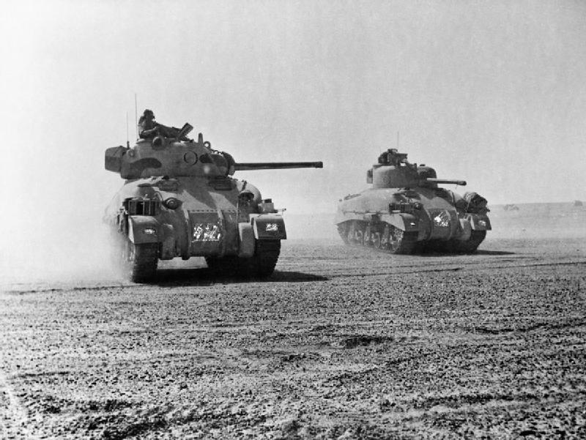
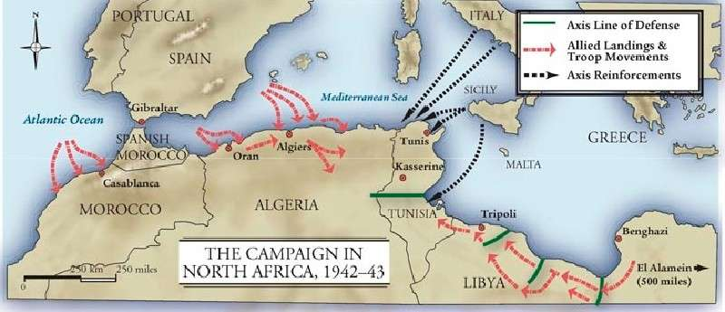
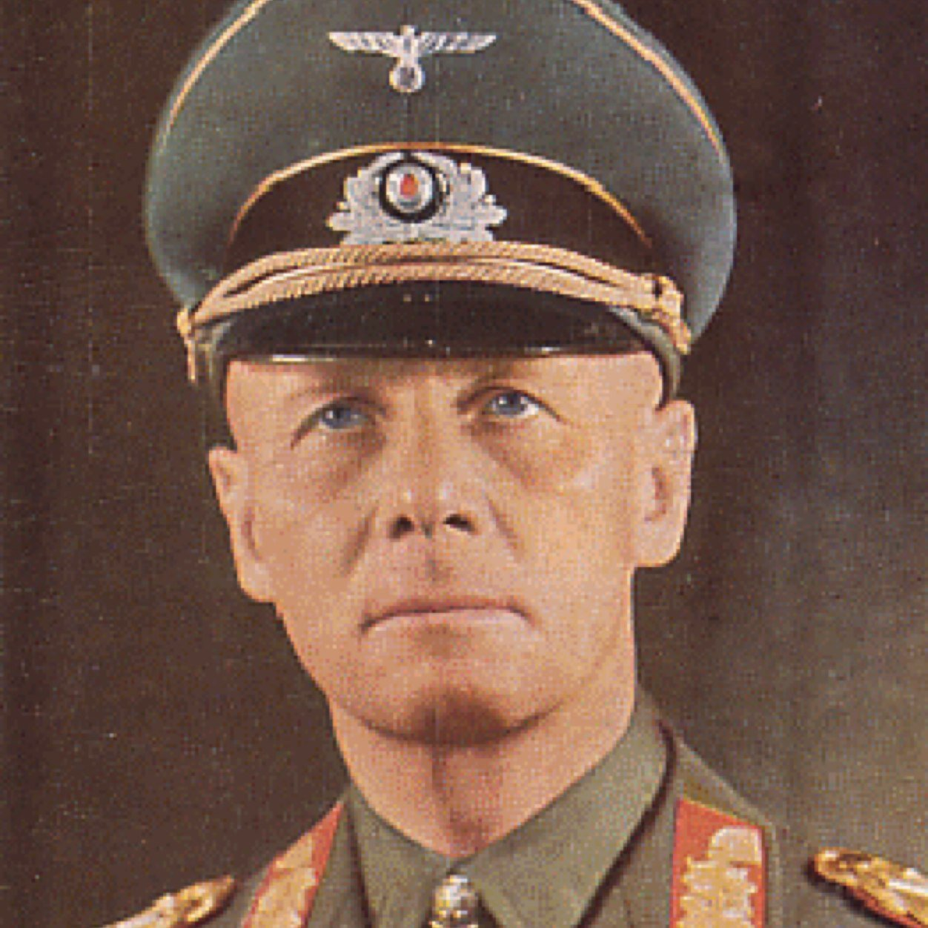
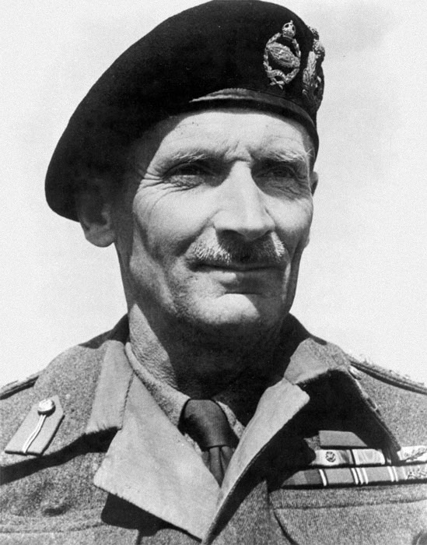

Slide 13
Invasion of Italy
July 1943 Allies attacked Sicily
40,000 German troops and 70,000 Italian troops escaped to Italy through Messina

Slide 14
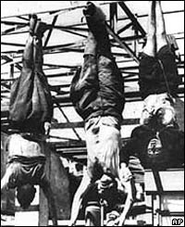
Italy Conquered
July 1943 King Victor Emmanuel III fired Mussolini and had him arrested
Fascist party dissolved
Sept. 3, 1943 Italy surrendered
Germans occupied Rome
June 4, 1944 Allies entered Rome

Slide 15
War in the Pacific Midway
Japan controlled much of SE Asia and the Pacific
June 1942 Battle of Midway
Ended Japanese naval superiority

Slide 16
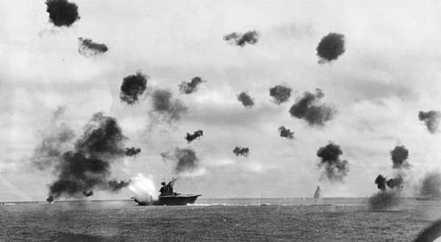
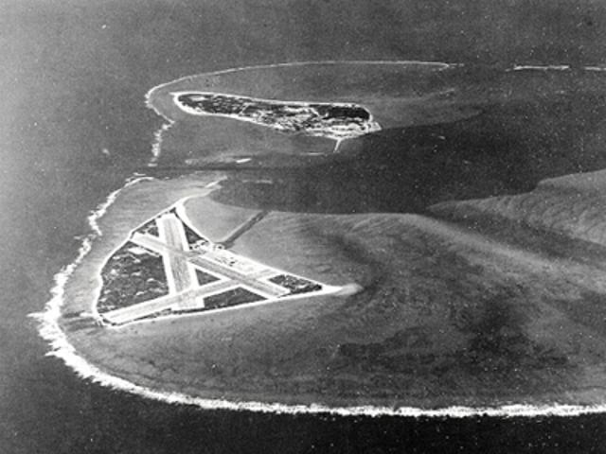

Slide 17
War in the Pacific Guadalcanal (Aug. 1942)
Allies led by General Douglas Macarthur & Admiral Chester Nimitz
6 month battle
First ally land victory in the Pacific
Plan to leapfrog to Japan (“Island Hopping”)
Japan would never surrender

Slide 18
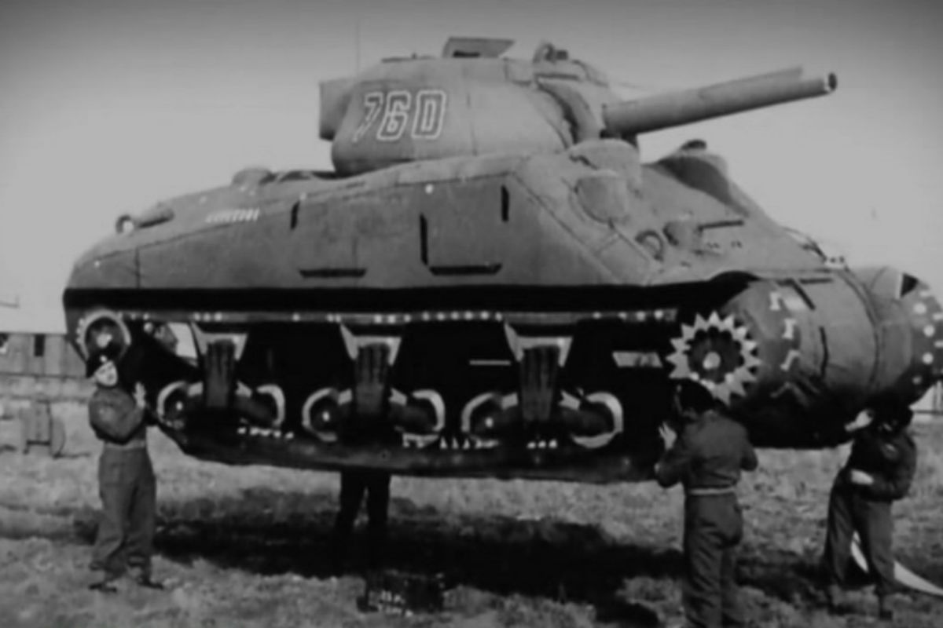
The War Comes to an End: Allies Invade FRANCE
TURNING POINT
1943 Allies build forces in Gr. Britain
May 1944- 3.5 mil Allied troops ready
Eisenhower, commander of Allied Forces in Europe, plan strike at Normandy, Coast of France
Ger. knew attack was coming

Slide 19
Allies Invade France: Operation Overlord
Allies set up decoy force w/headquarters, etc.
Code name: Operation Overlord June 6, 1944, D-Day
Germany was well fortified: concrete walls 3ft thick
In 1 month, 1mil troops landed; high casualties
By Aug.25 Allies are in Paris
By Sept. freed France, Bel.,Lux.,&Neth.

Slide 20
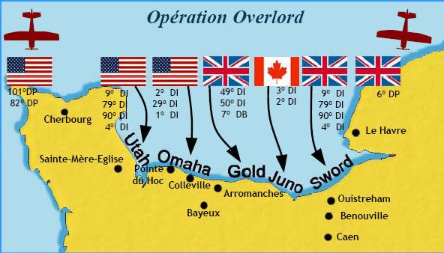
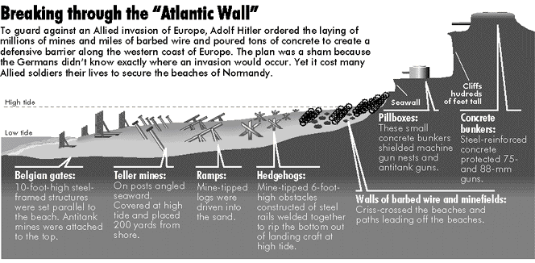
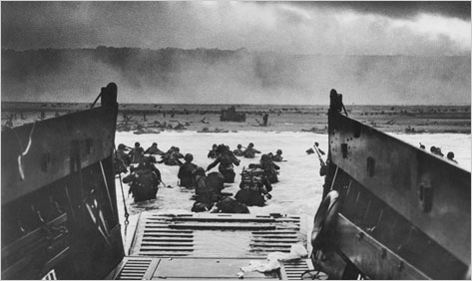
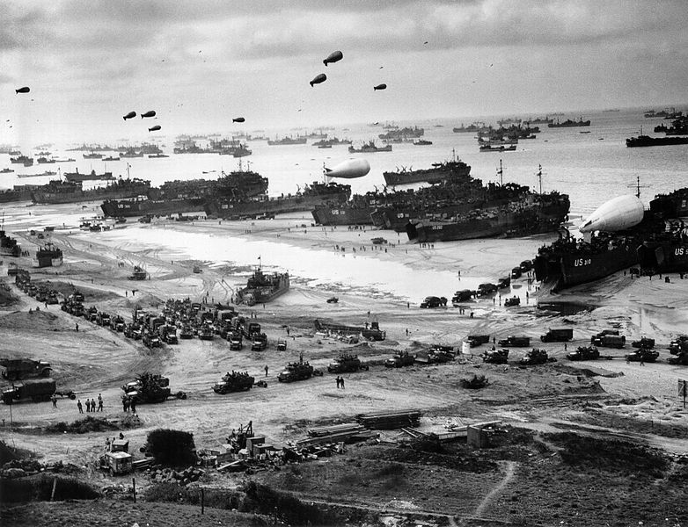

Slide 21
The Battle of the Bulge
Last German Offensive
The Allies move in from the West
SU. Moves in from the East
Ger. Counter attacks in the west
Dec. 16,1944: Ger. Breaks through American defenses
Allies push Ger. Back and they retreat

Slide 22
Yalta February 1945
Roosevelt, Churchill, Stalin
Discussed issues affecting the postwar world
United Nations proposed to maintain peace
Agreed to divide Germany

Slide 23
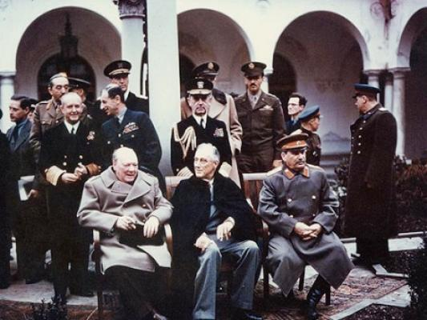

Slide 24
Germany’s Unconditional Surrender
March 1945-Allies & Soviets close in on Berlin
FDR died April 12-Truman becomes Pres.
Battle for Berlin: April-May 1945 Last Battle of WWII in Europe
April 28- Hitler marries Eva Braun
Hitler writes final address to the Ger. People: blames the Jews for starting the war and his generals for losing it.
April 30-Hitler & Eva kill themselves
Soviets raise red flag over Berlin
May 8-Germany Surrendered VE Day:
Victory in Europe

Slide 25
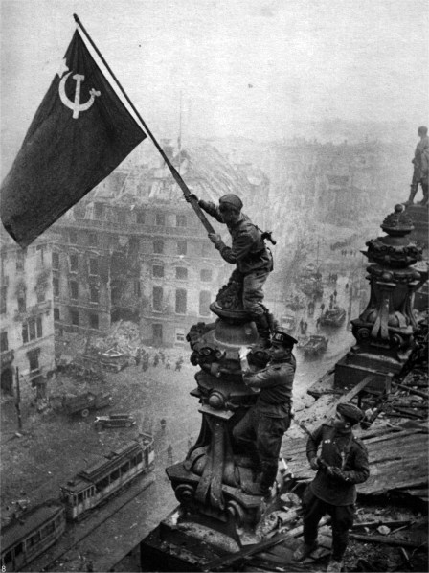
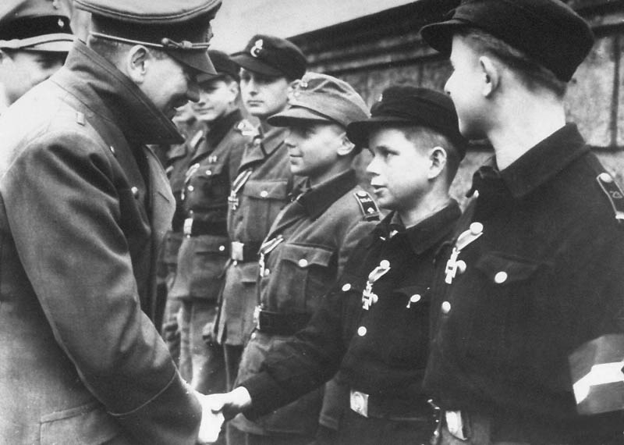

Slide 26
The Manhattan Project
The American Program to develop the Atomic Bomb
Einstein warned FDR that Germany was working on a bomb
Truman does not know about the top secret project until he’s in office
Military advisors urge him to use the bomb to avoid mil. of Am. Casualties in an invasion of Japan proper

Slide 27
IN THE PACIFIC: Battle of Okinawa, Operation Iceberg
One of the last battles of WWII: April-June 1945
Considered a strategic point to launch land invasion of Japan
Held many airstrips and harbors
U.S and Brit. Forces gain control of the island (in spite of 193 kamikaze attacks)
High casualties

Slide 28
Potsdam July 1945
FDR died in April of 1945
Harry Truman President
Churchill’s conservative party lost election
Clement Attlee Prime Minister
Issued Japan an ultimatum
Tension over the future of Europe

Slide 29
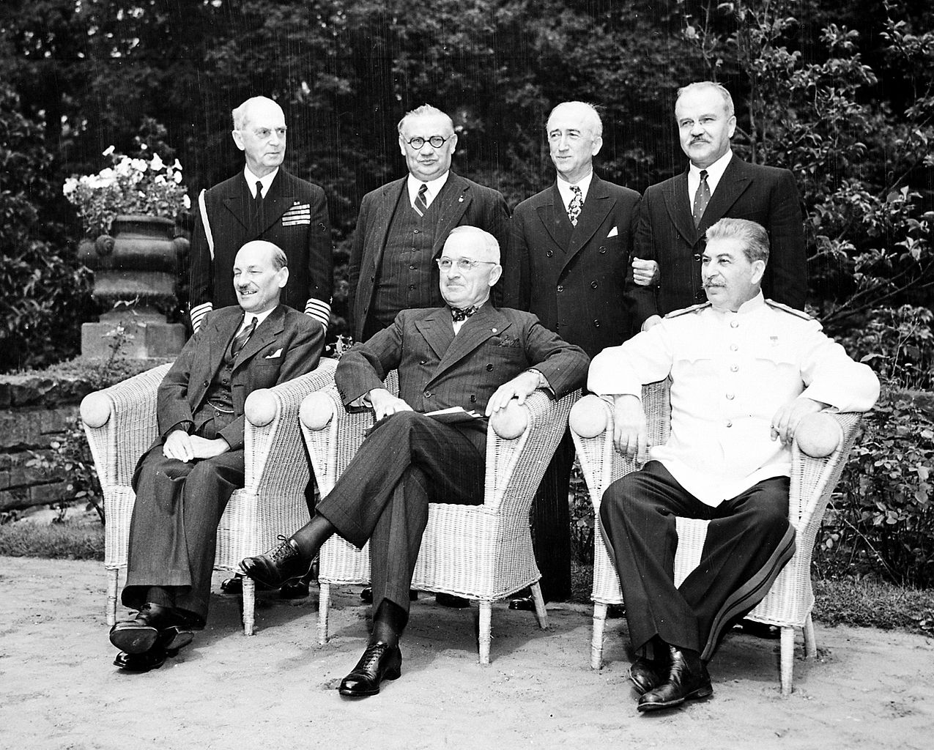

Slide 30
Victory over Japan
Macarthur regained the Philippines
Allied victories in Iwo Jima and Okinawa
Japan mainland bombed at will
General Hideki Tojo (Prime Minister) refused to surrender

Slide 31
Victory In Japan
Japan is retreating and loses big battles to ALLIES (Iwo Jima & Okinawa)
Use Kamikaze pilots: suicide pilots w/bombs in planes
Allies moving closer to Japan
July 26,1945 Truman warned Japan of “prompt and utter destruction” if they don’t surrender at once
Aug 6 ”Little boy” dropped first by The Enola Gay on Hiroshima
Aug 9 bomb dropped on Nagasaki
Sept. 2 Japan surrendered V-J Day

Slide 32
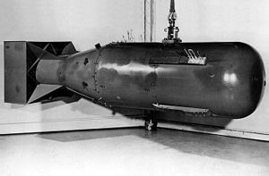
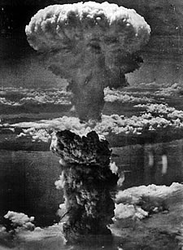
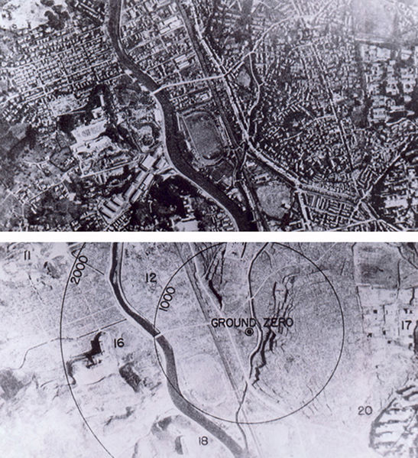
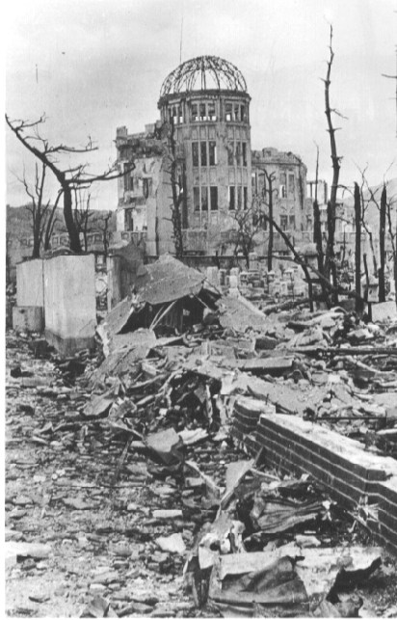
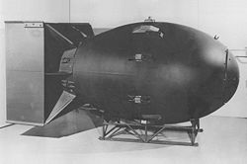

Slide 33
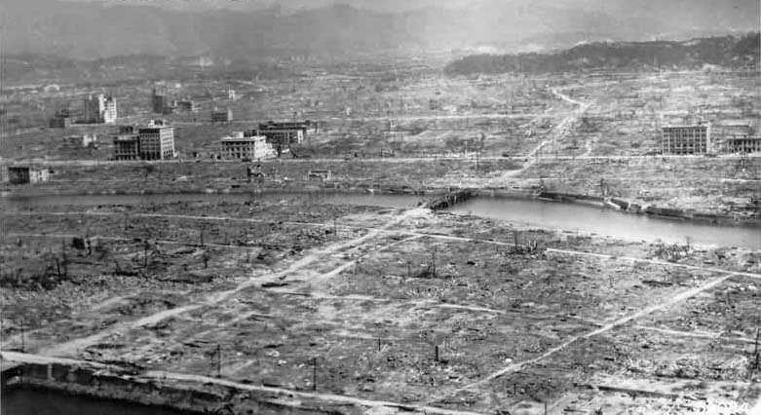
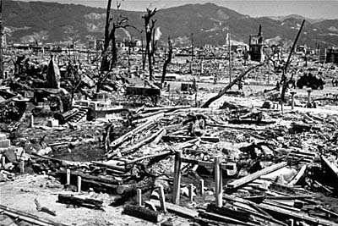
Hiroshima:
150,000+ casualties
Nagasaki:
75,000+ casualties

Slide 34
Effects of WWII
Soviet Union 22 million dead
Germany 8 million dead
Japan 2 million dead
USA 300,000 dead
Jews 6 million dead
Over 55 million dead
Most destructive war in history

Slide 35
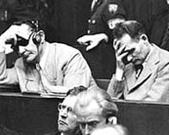
War Criminal Trials
Nuremburg, Germany
Nov. 1945 – Sept. 1946
Nazi war criminals
“Crimes against humanity”

