Slide 1
Phoenicians and Greeks

Slide 2
Early Seafaring
From 2000 to 1400 B.C. a group called the Minoans dominated trading on the Mediterranean Sea. They lived on an island of Crete.
The Minoans left behind wall paintings, seals, and vases. The art suggest women played a key role in their culture.
It is unclear why the civilization ended around 1200 B.C.

Slide 3
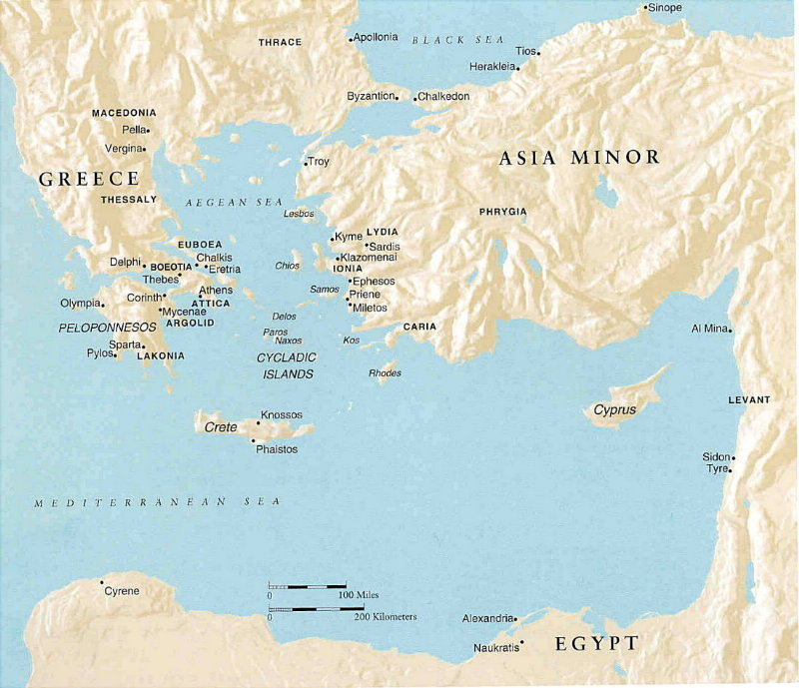

Slide 4
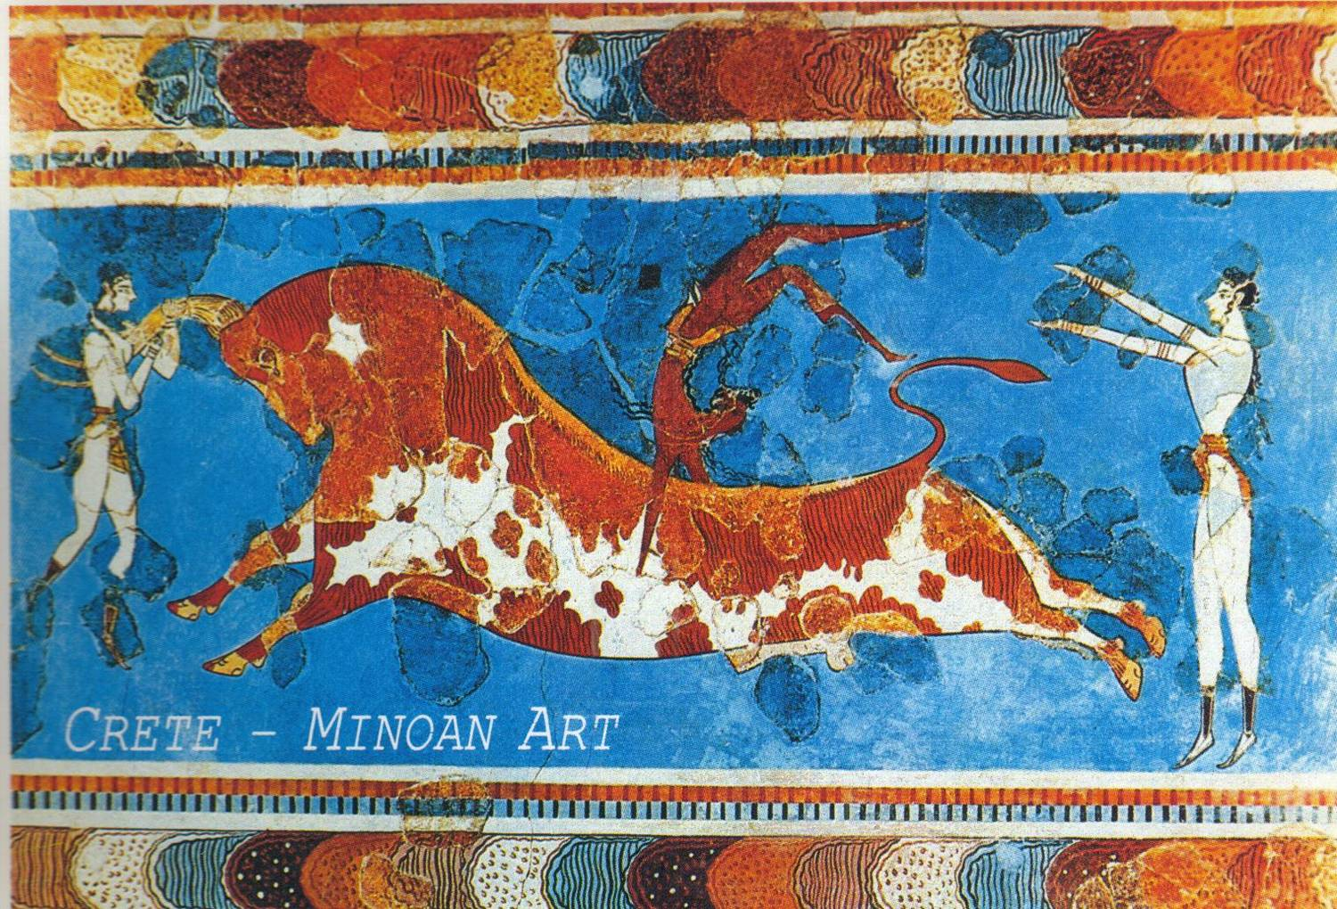

Slide 5
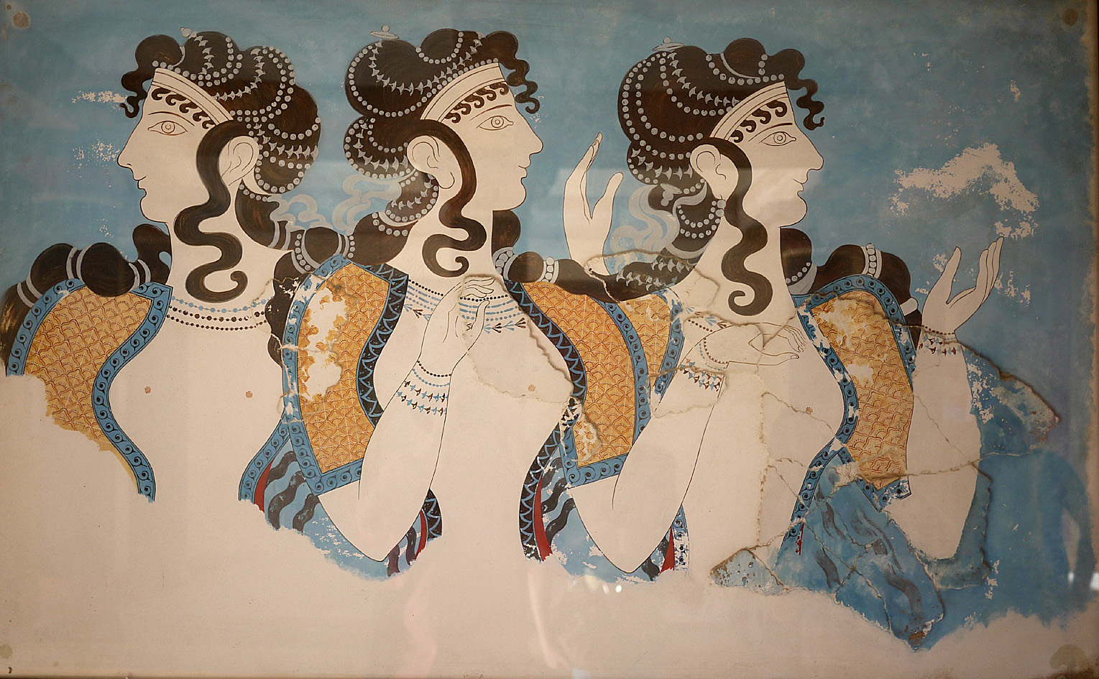

Slide 6
The greatest of all the early seafaring civilizations were the Phoenicians. They established city-states in what is now known as Lebanon. They traded throughout the ancient world around the Mediterranean Sea.
The Phoenicians were known for trading many good but a red-purple dye.
Their greatest legacy is the alphabet. They created a system of writing were one symbol stood for one sound. This is known as a phonetic alphabet. The Greeks would adopt this system.

Slide 7
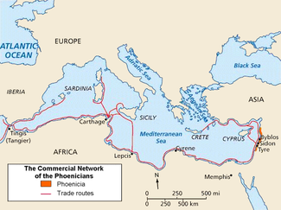

Slide 8
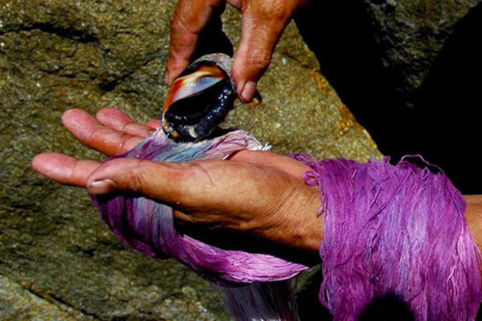

Slide 9
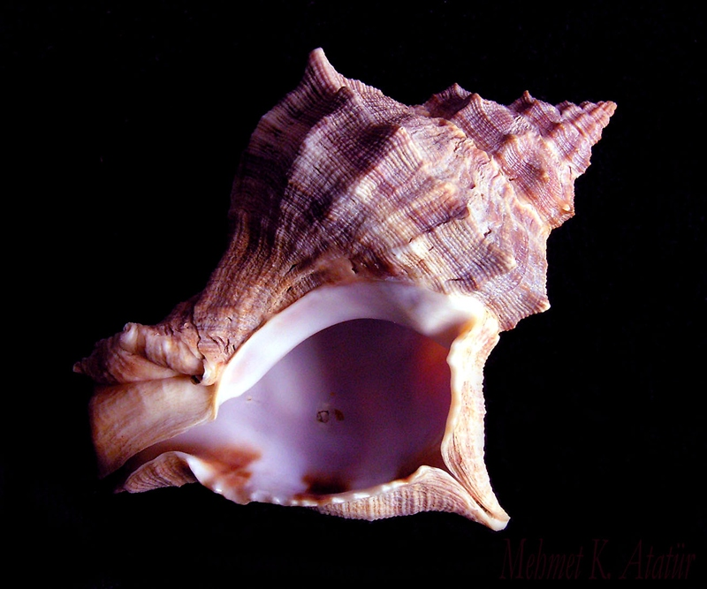

Slide 10
Greek Geography
Greece is a mountainous peninsula and hundreds of small islands in the Aegean Sea.
Greek life revolved round the sea. The climate is mild.

Slide 11
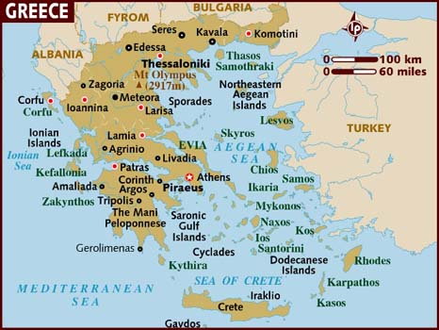

Slide 12
Early Greeks
The earliest of all the Greeks were the Mycenaeans. They were influenced by their encounters with the Minoans.
In the 1200s B.C. the Mycenaeans fought a ten year war against the city-state of Troy. This is known as the Trojan War. It is said that the war began when Helen, the wife of a Greek king, was kidnapped by a Trojan Prince.
In 1200 B.C. the Mycenaean civilization collapsed and was replaced by the Dorian.

Slide 13
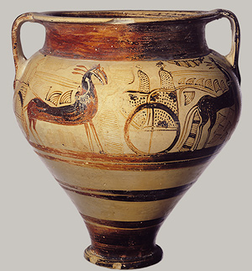

Slide 14
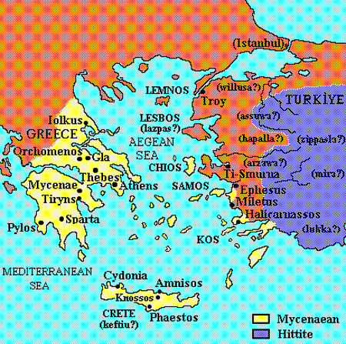

Slide 15
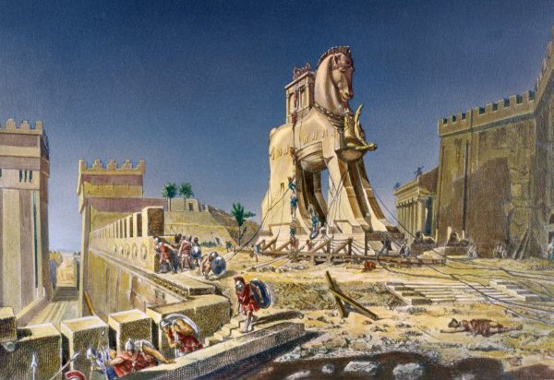

Slide 16
Little is known about the Dorians due to a lack of written records. Greek civilization declined during this time.
Due to no writing system people learned through spoken word. The greatest of all the storytellers was Homer. He told epics like the Iliad.
Greek myths were also created during this time.

Slide 17
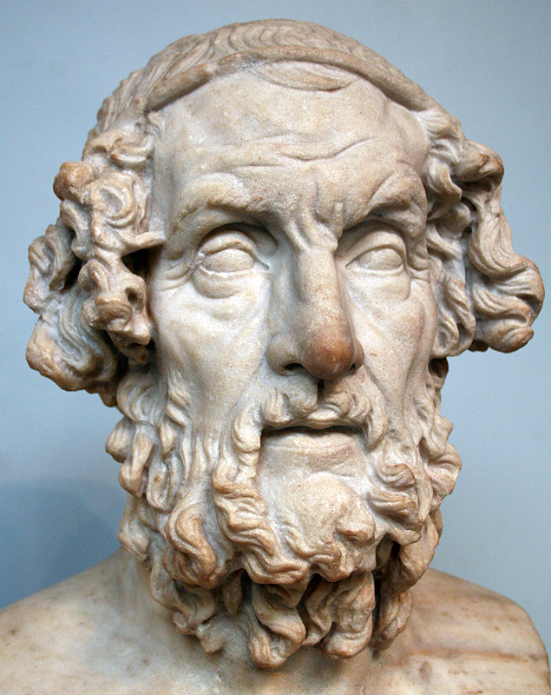

Slide 18
Rise of City States
By 750 B.C. the polis or city-state was the fundamental political unit in ancient Greece.
Two of the greatest city-states were Athens and Sparta.
Athens: known for its democracy, the outlawing of slavery, and a central governing body.
Sparta: known for the creation of a military state. Taxation of a conquered group the helots. Central governing body where a group of 30 elders proposed and made. The most powerful Greek army.

Slide 19
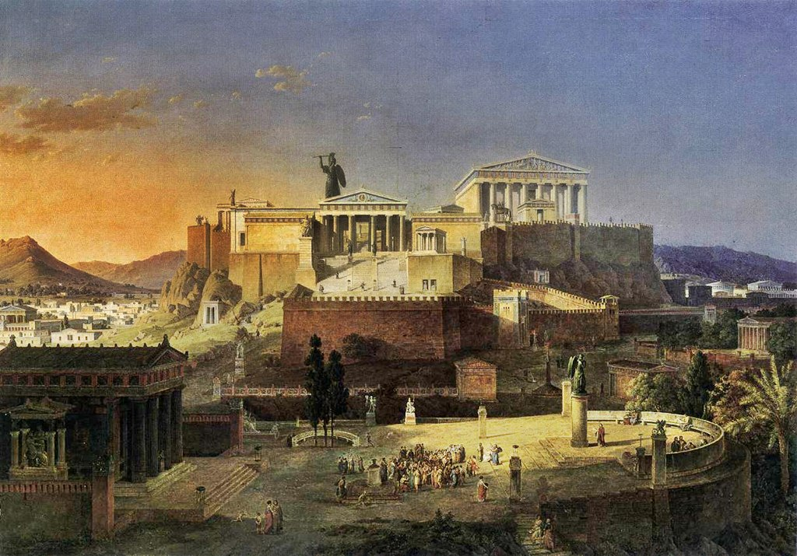

Slide 20
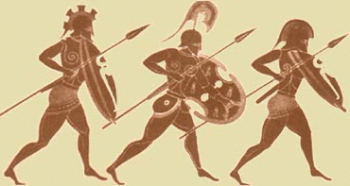

Slide 21
Persian War
In 546 B.C. the Persians conquered the area of Anatolia (present day Turkey).
In 490 B.C. 25,000 Persians under their king Darius were defeated by 10,000 Persians at the Battle of Marathon. Persians lost 6000 while the Athenians lost fewer than 200.
Ten years later the Persian king Xerxes set out to crush Athens.
At the Battle of Thermopylae the Persian army was held back for three days by 7,000 Greeks including 300 Spartans.
Eventually Xerxes was defeated at the Battle of Salamis where his navy was destroyed by the Athenian navy.
In 478 B.C. some Greek city-states formed the Delian League.

Slide 22
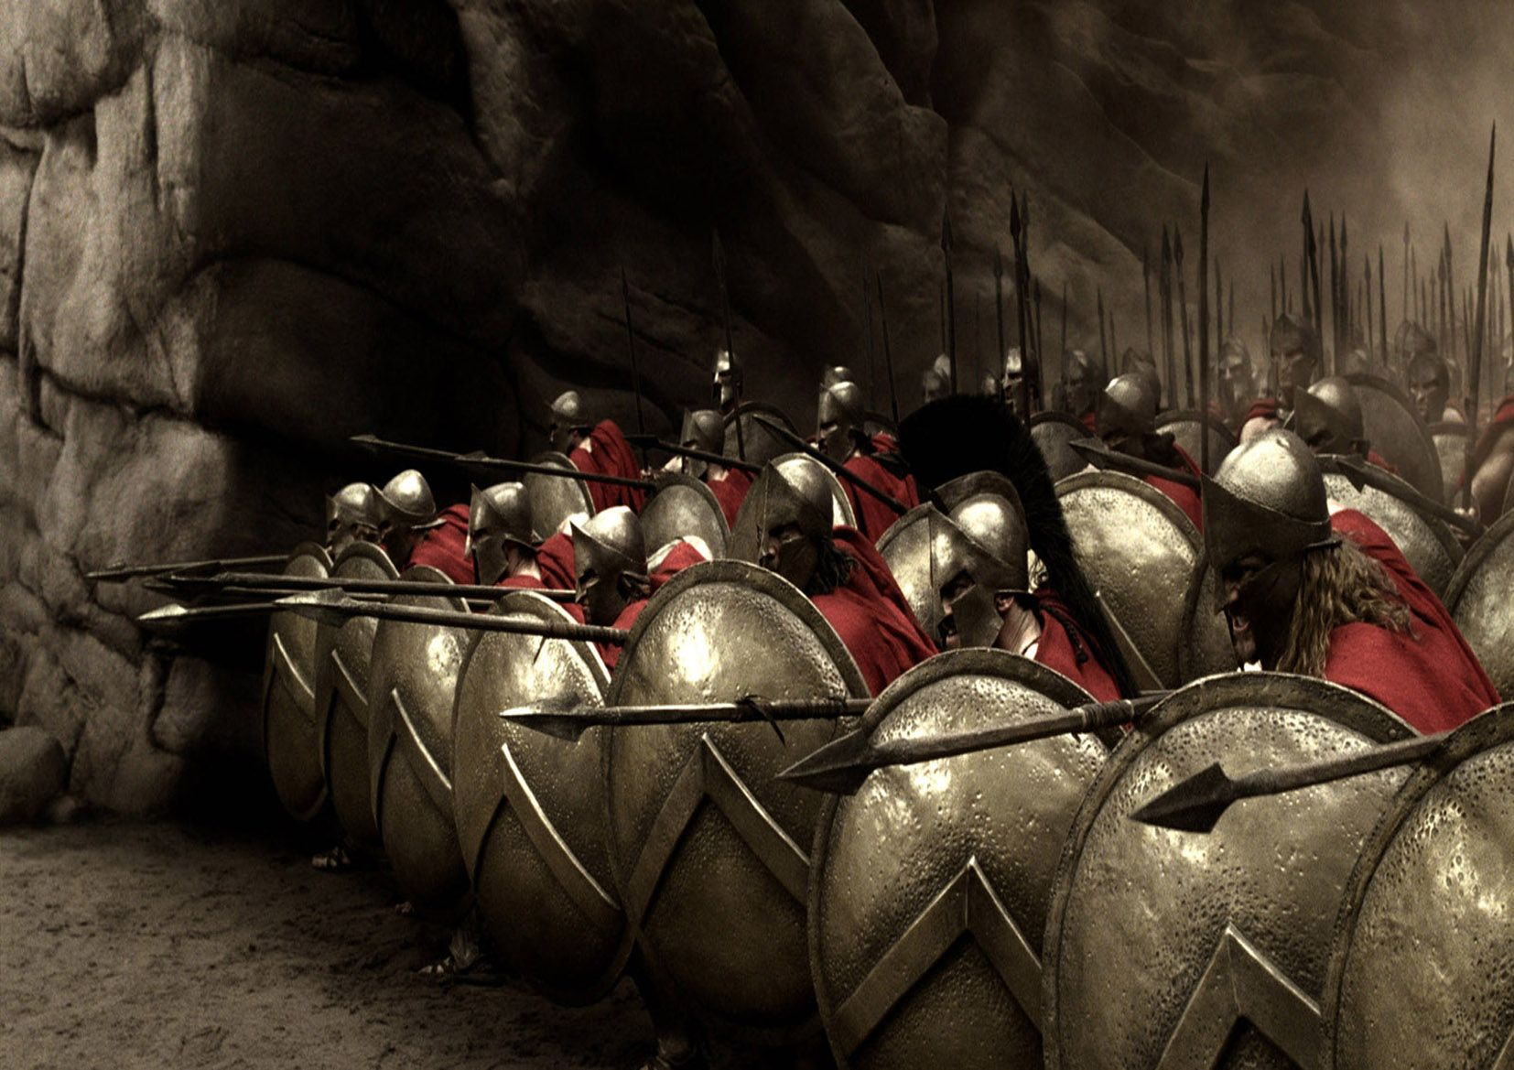

Slide 23
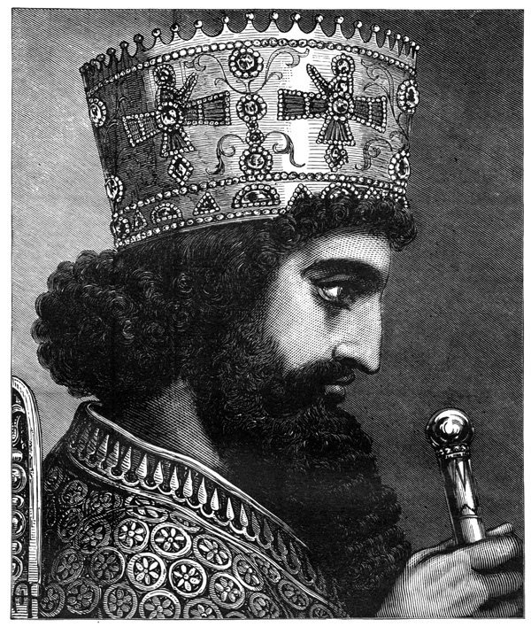

Slide 24
Greece’s Golden Age
Athens came to dominate not only the league but other city-states too beginning a golden age for Athens.
Athens leader, Pericles, used the leagues money to change the city-state and used the army to control other city-states.
During this time art and architecture thrived. Greeks wrote dramas; both tragedy and comedy.
Herodotus wrote and recorded Greek history.

Slide 25
Peloponnesian War
As Athens became more prosperous other city-states began to show hostility.
Leaders in both Athens and Sparta pushed for war with each other and war came in 431 B.C.
Athens had a strong navy and Sparta had a strong army.

Slide 26
Athens was attacked by Sparta from land. In 432 B.C. a plague killed 1/3 of the population including Pericles.
In 421 B.C. the two sides agreed to a truce; however in 415 B.C. Athens sent an army to the island of Sicily to crush Sparta’s ally, Syracuse.
Athens was defeated. The war ended in 404 B.C. when Athens surrendered. Athens lost its empire, power, and wealth.

Slide 27
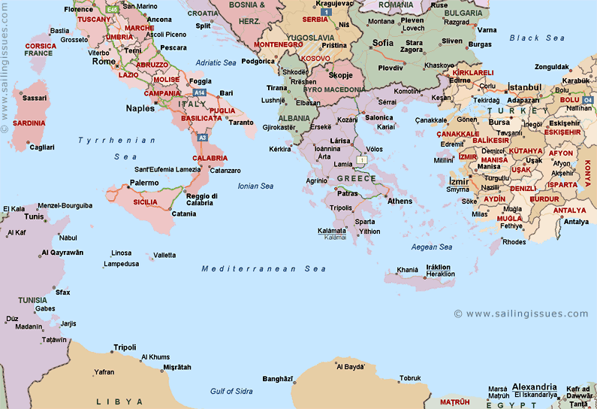

Slide 28
Greek Philosophy
After the war many were beginning to ask questions. These people are known as philosophers
Socrates: He asked people to question themselves. He is quoted as saying “ The unexamined life is not worth living”. A method of consistent questioning is known as the Socratic Method.
399 B.C.- Socrates was put on trial for “corrupting the youth of Athens”. He was put to death. He died by drinking hemlock.
Plato: He was a student of Socrates. Developed the idea of a republic.
Aristotle: He was a student of Plato. He developed the basis for the scientific method.

Slide 29
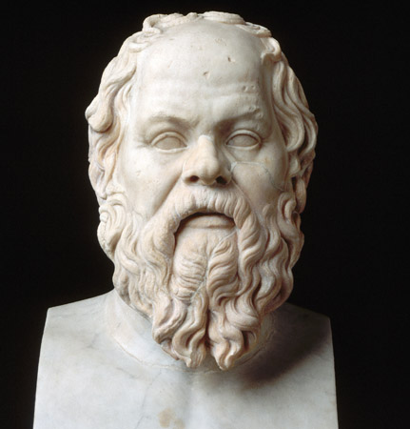

Slide 30
