Slide 1
The Rise of Islam
Muhammad changes the world…

Slide 2
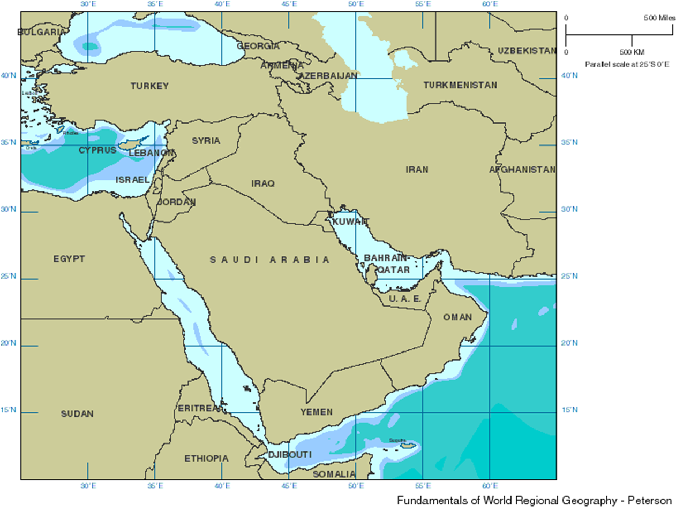
LOCATION
Arabian Peninsula – Southwest Asia, AKA the Middle East
Serves as a bridge between Africa, Asia, and Europe, allowing goods and ideas to be shared.

Slide 3
THE ARABIAN PENINSULA
This land is desert, so the people living there were nomadic.
“Bedouins” were organized into clans – tribes and groups that provided security and support in the harsh conditions

Slide 4
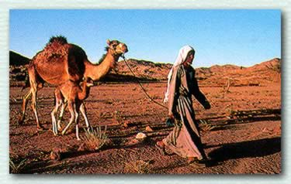
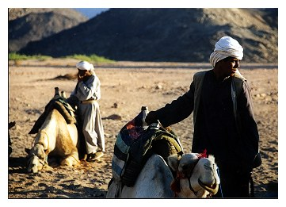
BEDOUINS

Slide 5
THE ARABIAN PENINSULA
By the early 600s CE, many Arabs settled in an oasis or market town, creating permanent trade routes between the Byzantine and Persian Empires, and along the Silk Roads
Traded – spices, incense, silk, ideas and other products, and used camels to transport across land.

Slide 7
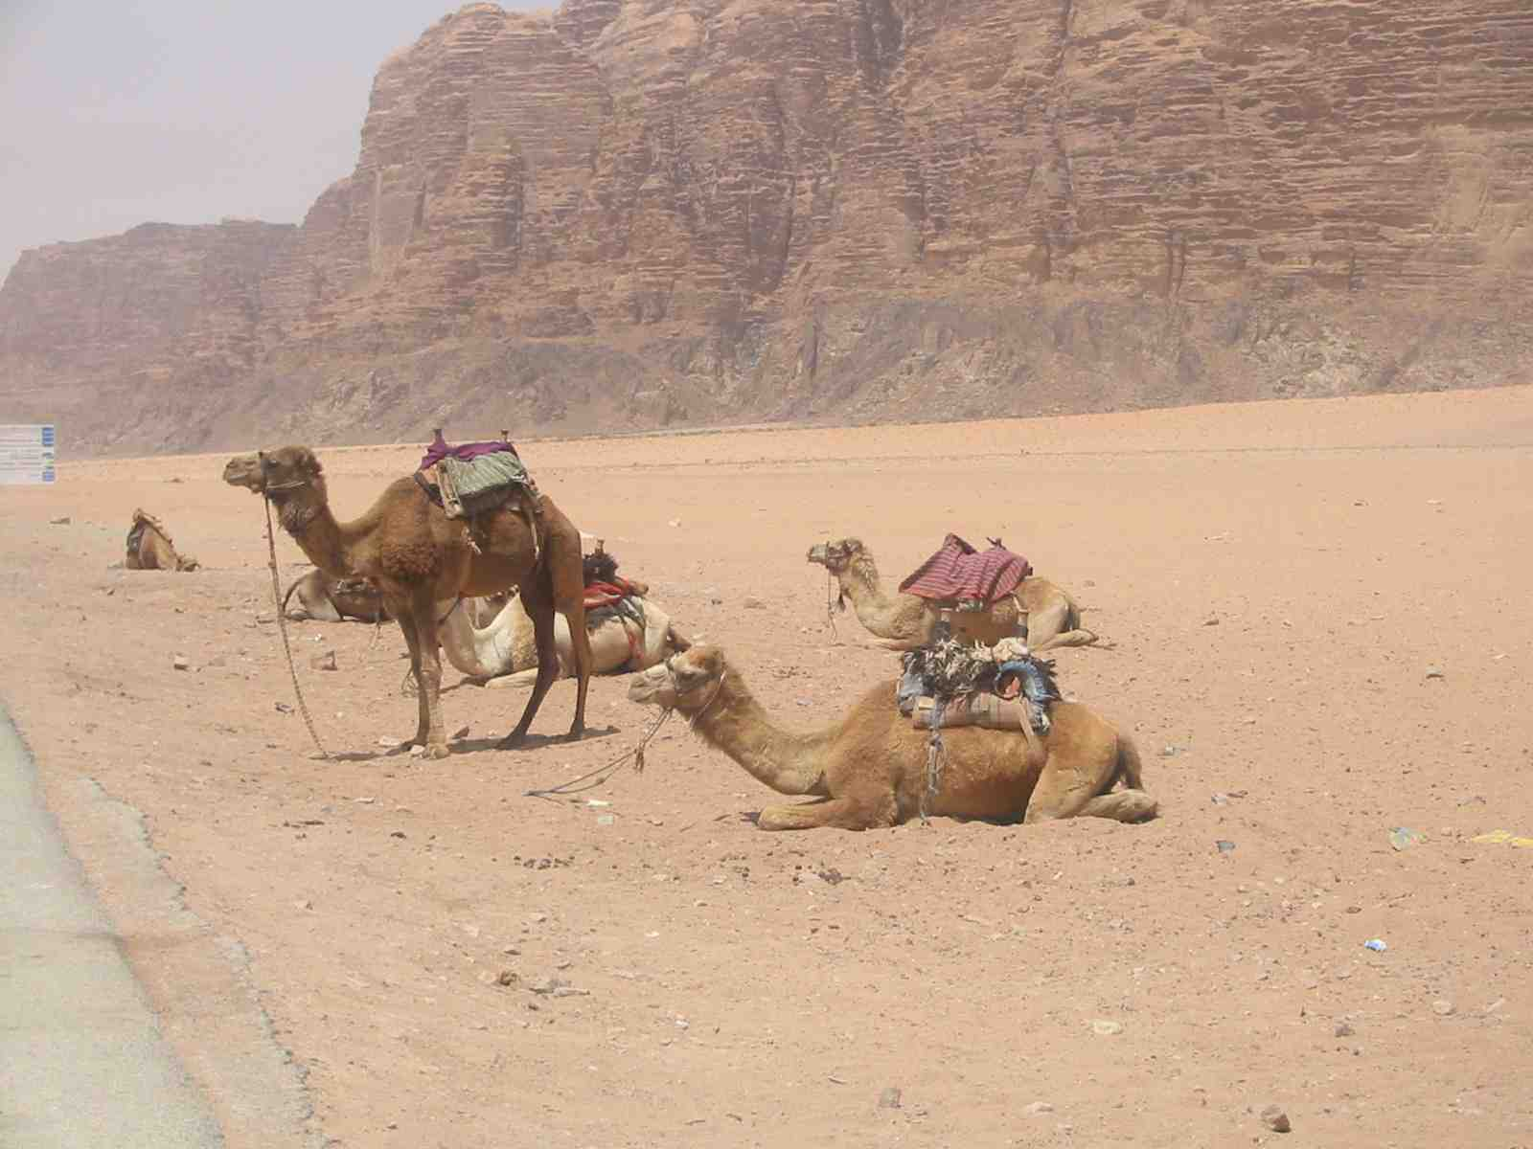
CAMELS!

Slide 8
THE ARABIAN PENINSULA
Mecca was along the trade routes, and traders would stop at the Ka’aba, adding idols to be worshipped along with many gods and spirits.
Monotheism also existed in the area – Arabic Christians and Jews worshiped one God.
God = Allah (Arabic) = Eluhim (Hebrew) = El (Aramaic)

Slide 9
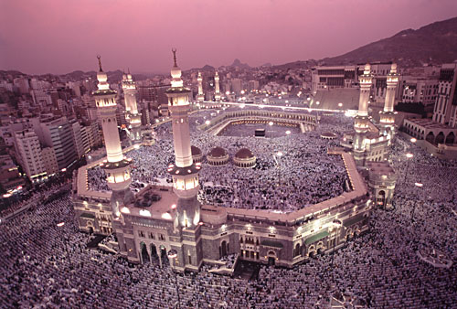
MECCA TODAY

Slide 10
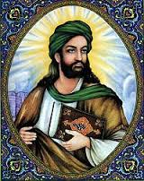
MUHAMMAD
Born in Mecca around 570AD; little is known of his early life
He had no formal education- he was an illiterate caravan worker and camel driver
Worked as a trader for a wealthy widow caravan owner, Khadijah, and at age 25, they married
Notes:
Parents were not poor, born into a prominent clan of Quraysh tribe in a Bedouin encampment where he spent the first 6 years of his life
Father died before he was born and mother died shortly after his birth, adopted by his uncle.

Slide 11
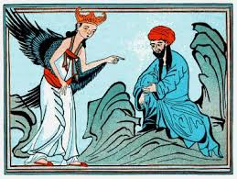
MUHAMMAD
Muhammad became distressed with the idol worship of Arabs, so he began to fast and meditate about the fate of his people.
At about 40, Muhammad heard the voice of the Angel Gabriel telling him that there was only one Lord, Allah.
Muhammad believed he was the last and the greatest in a series of prophets of Allah, starting first with Abraham and including Moses and Jesus. (Muhammad=“The Prophet”)

Slide 12
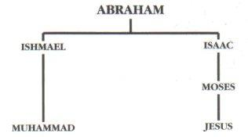
ABRAHAMIC RELIGIONS
Muhammad is a descendant of Abraham, and his beliefs are based on Abraham’s prophecy.
Judaism, Christianity, and Islam are all Abrahamic faiths, and the “God” is the same

Slide 13
THE DOME OF THE ROCK
In Jerusalem – oldest standing Islamic monument
Spot where Abraham prepared to sacrifice his son Isaac to God, and Muhammad ascended to heaven to learn Allah’s will

Slide 14
MUHAMMAD SPREADS ISLAM
Muhammad began to preach Islam in 613 CE, but was met with hostility and rejection in Mecca, because many thought it would hurt Mecca as a trading and pilgrimmage center.
Muhammad left Mecca in 622 CE and began the Hijrah, or “flight” to Yathrib, which was renamed Medina. This is year 1 in Muslim calendar.
There, he joined Arabs, Muslims and Jews together into one community, or “umma” and served them as a political, religious and military leader.

Slide 15
MUHAMMAD SPREADS ISLAM
In 630, Muhammad led 10,000 followers to Mecca
Many Meccans converted to Islam and join the umma.
Muhammad dies 2 years later in 632 at age 62.
After his death, Muhammad’s revelations were written in Arabic and collected the Qu’ran, the holy book of the Muslims, seen as a sequel to the Torah and Gospels

Slide 16
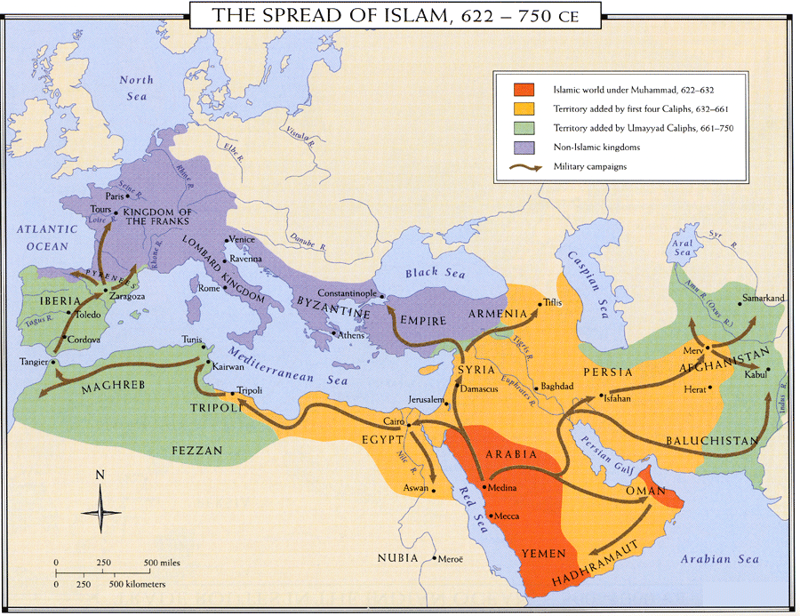

Slide 17
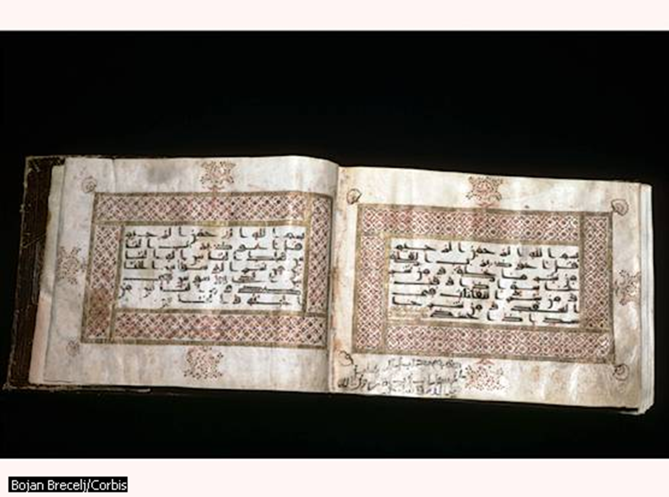
THE QU’RAN
Arabic is the language of the Qu’ran, and only Arabic is the true word of Allah, used to unite and control later conquered peoples.
8TH CENTURY QU’RAN

Slide 18
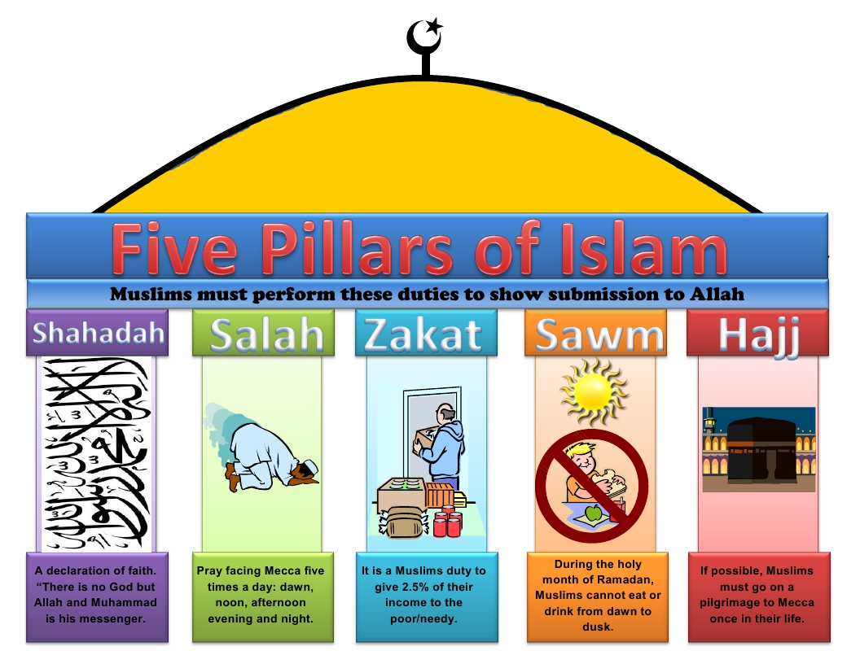
MUSLIM WAY OF LIFE
May not drink alcohol or eat pork
No priests or central religious authority – worship Allah directly
Ulama – scholar class of religious teachers who apply Muhammad’s teachings to everyday life.
Must follow the Five Pillars:
FAITH
PRAYER
ALMS
FASTING
PILGRIMMAGE (HAJJ)

Slide 19
THE END (OF THE BEGINNING)
BUT HOW DOES IT SPREAD TO THE ENTIRE WORLD…

Slide 20
THE BEGINNING (OF THE REST)
HOW ISLAM STARTS TO SPREAD TO THE ENTIRE WORLD…

Slide 21
AFTER MUHAMMAD’S DEATH
The umma must select a new leader, since Muhammad had no son for an heir
One group felt that Ali, Muhammad’s son-in-law and closest male relative should become Islam’s leader (follows Bedouin traditions)
Another group wanted more experience and supported Abu-Bakr, Muhammad’s friend, father-in-law and a military leader

Slide 22
4 RIGHTLY GUIDED CALIPHS
Abu-Bakr is chosen as the First Caliph (“deputy” of the Prophet), and this causes a split
Those who supported Abu-Bakr later become known as the Sunni sect of Islam
Those who wanted Ali (and later his son Husain) later become the Shi’a sect of Islam (now known as Shiite)
Abu-Bakr fought against Bedouin tribes who wanted to break away from the umma and maintained unity through military conflict

Slide 23
4 RIGHTLY GUIDED CALIPHS
Umar ibn al-Khattab became the Second Caliph after Abu-Bakr’s death
Umar maintained unity by dividing the spoils of war from outsiders among the umma
Umar spreads Islam to present-day Egypt, Syria and Iraq.
These are not religious wars for Islam, but a way to promote and maintain unity among Bedouins.

Slide 24
4 RIGHTLY GUIDED CALIPHS
Uthman ibn Affan is elected Third Caliph
Uthman spreads Islam through Egypt and into Northern Africa
Uthman’s family, the Umayyads, originally opposed M long ago, and some members of the umma resented him.
Uthman is assassinated in 659 CE, contributing to growing tensions

Slide 25
4 RIGHTLY GUIDED CALIPHS
Ali ibn Abi Talib becomes the Fourth Caliph
Ali is Muhammad’s cousin and the second person ever to convert to Islam
Conflict arose between Ali and Uthman’s family, led by Mu’awiyah, the Muslim governor of Syria.
Ali tried to resolve the conflict with diplomacy, not warfare, and ultimately was stabbed to death in 661 CE.

Slide 26
4 RIGHTLY GUIDED CALIPHS
ISLAMIC CALENDAR | CALIPH | GREGORIAN CALENDAR | MAJOR DEVELOPMENTS
11-13 AH | Abu-Bakr | 632-634 CE | Fought Bedouin tribes that tried to break away and maintained unity through military conflict
13-23 AH | Umar | 634-644 CE | Fought outsiders and expanded Islam to Egypt, Syria and Iraq
23-35 AH | Uthman | 644-656 CE | Spreads Islam through Egypt and into N. Africa
35-41 AH | Ali | 656-661 CE | Conflict arises between Ali and Umayyads, leading to two sects of Islam

Slide 27
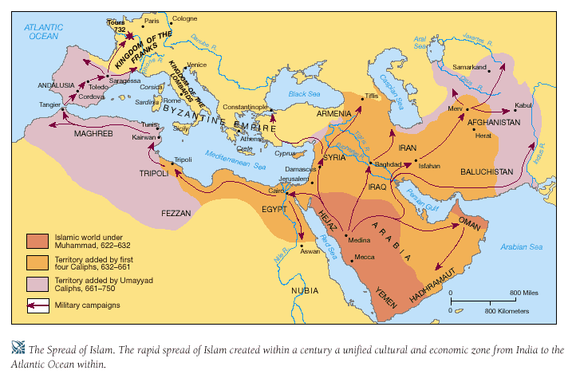
SPREAD OF ISLAM

Slide 28
WHY ISLAM SPREAD RAPIDLY
Abu-Bakr invoked jihad, or “striving,” to encourage the expansion of Islam
The Bedouins had superior military skills, creating a strong army

Slide 29
WHY ISLAM SPREAD RAPIDLY
The Persian and Byzantine Empires were weak foes
Non-Christians (Byzantine) and non-Zorastrians (Persian) were persecuted in their empires and welcomed the Islamic invaders
Islam’s message of equality had wide appeal among the people it spread to.

Slide 30
WHY ISLAM SPREAD RAPIDLY
Conquered peoples could maintain their own religion, but had to pay a poll tax to avoid military duties – created a strong economic base
Those who converted to Islam avoided the poll tax – added incentive

Slide 31
EFFECTS OF ISLAM’S SPREAD
When Islam expanded, the old trade networks of the Classical Period were revived between Africa and Eurasia
Centers of learning flourished in Cairo, Baghdad and Cordoba in Spain

Slide 32
EFFECTS OF ISLAM’S SPREAD
Arabic becomes the shared language of Muslims
Mecca becomes the “international” city where Muslims from across Eurasia and Africa come together and exchange information and cultural traditions

