Slide 1
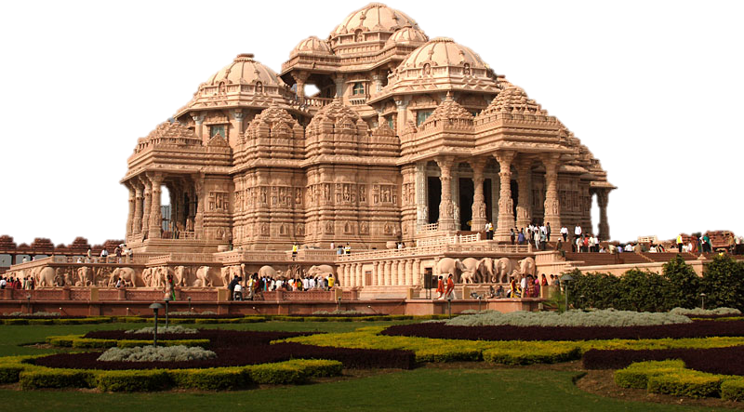

Slide 2
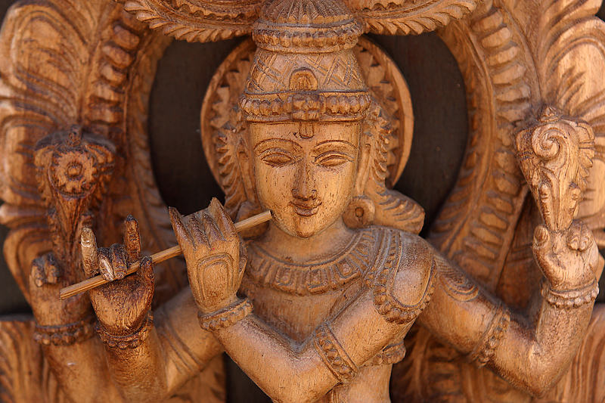
Hinduism Definition: a way to liberate its followers from illusions and mistakes of everyday life

Slide 3
Aryans and the Vedic Age
Aryans invade India, bring sacred scriptures that are first sung then later written in Sanskrit.
Vedas are books of prayer, song, stories, etc.
tried to explain how a person could achieve liberation from desire and suffering.

Slide 4
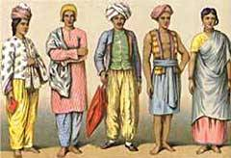
Caste System
A social hierarchy from the Aryans and formalized with laws
“Caste” –Portuguese for lineage or race
In society:
varna (caste) = social class or level
Varna – “Color” in Sanskrit
varnas decide marriage, job, neighborhood, etc.

Slide 5
Caste System
In belief:
Actually 2 concepts – Varna and Jati. 4 Varnas (class level based on temperament) and hundreds of Jatis (based on occupation)
Varnas –
Brahmin: study/teach;
Kshatriya: power/protect;
Vaisya: earn/give;
Sudra: serve
Jati – born into, no mobility. Farmer, barber, shepherd, etc. (occupation)

Slide 6
Varnas in belief:
Brahmins (priests)
Kshatriyas (warriors)
Vaisyas (merchants)
SHOWS SIZE
Sudras (laborers)

Slide 7
Caste System
Pariahs – outside varnas
“untouchables”
given “impure” jobs (grave diggers, trash collectors)

Slide 8
Caste System in Society
Brahmins (priests)
Kshatriyas (warriors)
Vaisyas (merchants)
SHOWS POWER
Sudras (laborers)
Pariahs (untouchables)

Slide 9
Beliefs
dharma = duty
Purpose in life is to follow dharma and perform duty
Include ethical values and obligations
karma = how you live this life determines what you will be in the next
live a good life and fulfill your dharma
Samsura (reincarnation) = rebirth of the soul – until one reaches Moksha

Slide 10
Reincarnation Cycle
Material
Desires
Selfish
Actions
Merits
& Sins
Death
Rebirth
Soul
Good
Neutral
Bad

Slide 11
Moksha
The goal is to reach moksha
(The state of perfect understanding of all things – may take several lifetimes)
= soul breaks free of material world. Free from the cycle of reincarnation.
person
Atman (soul)
body

Slide 12
Gods
All gods are concrete forms of the brahman (“big”)
important gods
Brahma – creator
Vishnu – preserver
Shiva – destroyer
Possibly up to 330 million gods, or only 1

Slide 13
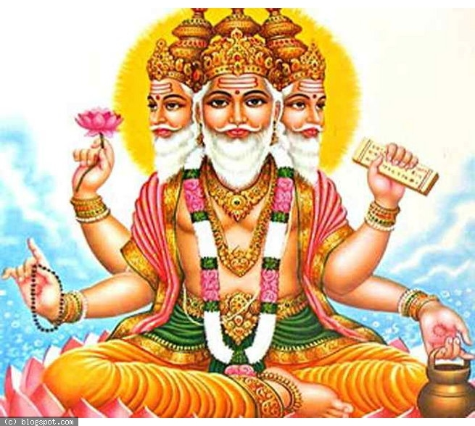
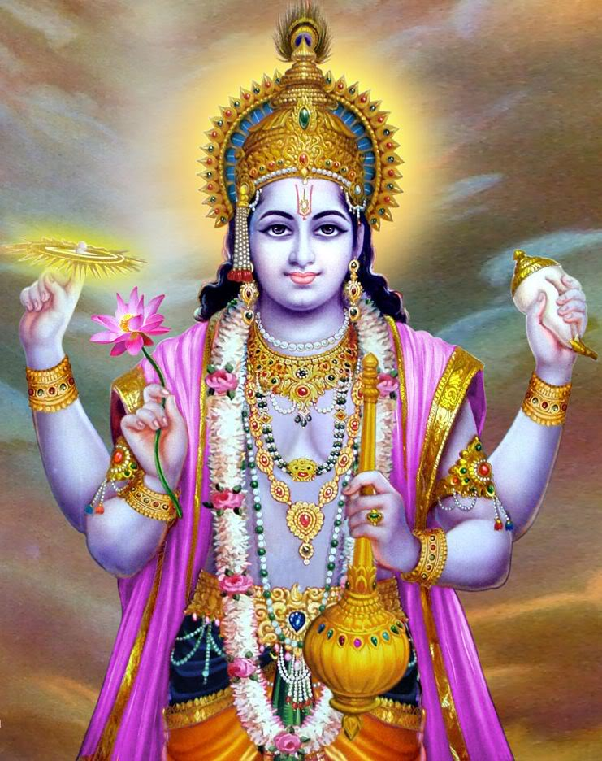
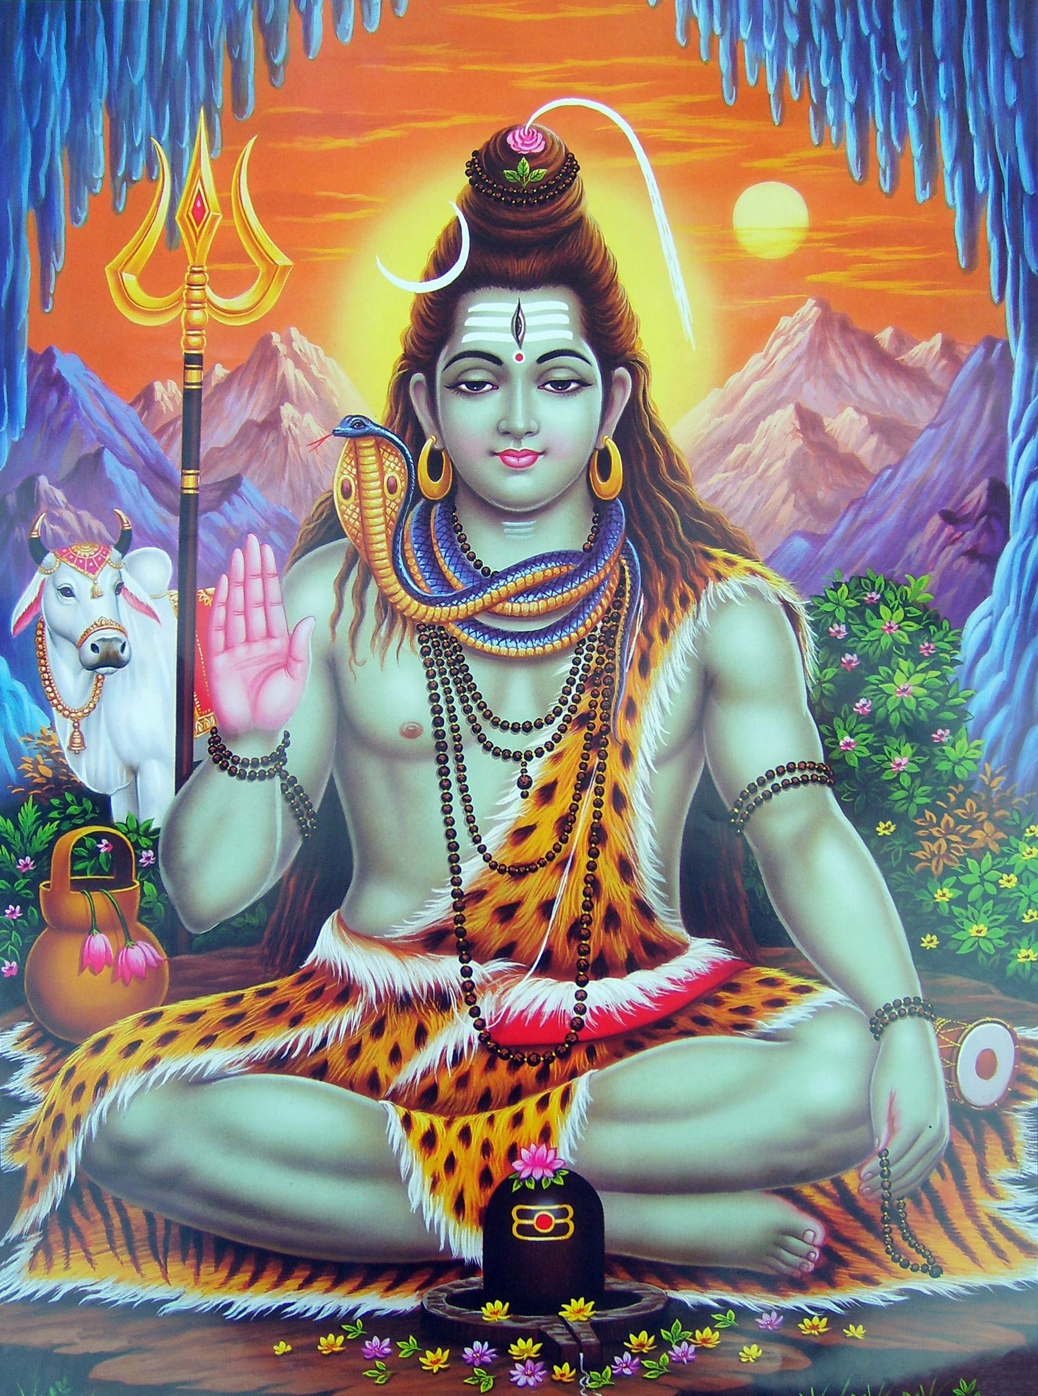

Slide 14
The River Ganges
The Ganges river flows from the Himalayas to the Bay of Bengal.
To the Hindus the Ganges is a goddess known as Mother Ganga.
Each Hindu seeks to make a pilgrimage to the river and bath in the holy waters.
When Hindus die many have their bodies burned along the banks of the river and then have the ashes spread in the river.

Slide 15
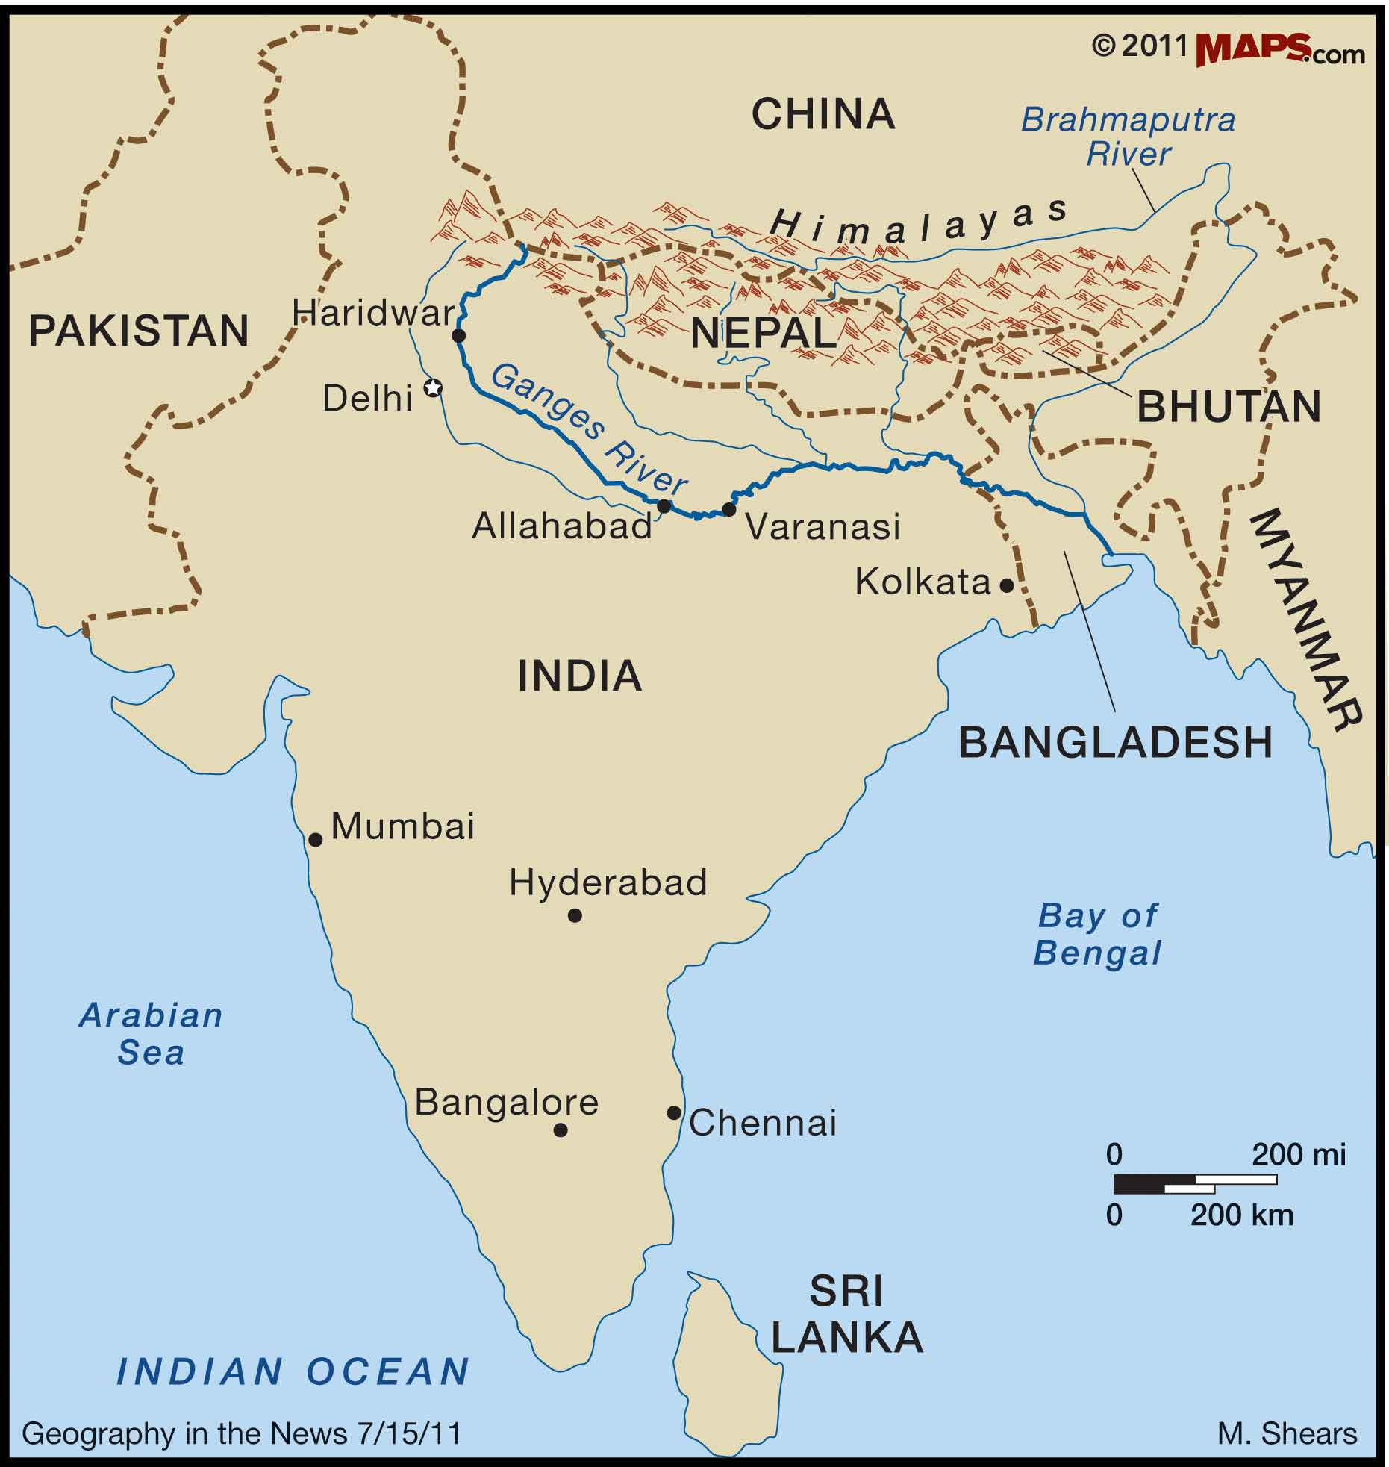

Slide 16
