Slide 1

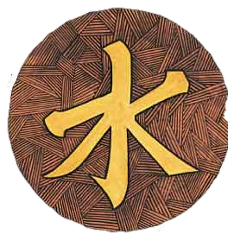

Philosophies of The Shang and Zhou Dynasties

Slide 2
Political
Shang Dynasty 1700 – 1027 BCE
  dynasty = ruling family
  first to leave written records
Zhou Dynasty 1027 – 256 BCE
  feudalism – nobles control lands
  dynastic cycle – rise of fall of rulers caused by invaders and warring nobles

Slide 3
Religion
During Zhou Dynasty royal authority comes from heaven – “Mandate of Heaven”
If something bad happens, for example a flood or poor crops, then nobles would see this as a reason to overthrow the ruling dynasty or king

Slide 4
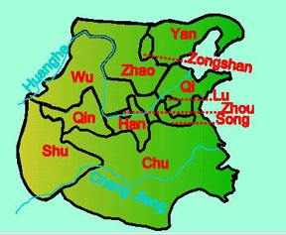
Social Structure
In response to the “the warring states period” scholars and philosophers developed solutions to restore the the values of harmony, social order, and respect for authority.
The Warring States Period of Ancient China
480 BCE to 221 BCE

Slide 5
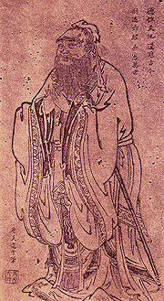
Social Structure
Confucianism
  Confucius (551 – 479 BCE)
  Social order, good government,
  and harmony
  5 Relationships
    Ruler & People
    Father & Son
    Husband & Wife
    Older Brother & Younger Brother
    Friend & Friend
filial piety – respect for parents

Slide 6
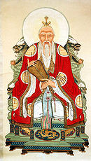
Social Structure
Daoism (Taoism)
  Live simply and in harmony with
  Nature
  - Follow “the way”
Legalism
  Highly efficient & powerful government is required to restore order in society.
  Used harsh punishment
  Controlled peoples ideas and actions
Founder -Laozi

Slide 7
Religion
yin and yang
  balance of two forces
  yin = Earth, darkness, female, cool, wet
  yang = Heaven, light, male, warm, dry

Slide 8
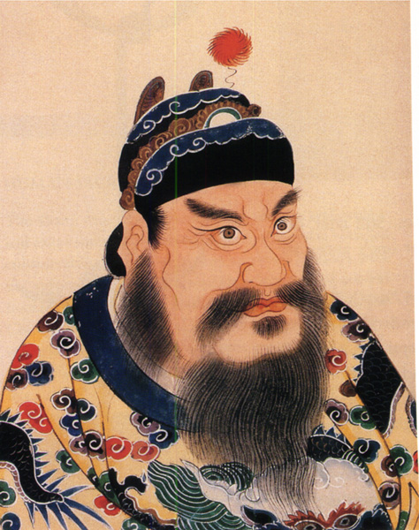
Qin Dynasty
Ruler Shi Huangdi was a tyrant
Ruled using Legalist ideas
Murdered Confucian scholars
Unified China
Built 4000 miles of roads
Built Great Wall of China
  Millions died building it
Dynasty lasted only 20 years (202 BCE)
  Peasants revolt and HAN Dynasty is born

