Slide 1
Rome: Republic to Empire

Slide 2
Geography of Rome
Rome was built on seven hills on a curve of the Tiber River.
Rome is situated half way between the Alps to the north and the southern tip of Italian peninsula.
The city is also located near the center of the Mediterranean Sea.

Slide 3
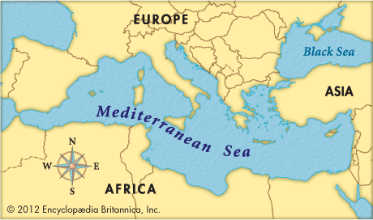

Slide 4
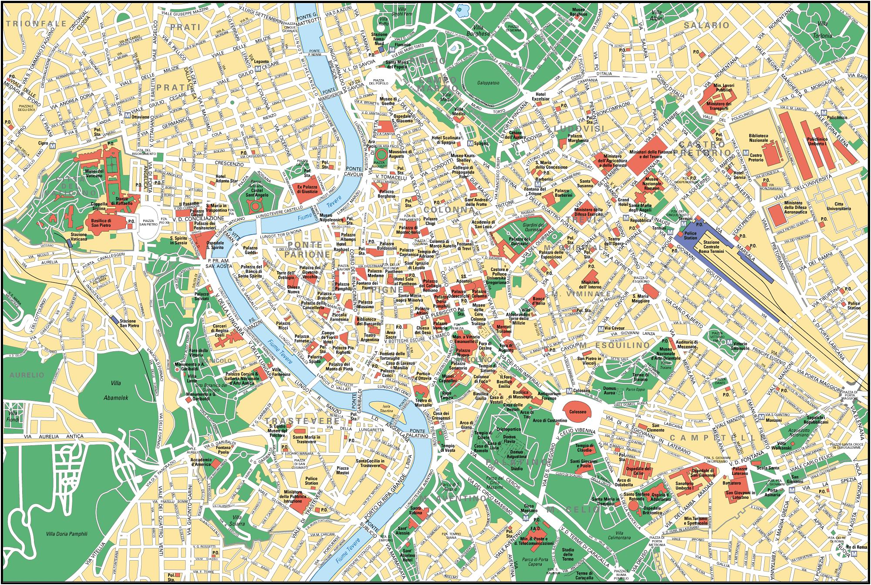

Slide 5
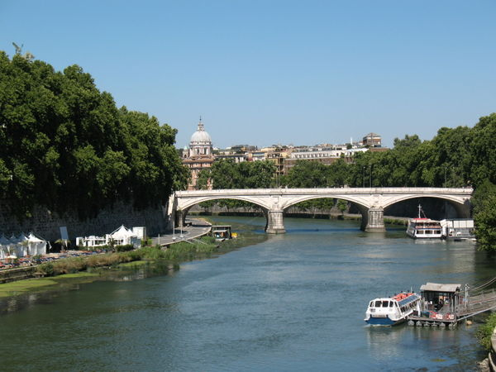

Slide 6
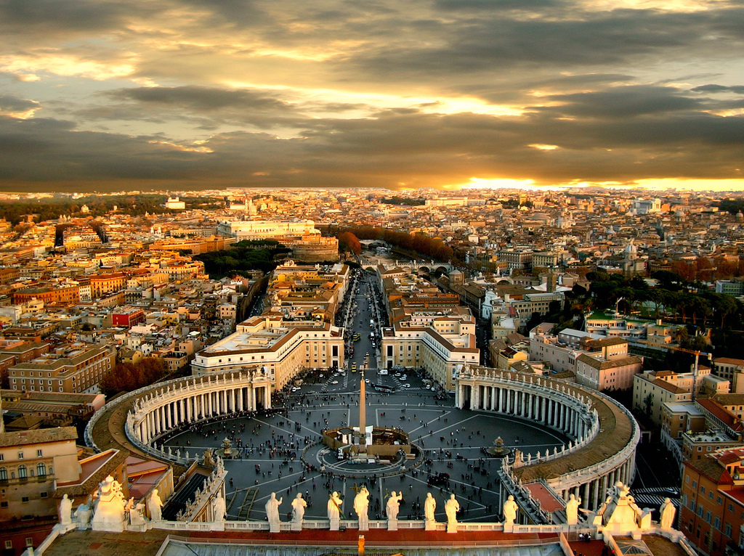

Slide 7
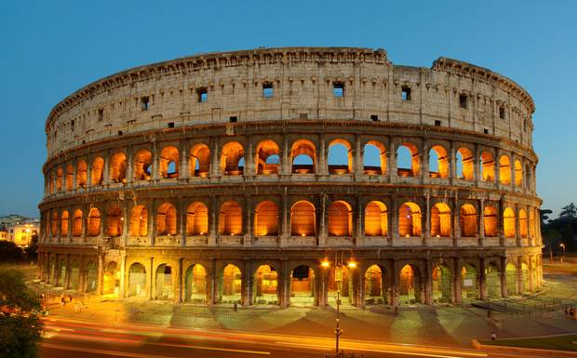

Slide 8
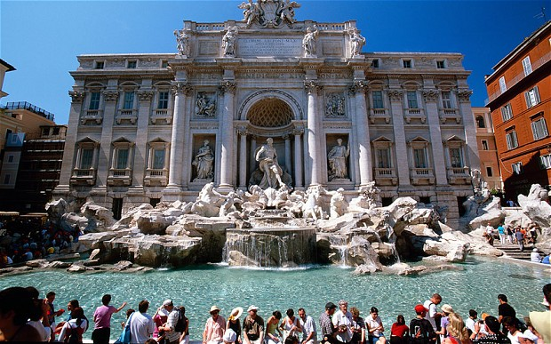

Slide 9
The Early Republic
Around 600 B.C. Rome was unified into one city that covered nearly 500 square miles.
The last king of Rome, Tarquin the Proud, was ousted from power in 509 B.C.
Shortly after Romans declared that no king would rule Rome again and created a republic.
Only free-born males would be granted Roman citizenship and voting rights.
Early on two groups coveted power: the Patricians and the Plebeians.
The Patricians: wealthy land owners that had most of the power
The Plebeians: common farmers , artisans, and merchants that made up the majority of the populations. Elected representatives called tribunes.

Slide 10
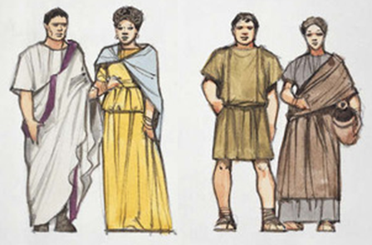

Slide 11
Government in the Republic
In 451 B.C. Rome’s laws were officially written down on 12 tablets and placed in the Forum
Forum was the center of Roman political life:
Two officials called consul commanded the army and directed the government. Their term was only 1 year and they could not be reelected for another ten years.
They could veto the others decision.
The Senate was a 300 member assembly that made decisions regarding foreign and domestic policy.
At first the Senate was made up of only patricians but later Plebeians were allowed to join.
The Roman army was organized into units called legions. Service was mandatory if you owned land or wanted to seek certain public offices.

Slide 12
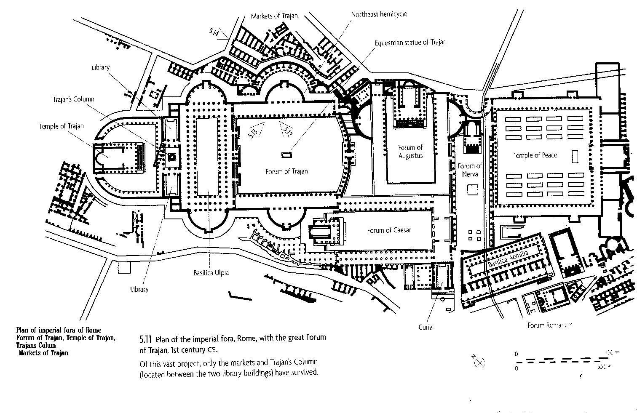

Slide 13
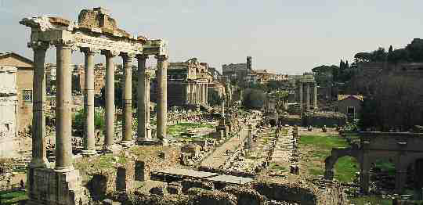

Slide 14
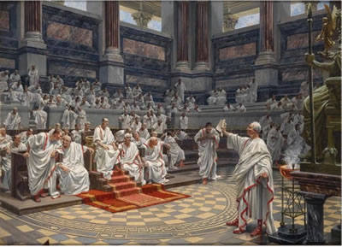

Slide 15
Rome’s Influence Grows
By 265 B.C. Rome had conquered nearly all of the Italian peninsula and incorporated conquered peoples into Roman life.
Because of Rome’s location on the Mediterranean Sea, Rome had an extensive trade network.
From 264 B.C.- 146 B.C. Rome and Carthage, a city-state in north Africa, fought a series of wars known as the Punic Wars.
During the Second Punic War a Carthaginian named Hannibal tried to take Rome but failed even though he inflicted heavy loss on the Romans.
The Third Punic War saw Rome defeat Carthage for good in 146 B.C. and become masters of the western Mediterranean Sea.

Slide 16
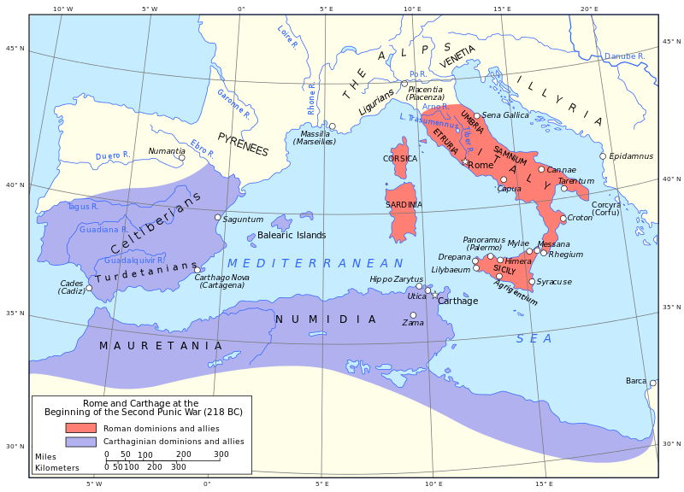

Slide 17
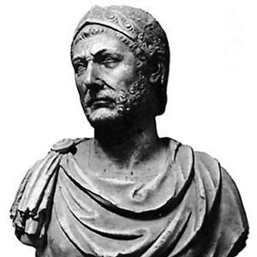

Slide 18
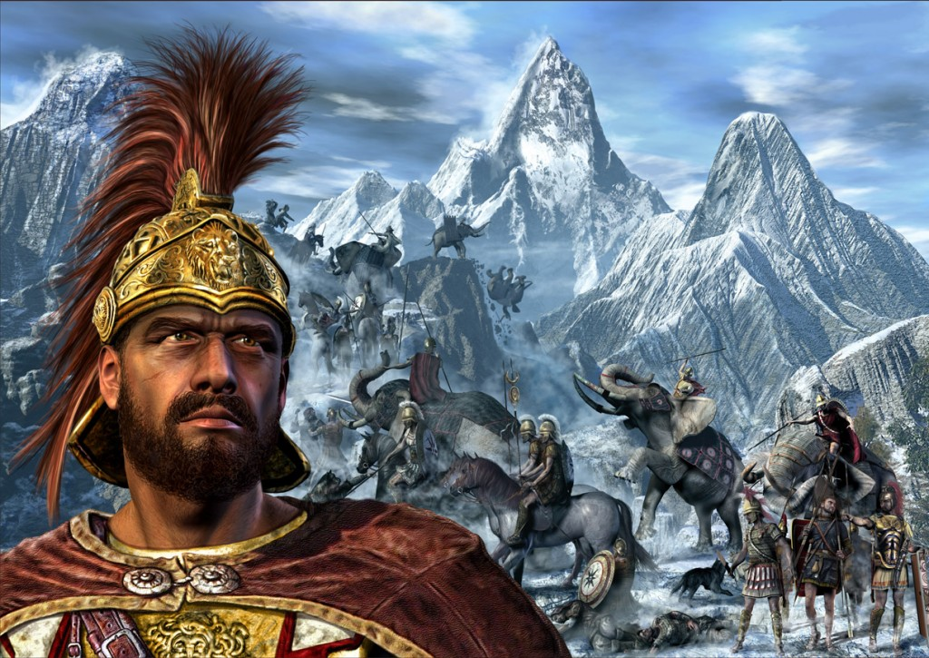

Slide 19
The Republic Collapses
As Rome grew in size the gap between the rich and the poor became larger.
Many farmers were left jobless and homeless.
The Army was no longer loyal to the Republic. Generals amassed large numbers of soldiers who owned their allegiance to their commander not the Republic.

Slide 20
Caesar Takes Control
Caesar was a very popular general. He was a consul along with his friend Pompey. After leaving consul he declared himself governor of Gaul (present day France).
While there he fought for 8 years (58 – 50 B.C.) to defeat all of Gaul. By doing this he gain tremendous from the people of Rome except for the Senate and Pompey, now his rival.
He was ordered to disband his army and return home by the Senate and Pompey in 50 B.C.
He refused and instead with his army crossed the Rubicon River and marched on Rome. He defeated Pompey and in 46 B.C. was named dictator of Rome and two years later named dictator for life.
He instituted many reforms such as granting citizenship to many outside of Italy.
In 44 B.C. he was assassinated by several Senators including Marcus Brutus.

Slide 21
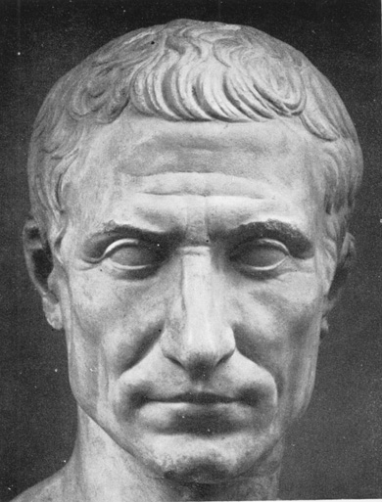
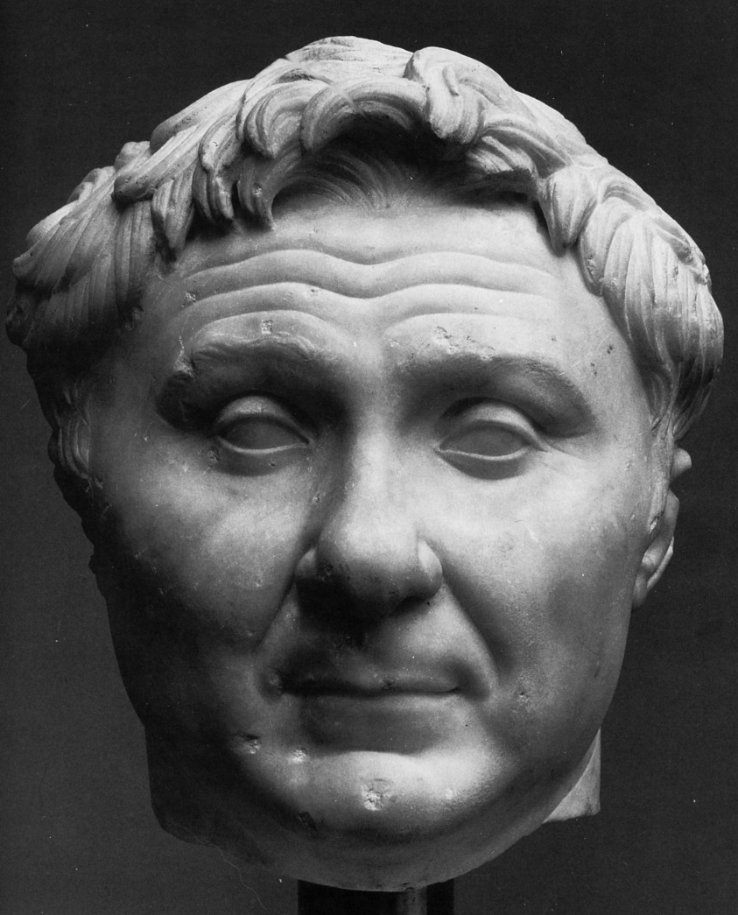
V.

Slide 22
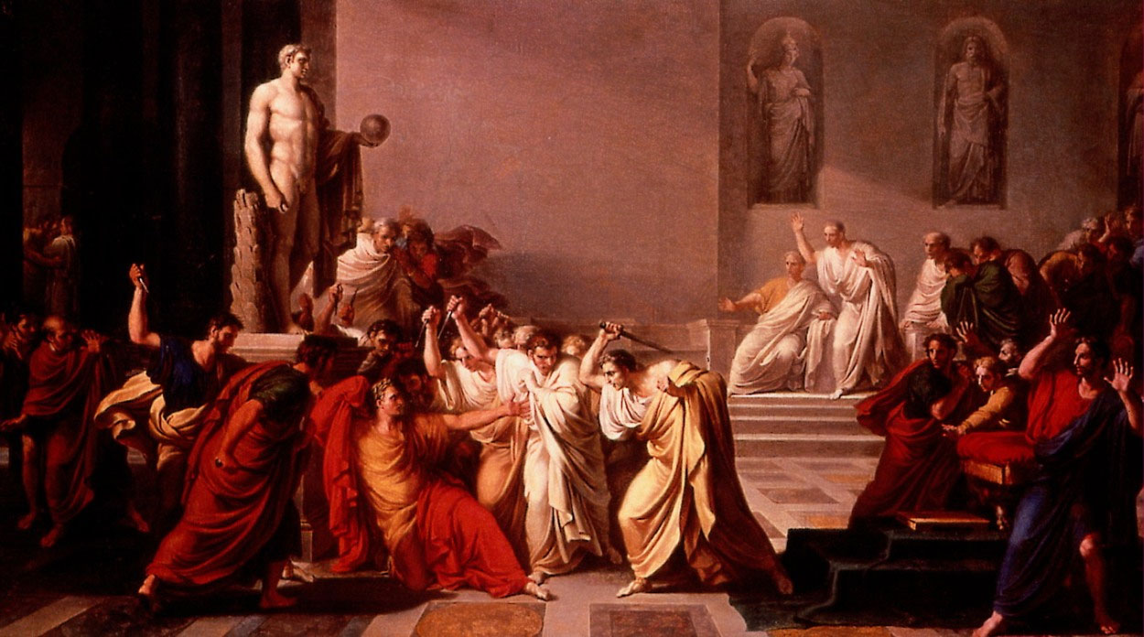

Slide 23
An Empire Begins
In 43 B.C. Octavian, Mark Antony, and Lepidus took control of Rome and ruled as a triumvirate.
Octavian soon pressured Lepidus to retire and He and Mark Antony fought for control of Rome.
Mark Antony met the Queen Cleopatra of Egypt and together they tried to defeat Octavian but failed.
Octavian became the ruler of Rome and took the name Augustus meaning “exalted one”. Rome was now an empire.

Slide 24
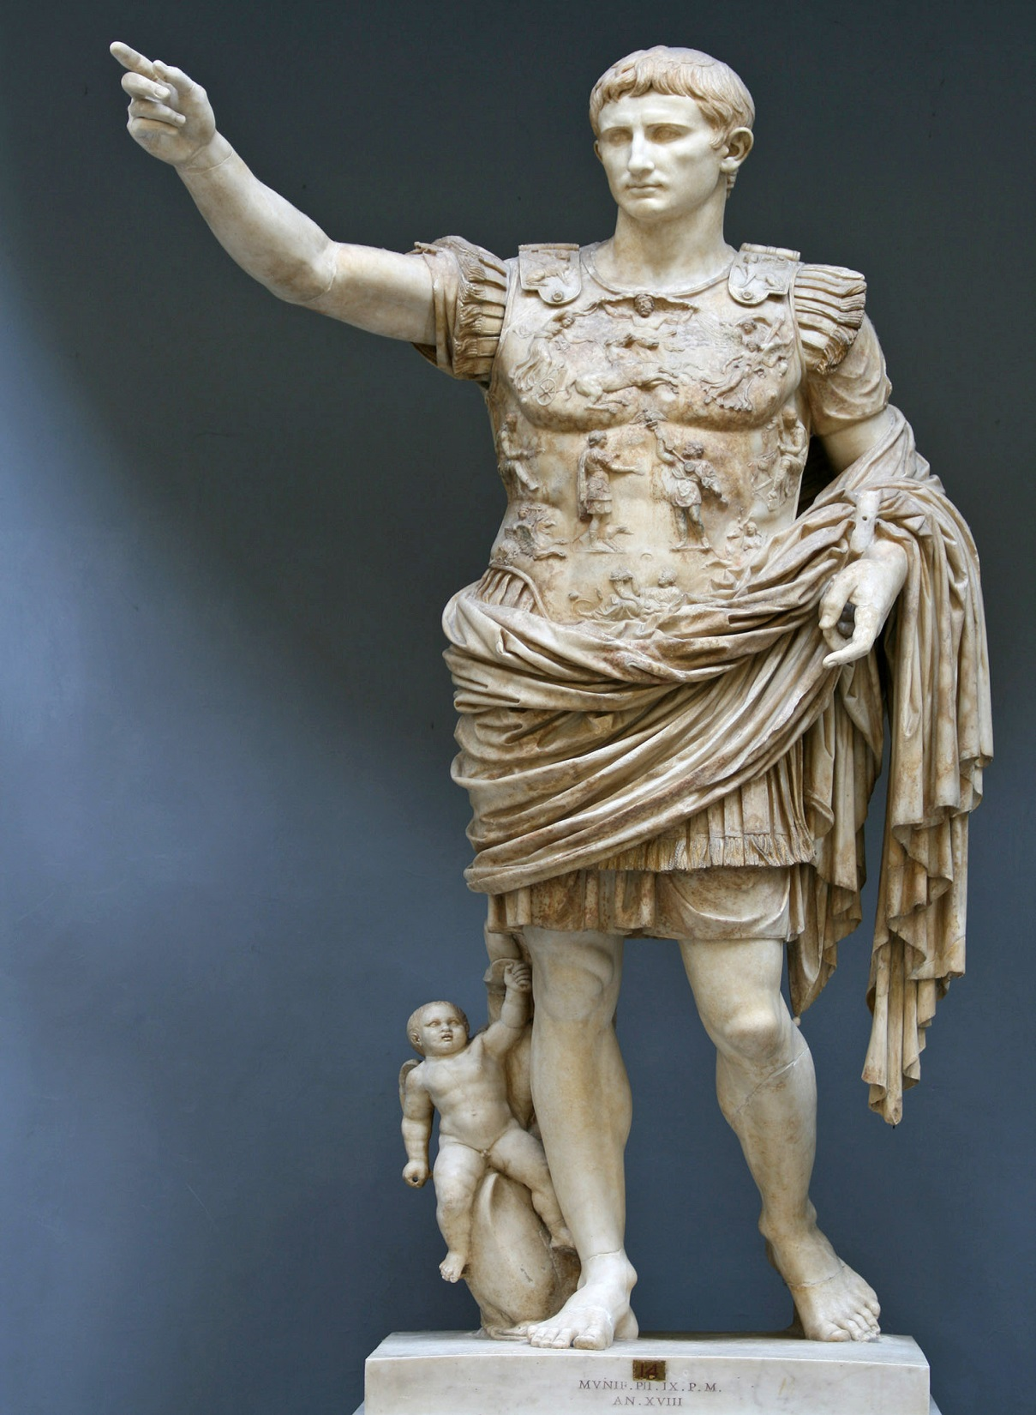

Slide 25
Roman Life and Culture
For 207 years peace reigned throughout the empire during a period known as the Pax Romana or “Roman Peace”.
By the second century A.D. the Roman Empire stretched from Spain in the west to India in the east and African in the south to Britain in the north.
Agriculture was the most important industry.
Slavery was an important feature of everyday life in Roman society.
Gods and Goddesses were linked to the government and include Jupiter (father of the gods), Juno (his wife), and Minerva (goddess of wisdom and arts).

Slide 26
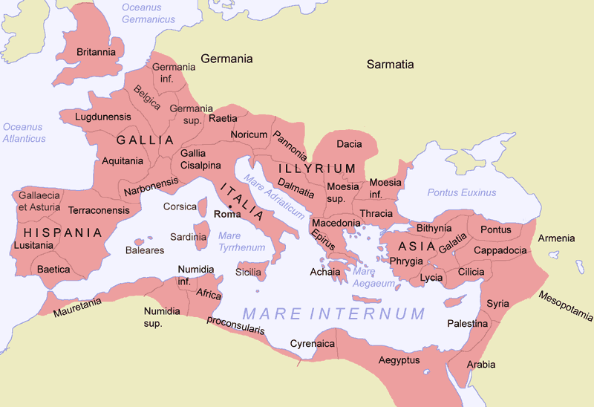

Slide 27
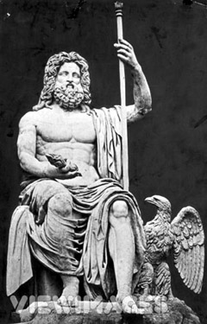

Slide 28
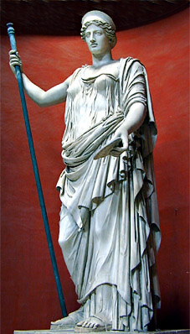
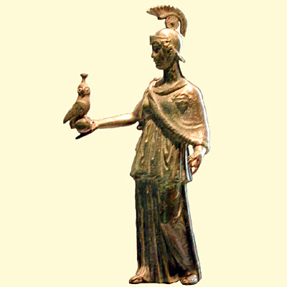

Slide 29
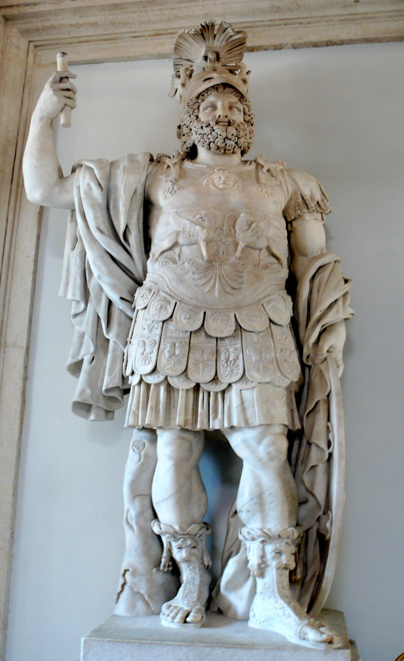

Slide 30
Christianity and the Empire
Due to the size of the empire there were many religions but none were more important that of the Roman gods.
In A.D. 70 Roman officials put down a Jewish rebellion and destroyed the temple in Jerusalem.
Christianity spread quickly throughout the Roman Empire; however it posed a serious challenge to the Roman rulers.
Christians were persecuted for not worshiping Roman gods. Many were crucified, burned, banished, or offered up in the circus arenas.

Slide 31
By the second century A.D. millions of Christians lived in the empire and the religion appealed to many different groups.
In A.D. 312 Constantine was fighting for control of the empire. Before a battle he asked for divine help and had a vision of a cross. He had the cross painted on the shields of his soldiers and won the battle.
In A.D. 313 Constantine issued the Edict of Manila that put an end to the persecution of Christians and welcomed them into the empire.
In 380 the emperor Theodosius made it the official religion of the empire.

Slide 32
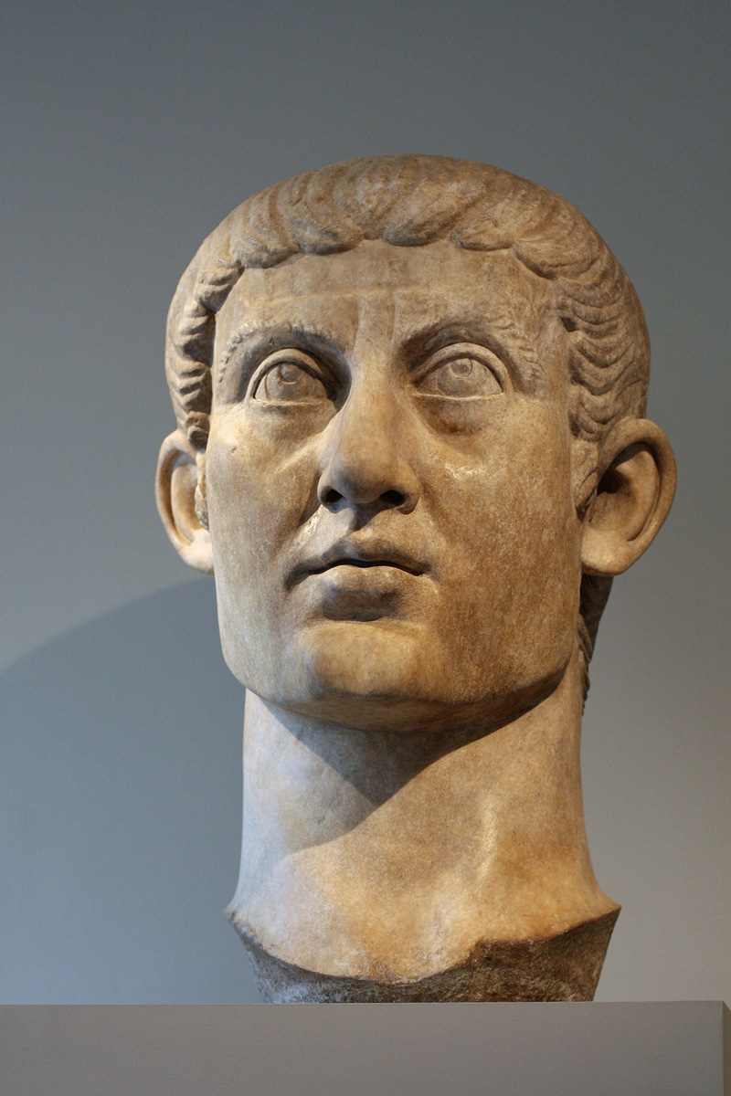

Slide 33
