Slide 1
The Middle Ages

Slide 2
The Start of the Middle Ages
In the 5th century (400s) Germanic tribes invaded and overran the western half of the Roman Empire.
The collapse of the western Roman empire changed the economy, government, and culture.
There was a disruption of trade, a downfall of the importance of cities, and the population Europe became more rural.
As the population shifted to rural areas there was a sharp decline in learning.

Slide 3
Only priests and other church officials were literate.
The Latin language was no longer spoken and understood but new languages such as French and Spanish emerged.
Governments changed: people were now loyal to a chief (lord) rather than public government and written law.

Slide 4
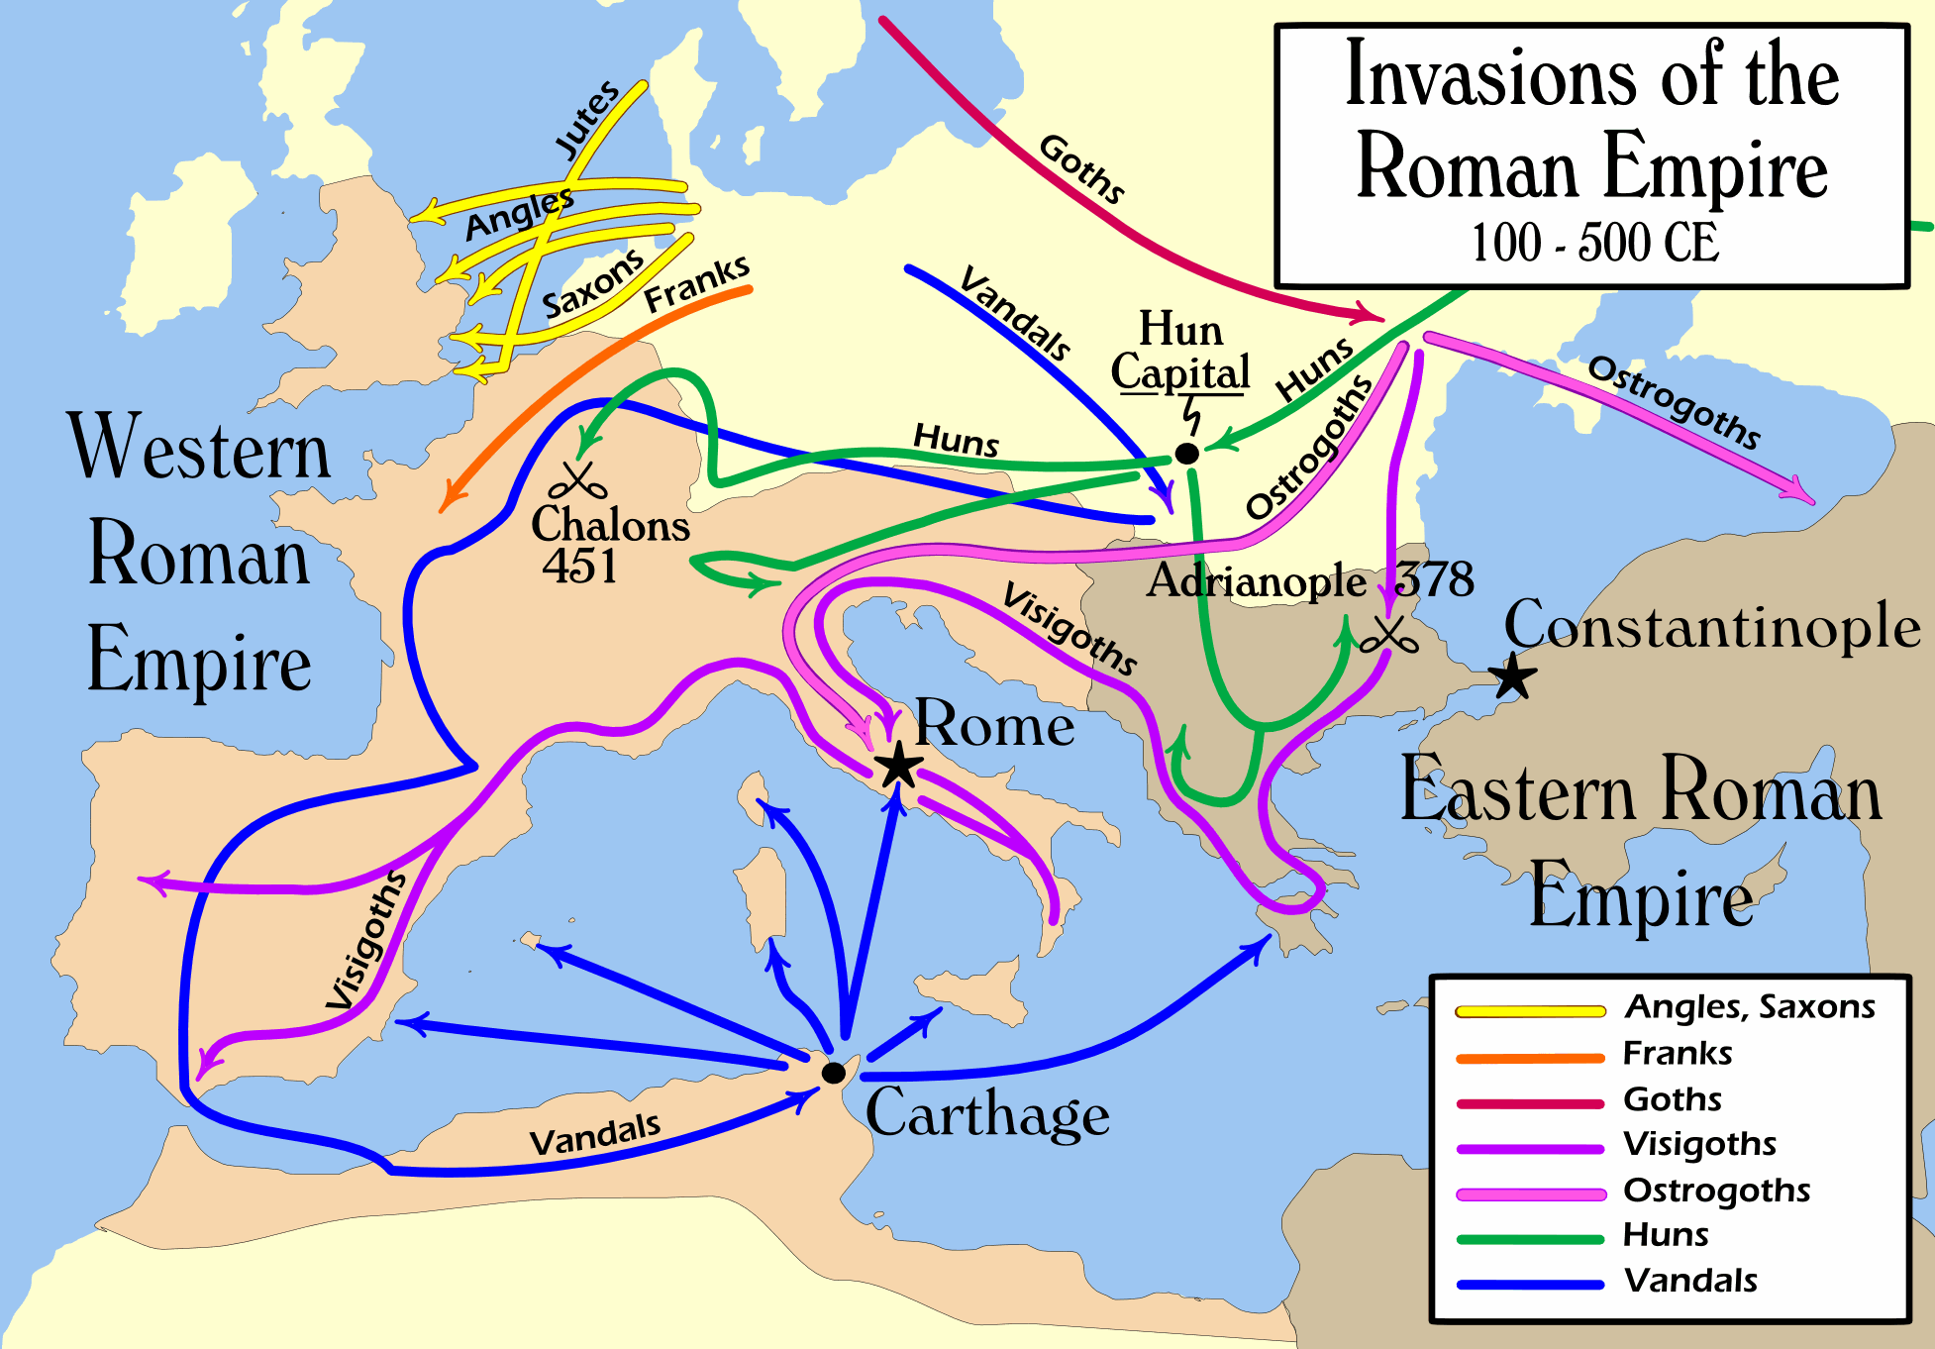

Slide 5
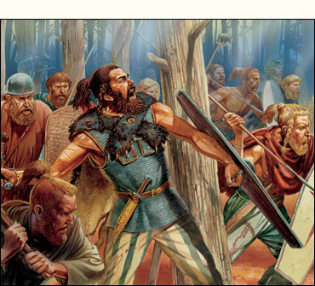

Slide 6
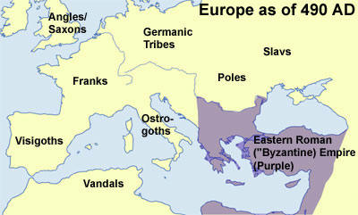

Slide 7
Spread of Christianity
Germanic peoples were pagan.
As the Roman people spread so did the Christian faith.
Under the leadership of the Frankish leader Clovis Christianity began to spread to the Germanic people.
Monasteries were built to bring the Christian faith to new groups. Monks and nuns lived worked in the monasteries which became centers for learning.
In 732 the spread of Islam was stopped at the Battle of Tours.

Slide 8
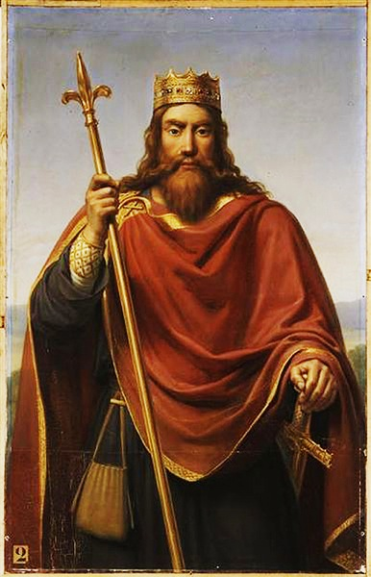

Slide 9
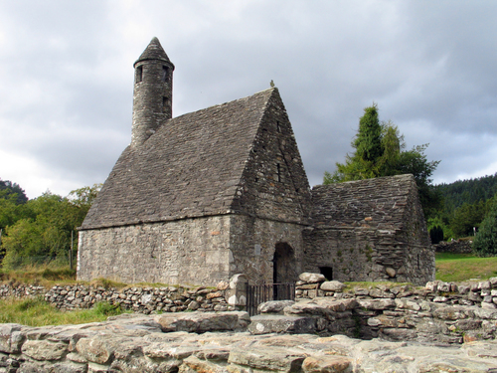
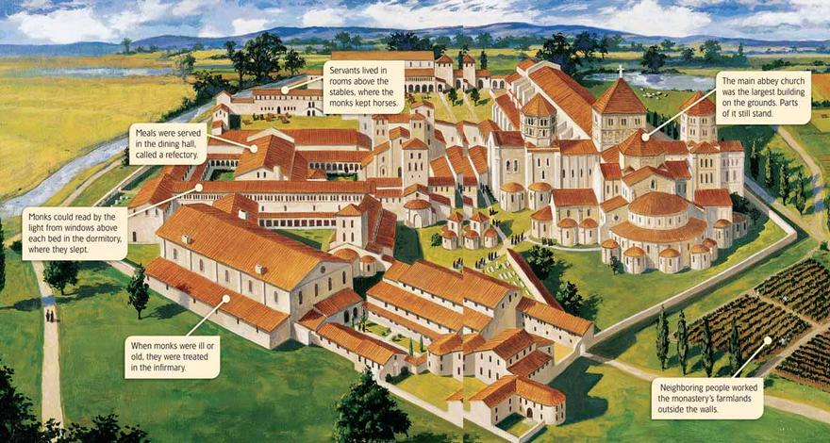

Slide 10
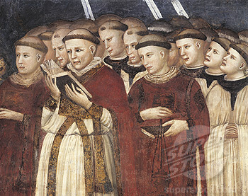

Slide 11
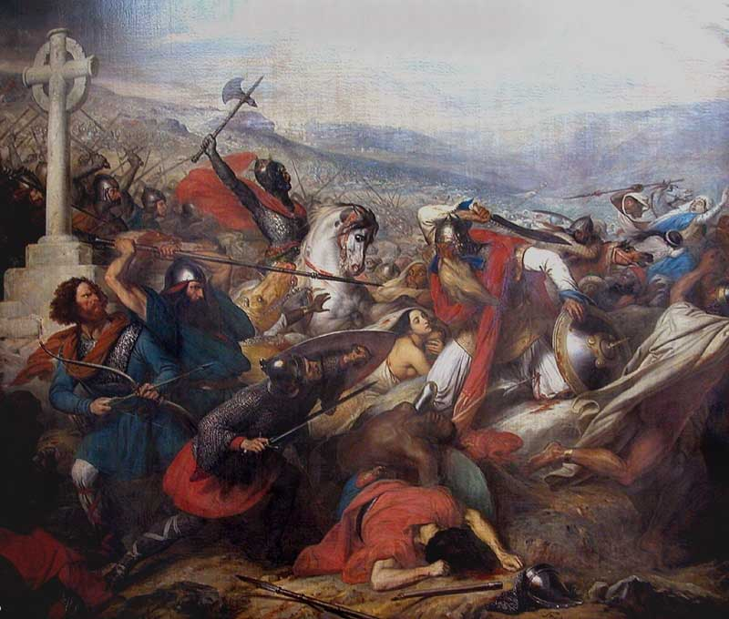

Slide 12
Charlemagne’s Rule
In 771 Charlemagne (Charles the Great) became the king of the Franks.
He conquered new lands, spread Christianity , and united western Europe for the first time since the fall of the Roman Empire.
By 800 Charlemagne’s empire was larger than the Byzantine (Eastern Roman Empire)
In 800 Pope Leo III crowned Charlemagne “Roman Emperor”. Charlemagne became the first emperor of what would became the Holy Roman Empire.

Slide 13
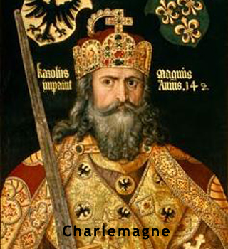

Slide 14
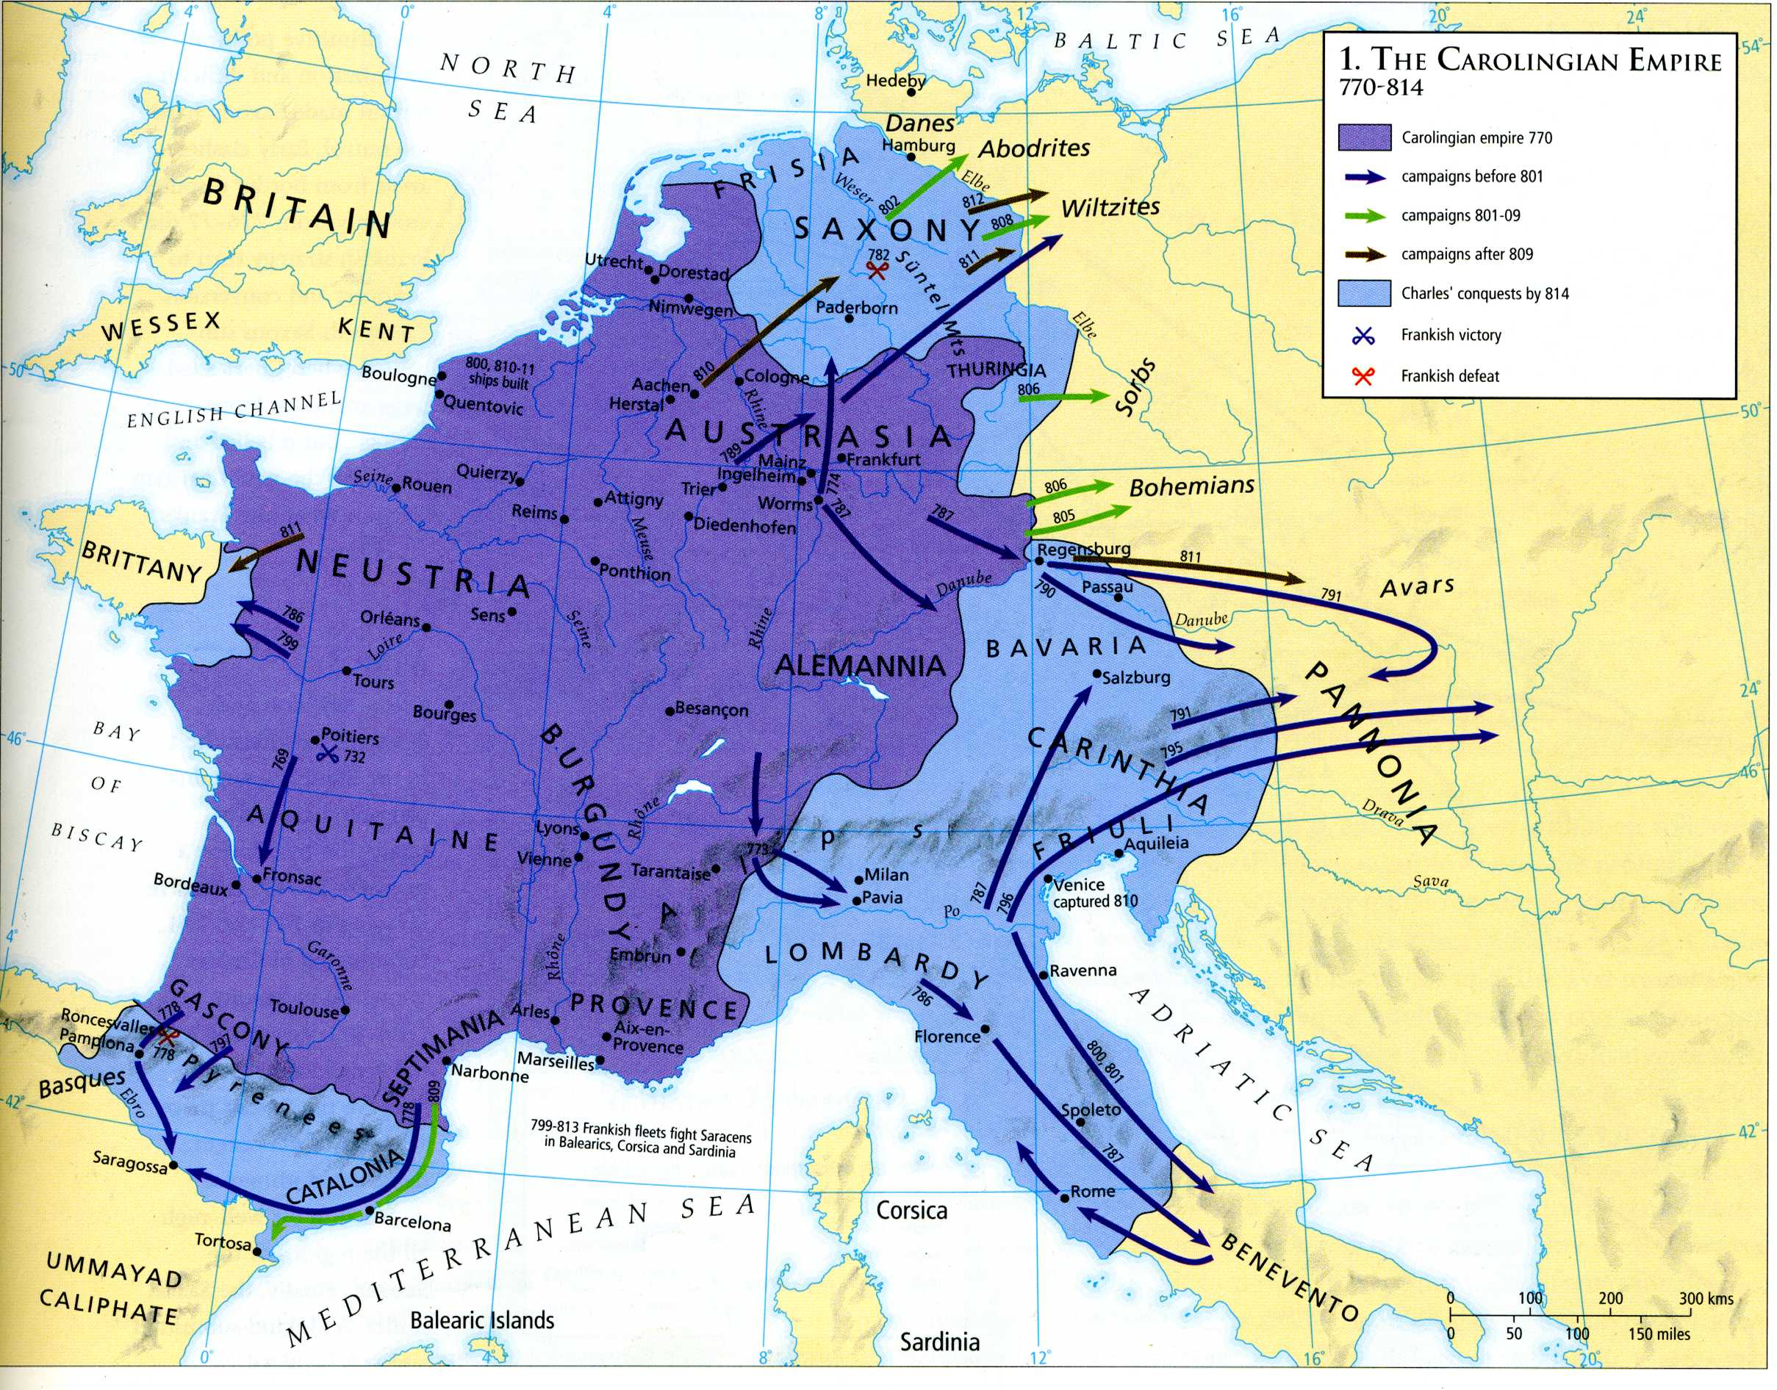

Slide 15
Emergence of Feudalism
By the 900s a new government system was forming in Europe based on the control of land known as feudalism.
The system used a class structure headed by a lord who granted land called a fief to lesser nobles known as vassal.
In exchange the vassal would pledge loyalty to his lord.
The lowest group in this system were the peasants. Many of these people were serfs, or people that could not legally leave the place they were born.

Slide 16
The manor was the economic component of feudalism.
The lord provided housing and farmland to the serfs. In return the serfs worked the land, cared for the animals.
The serfs owned their lord a duty, or tax, in form of grain.

Slide 17
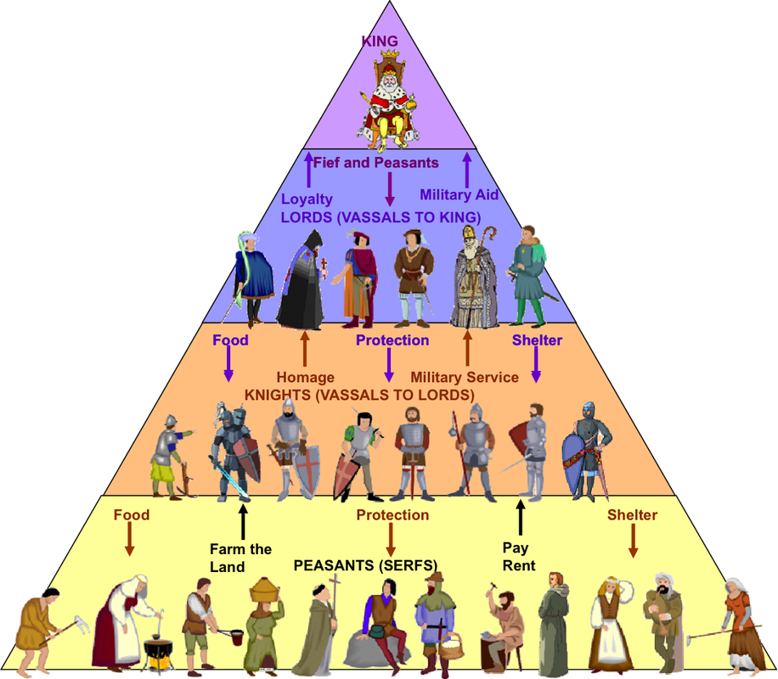

Slide 18
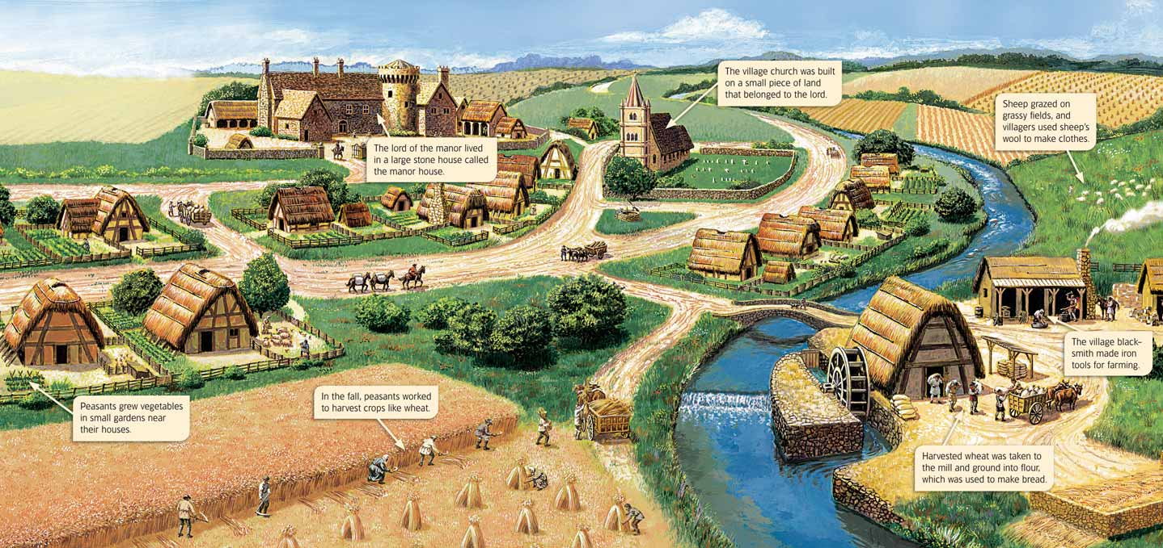

Slide 19
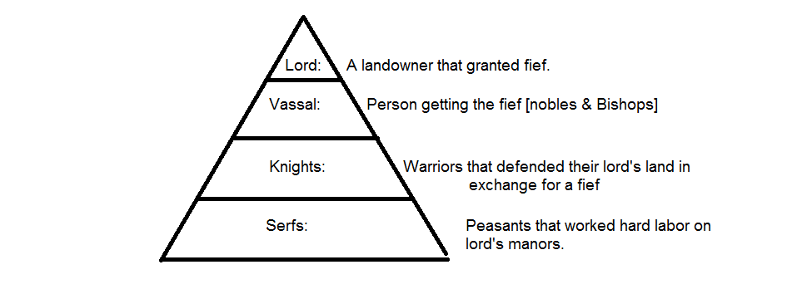

Slide 20
Clashes between the Pope and Kings
By the mid 900s the Holy Roman Empire was the most powerful state in Europe.
The church was closely tied to politics.
The Emperor had the power to appoint church officials such as bishops. This was known as lay investitures.
In 1057 Pope Gregory VII banned the practice. This upset the King Henry IV.
As a result the two sides reached an agreement in which the Pope would appoint the officials but the King could veto the appointment.

Slide 21
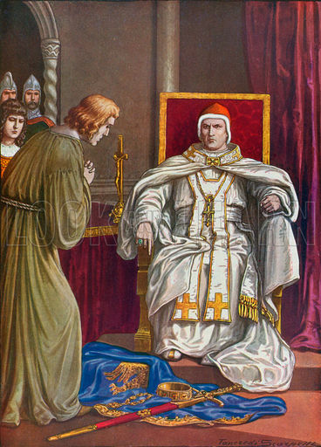

Slide 22
The Crusades
In 1093 Constantinople was under attack from Muslim Turks.
Pope Urban II called for “holy war” or a crusade to take control of the holy lands.
Knights and commoners alike went to the holy lands to capture Jerusalem.
There were4crusades to the holy lands. There was even a children's crusade that began in 1212 in which 30,000 children were led by 12 year old Stephen of Cloyes.

Slide 23
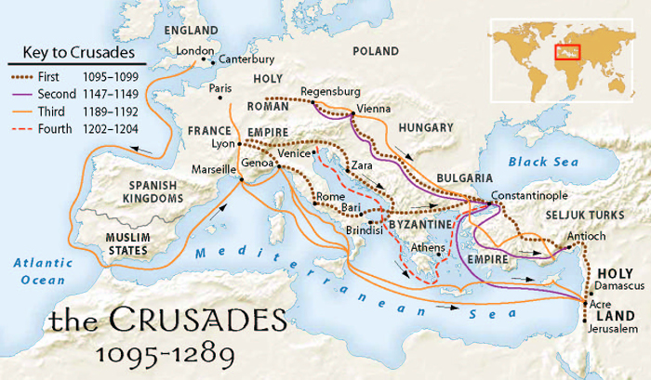

Slide 24
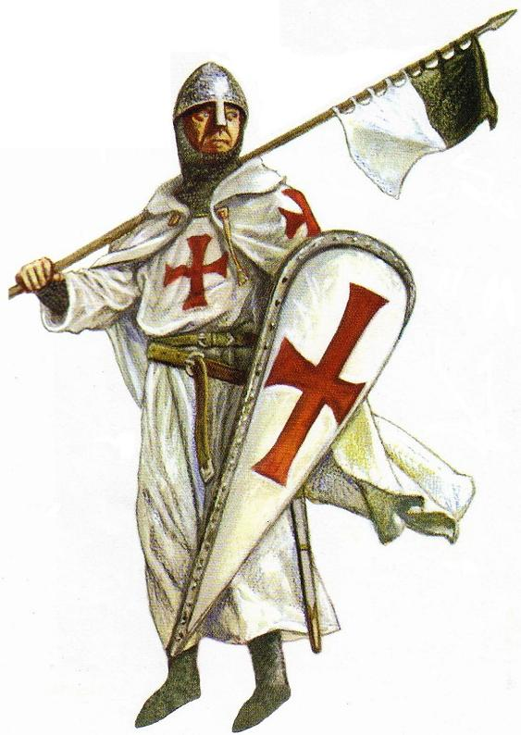

Slide 25
The Lasting Effect of the Middle Ages
The middle ages saw the decline of learning as well as the creation of new nations.
A new form of governmental structure, feudalism, began.
The population of Europe was decimated by the Bubonic Plague, in which 1/3 of the total population died.
The church became more and more important.
Soon a new era known as the Renaissance would usher in more changes.

