Slide 1
The Reformation

Slide 2
Luther Challenges the Church
By 1500 many in Europe had become critical of the Catholic Church.
In 1517 a monk named Martin Luther wrote a series of statements called the 95 Theses.
List of arguments against the practice of indulgences; payment to forgive sin.
Luther posted the list on church doors in Wittenberg.
3 main teachings:
Salvation came from faith in God’s forgiveness
Church teachings should be based on the Bible and the Pope and Church traditions were false.
All people of faith were equal so priests were not needed.
Luther’s teachings and actions start the Reformation.

Slide 3
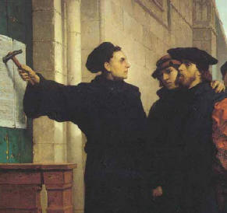
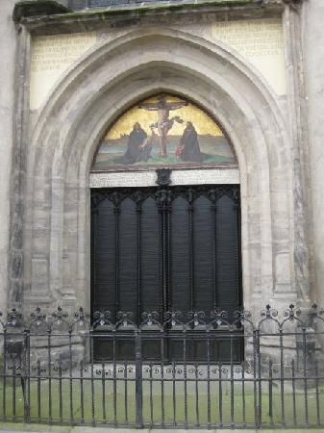
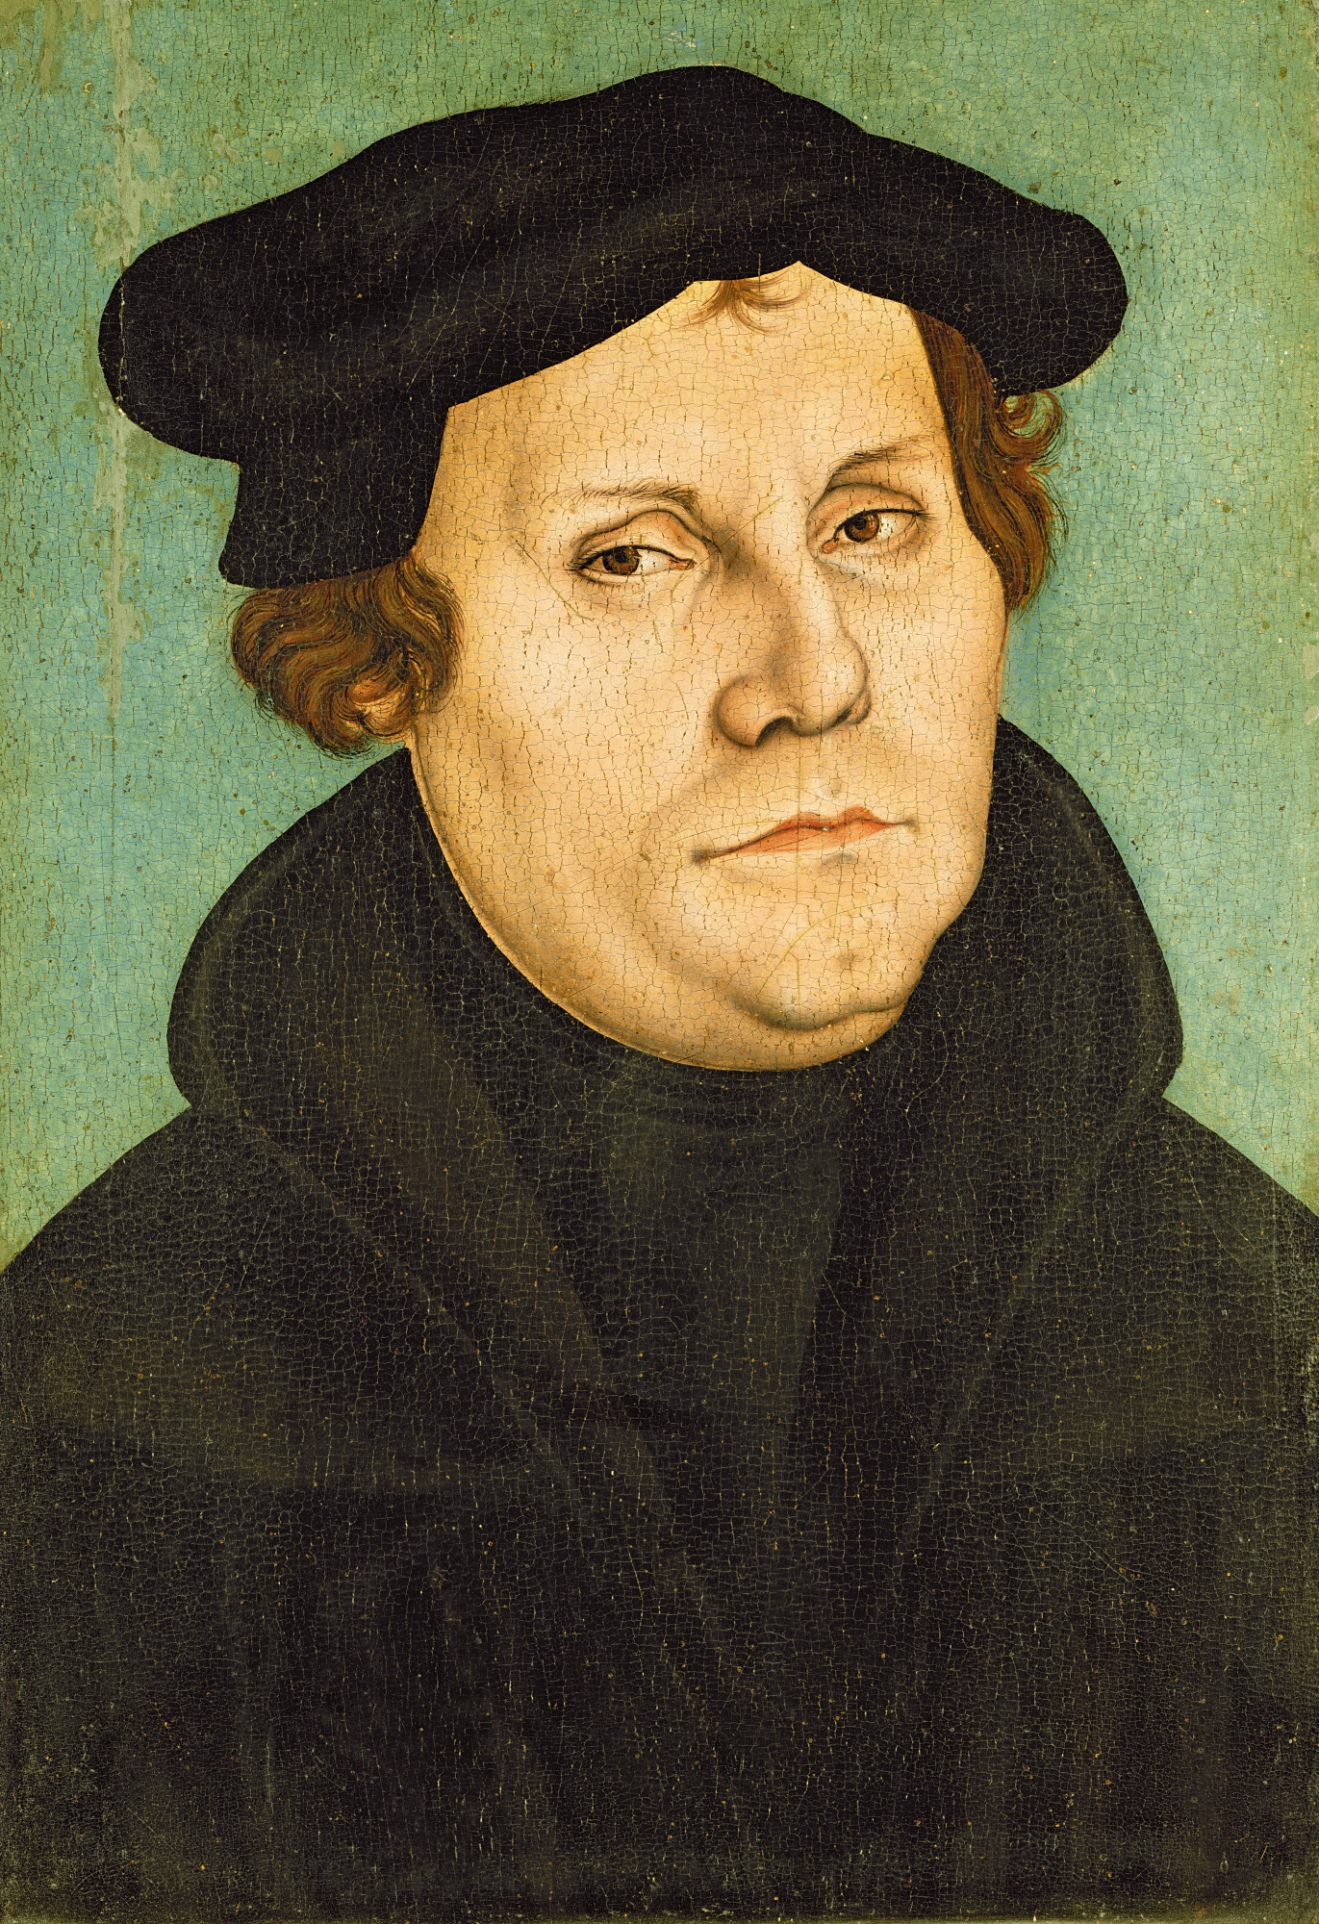

Slide 4
Rise of Protestantism
In 1520 Pope Leo X excommunicated, kicked out of the Church, Martin Luther after viewing him as a threat.
Holy Roman Emperor Charles V ordered Luther to recant, take back his statements. Luther refused and was branded an outlaw by the Edict of Worms.
By 1529 some German princes were loyal to Luther and some remained loyal to the Pope.
Those that were loyal to Luther became known as Protestants. Later this term came to mean any Christian that is not Catholic.
Soon after the German princes were at war with each other and in 1555 Charles V made peace. Each Prince could determine the official religion in his state. This is known as the Peace of Augsburg.

Slide 5
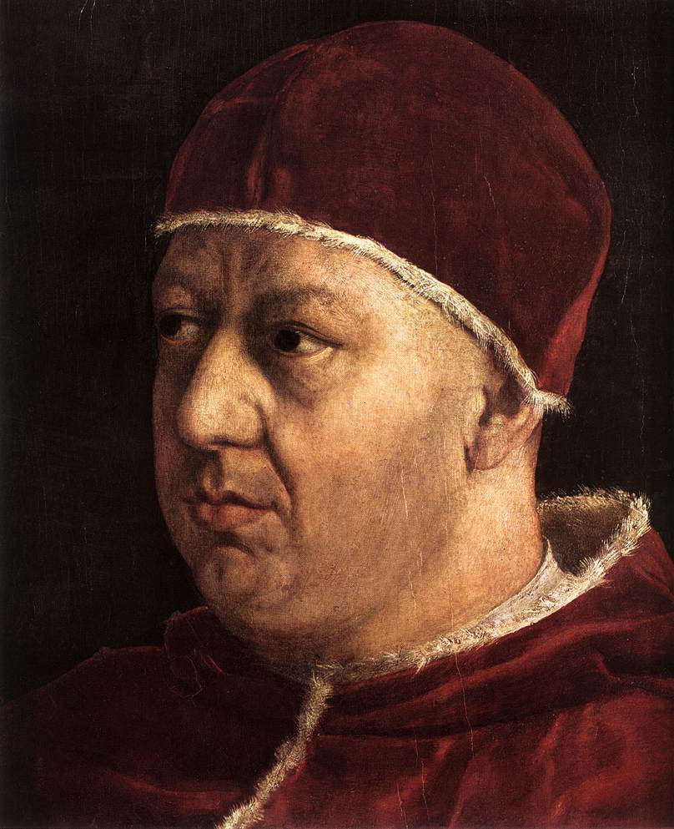
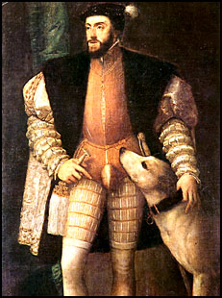

Slide 6
Henry VIII and Protestantism
England’s King Henry VIII was a devout Catholic but his wife Catherine of Aragon could not give him a son and the heir to the throne. So he wanted a divorce in 1527.
The Pope would not grant the divorce in fear of upsetting the Holy Roman Emperor Charles V who was Catherine's uncle.
Henry broke away from the Pope and he and parliament appointed Henry the head of the church in England.
Henry remarried but did not have son but instead a daughter, Elizabeth. He remarried again and finally had a son named Edward. King Henry VII remarried 3 more times.

Slide 7
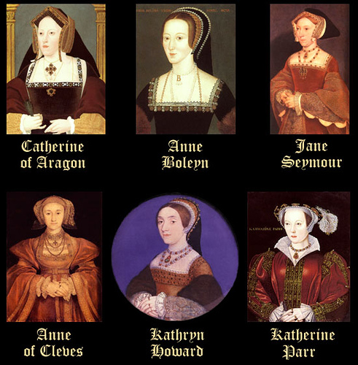
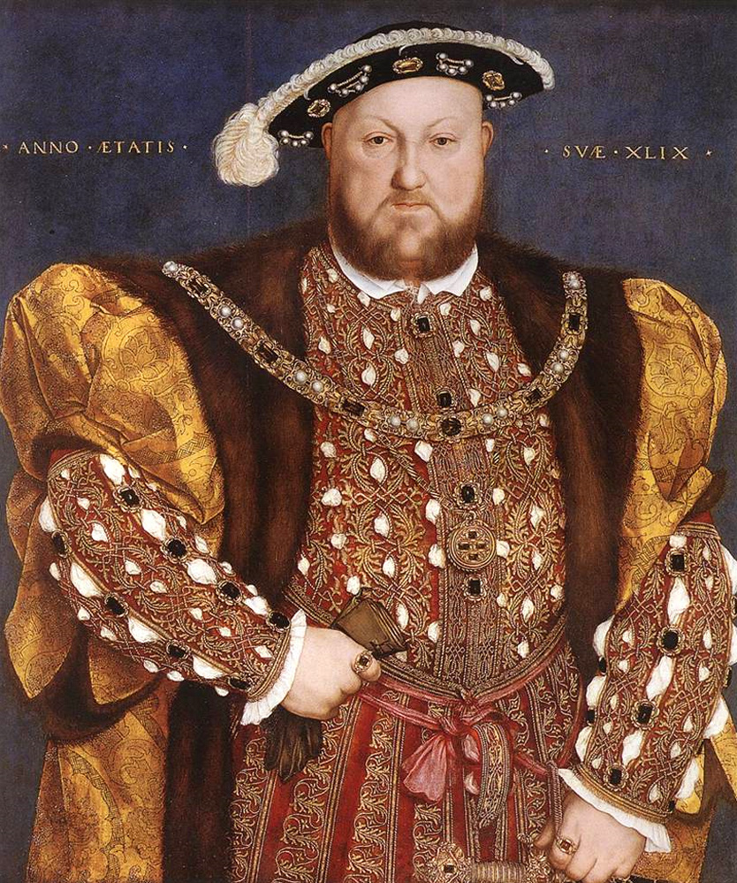

Slide 8
When Henry died his son became king but died just six years later. During this time England officially became protestant.
Mary I returned England to the Catholic church and then her sister Elizabeth I returned the country to Protestantism.
Elizabeth I and parliament created the Anglican Church or the Church of England in 1559.

Slide 9
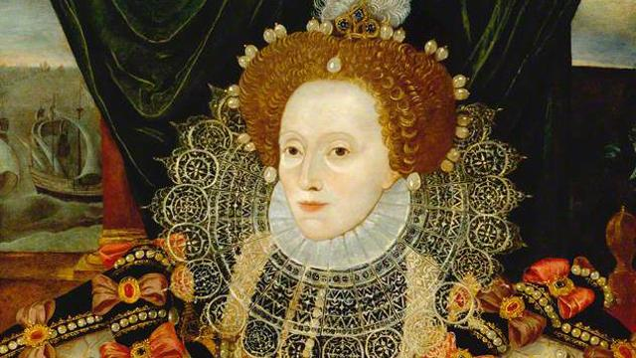
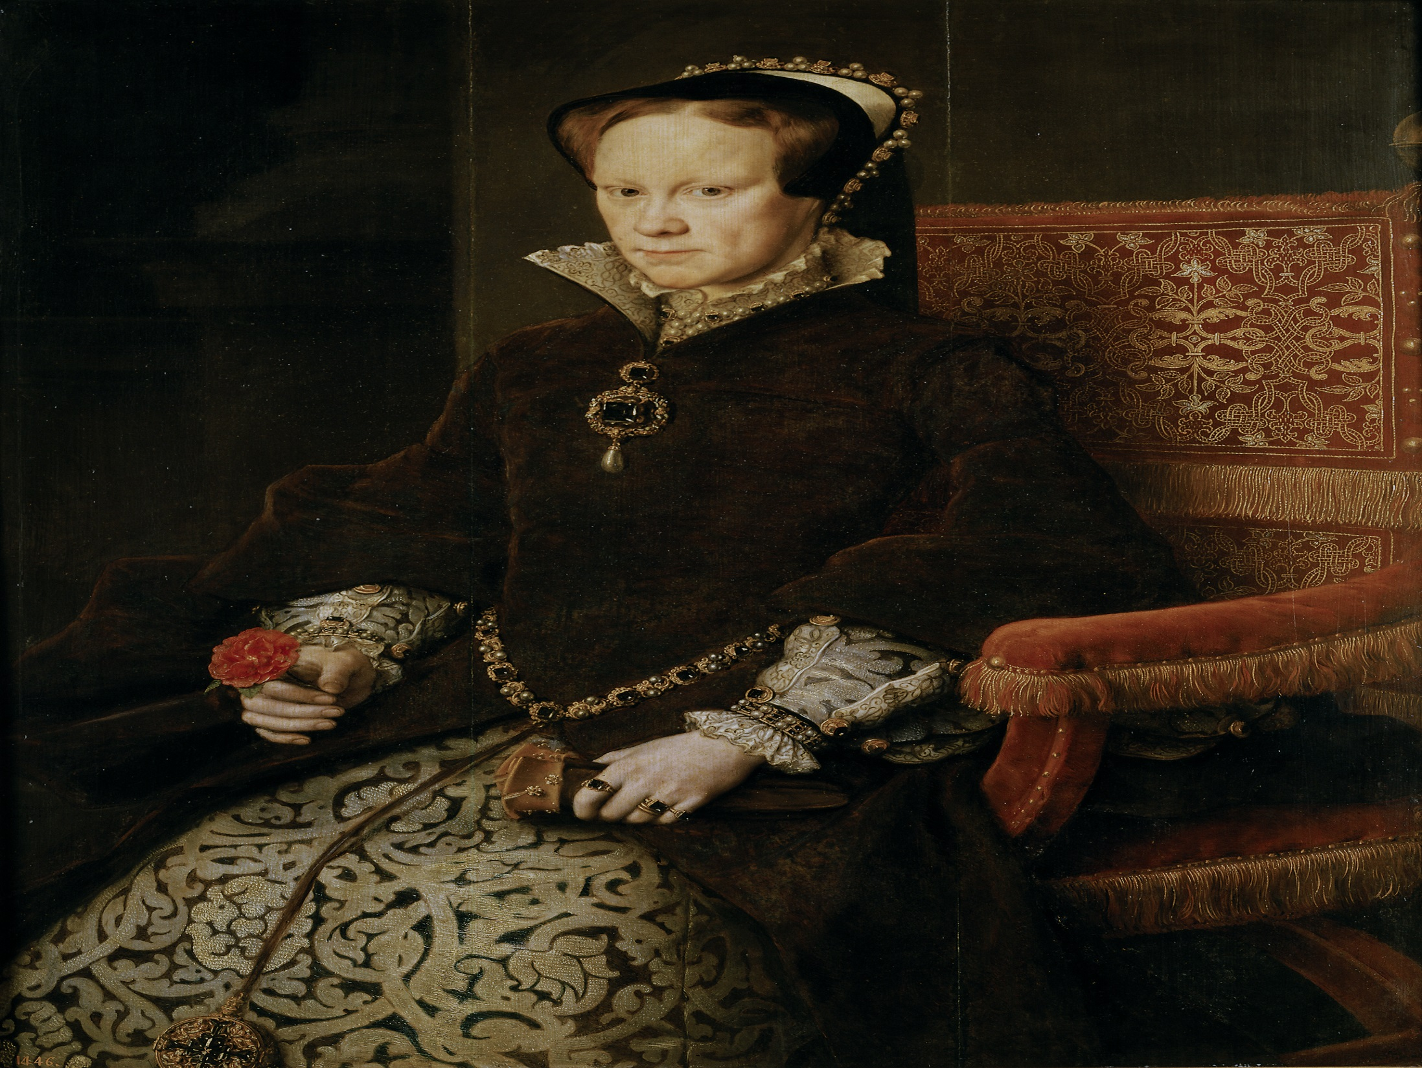

Slide 10
John Calvin and the Spread of Protestantism
In 1536 a lawyer named John Calvin published a work in which he argued that people cannot earn salvation but instead God had already chosen.
This is known as predestination. His teachings are known as Calvinism.
A Scottish Preacher named John Knox put Calvin’s teachings in to practice. Knox’s followers became known as Presbyterians.
Groups in Switzerland, the Netherlands, and France all adopted Calvin’s teachings.

Slide 11
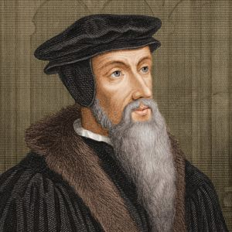

Slide 12
The Catholic Reformation
At the same time as the Protestant Reformation Catholics were seeking reforms in their own church, this is known as the Catholic Reformation or the Counter Reformation
In 1540 Pope Paul III created a new religious order called the Society of Jesus. Its members were called Jesuits.
The Jesuits were led by Ignatius of Loyola who had dedicated himself to daily prayer, meditation, study.
The Jesuits had three main goals: create schools, convert non-Christians to Catholicism, and to stop the spread of Protestantism.

Slide 13
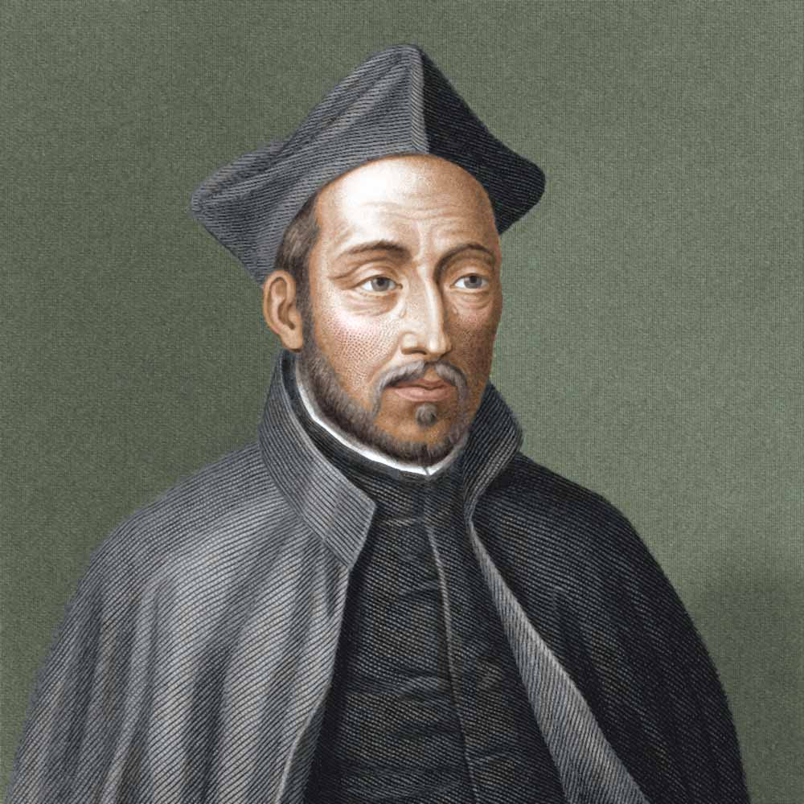

Slide 14
Pope Paul III called for a meeting of bishops and cardinals to meet in Trent, in northern Italy in 1545. This meeting is known as the Council of Trent.
The council met from 1545-1563 and were charged with reforming the church.
They issued several doctrines that became church law.
The church’s interpretation of the Bible was final
Faith and good work was needed for salvation
Bible and Church traditions were the authority
Indulgences were a valid expression of faith.

Slide 15
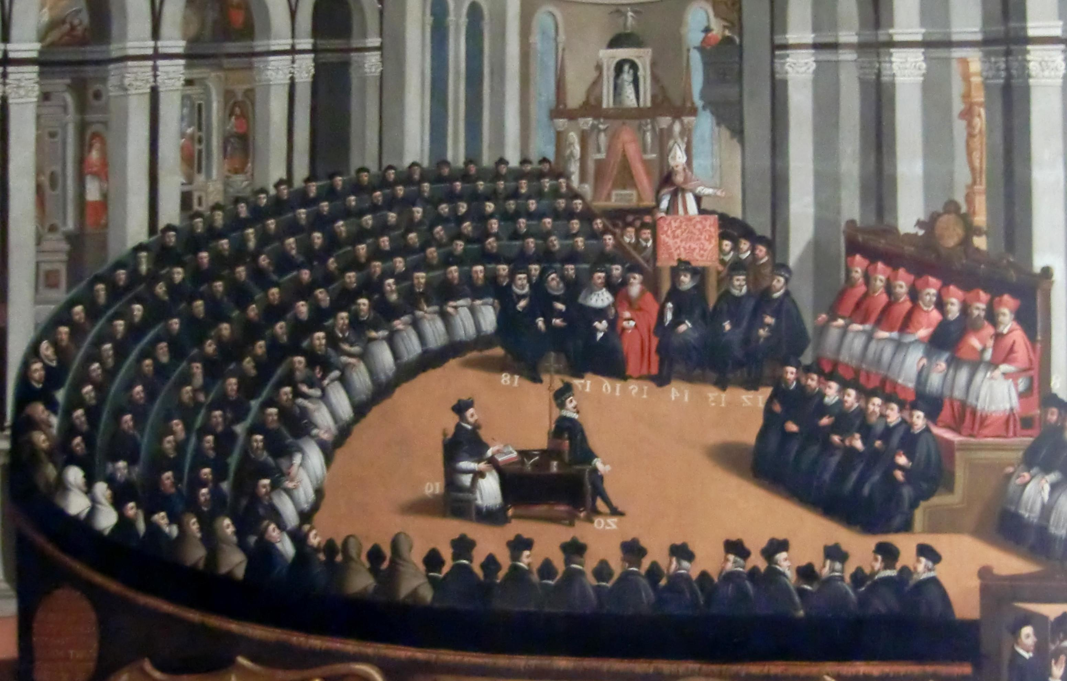

Slide 16
The Legacy of the Reformation
The Reformation ended the cultural unity of Europe
It promoted education which caused the creation of schools and universities.
The Catholic faith became more unified.
As church authority declined it gave rise to modern nation-states.
It laid the ground work for a period of educational renaissance known as the Enlightenment.

