Slide 1
The Renaissance

Slide 2
The Birth of the Renaissance
The Renaissance began in Italy and lasted from 1300 to 1600.
Renaissance means rebirth.
The Italian Renaissance was a revival or art, learning, and a return to a culture that mirrored that of classical Greece and Rome.

Slide 3
The movement began in Italy for three reasons; thriving cities, a wealthy merchant class, and the classical heritage of Greece and Rome.
Cities became the centers for trade and where dominated by the merchant class
One such family of merchants, the Medici, controlled politics in Florence for many years.

Slide 4
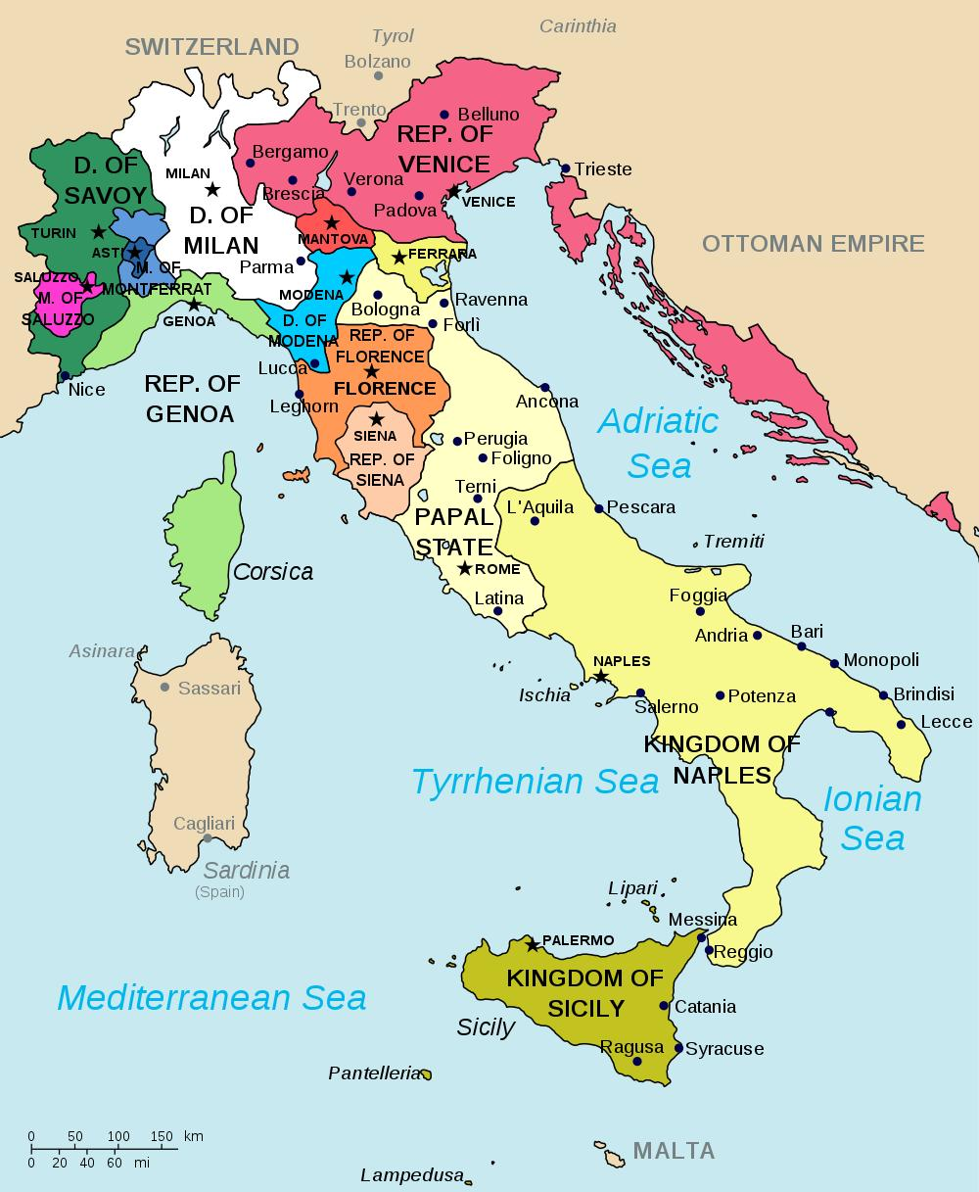

Slide 5
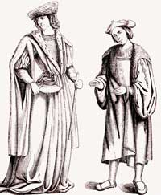

Slide 6
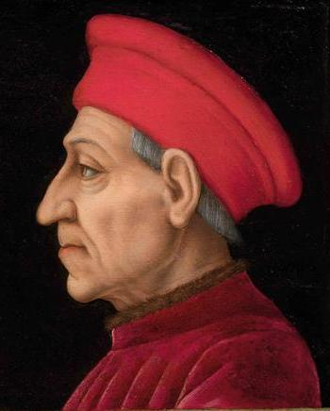

Slide 7
Classical and Worldly Values
Many individuals studied the Roman and Greek manuscripts.
This led to a movement known as humanism; focused on human potential and achievements.
This helped reintroduce the subjects of history, literature, and philosophy. These are known as the humanities.
These same people believed that individuals could live life without offending God.

Slide 8
The wealthy had expensive clothes, good music, and fine food. Even church leaders lived in mansions had had many luxuries.
Society had become secular, or more worldly than spiritual.
Church leaders became the patrons of the arts. They decorated their cities expensive art.
Many educated men strove to be masters of all subjects. This is known as a “universal man or Renaissance man”.

Slide 9
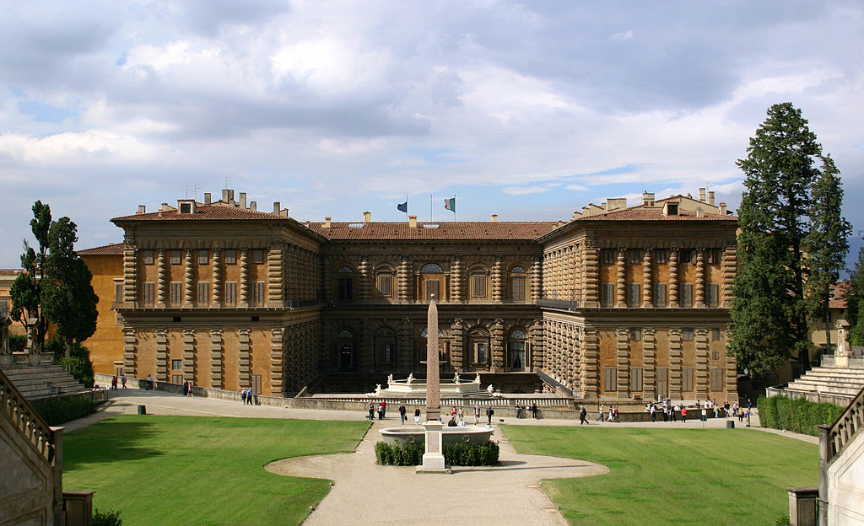

Slide 10
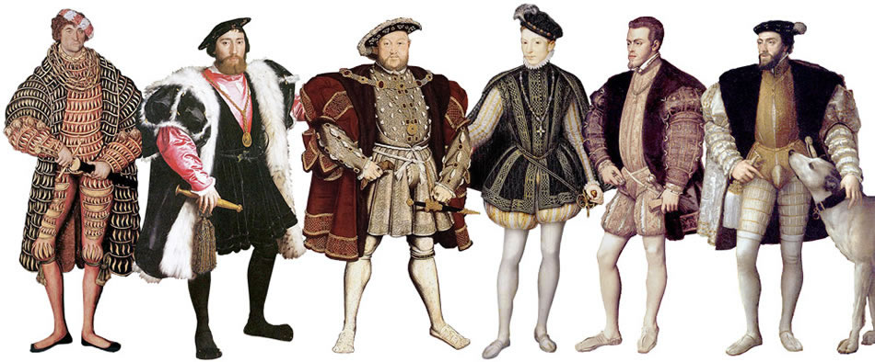

Slide 11
Renaissance Art
Art was revolutionized (changed) during the Italian Renaissance.
Artist used new techniques such as perspective and realism.
Michelangelo and Donatello both utilized realism to portray the human body.
Leonardo da Vinci was a painter and inventor who created works such as the Mona Lisa and Last Super and sketched drawings of machines hundreds of years before their time.

Slide 12
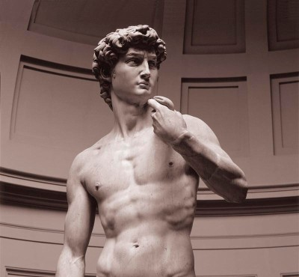

Slide 13
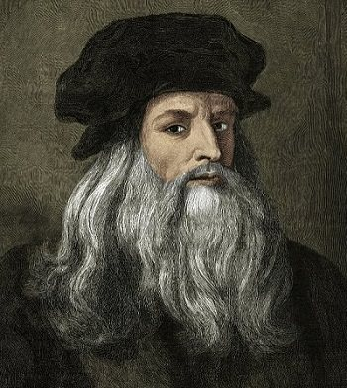

Slide 14
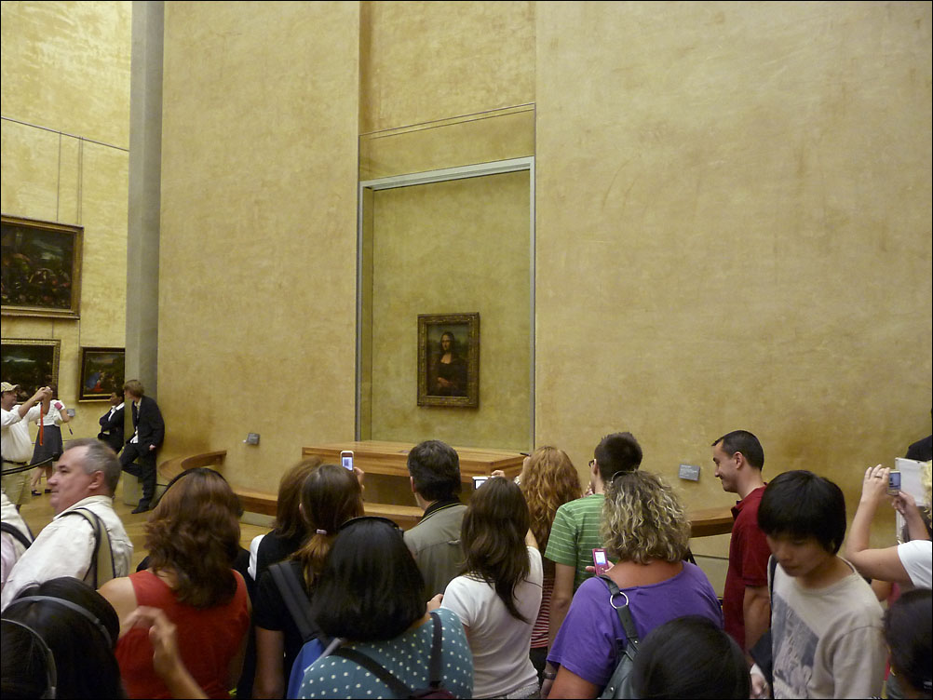
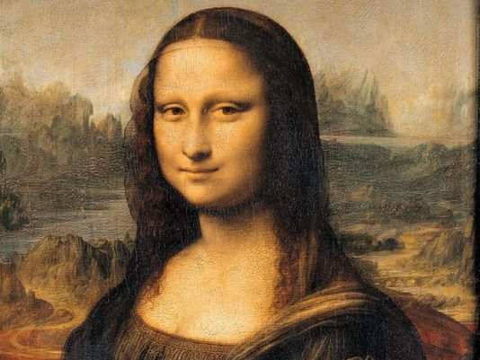

Slide 15
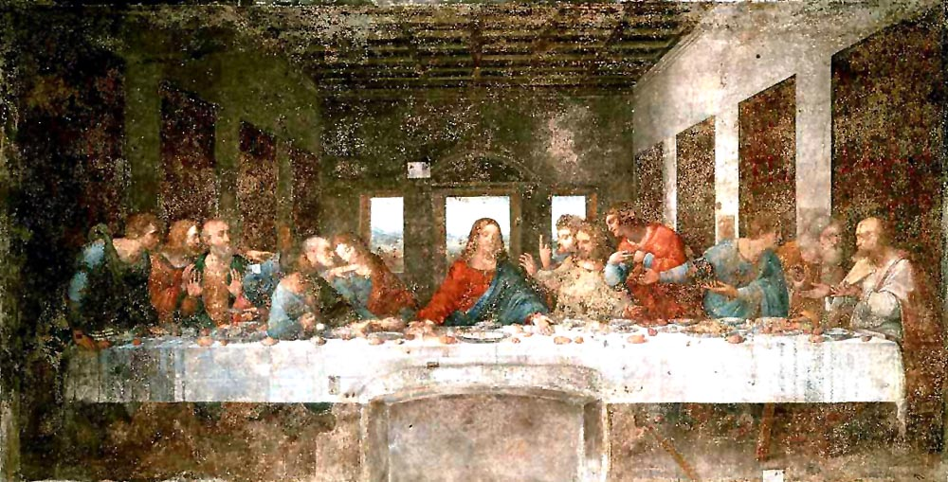
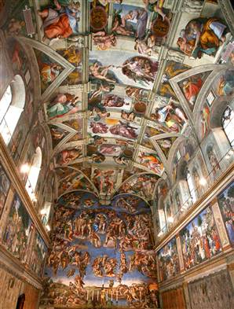
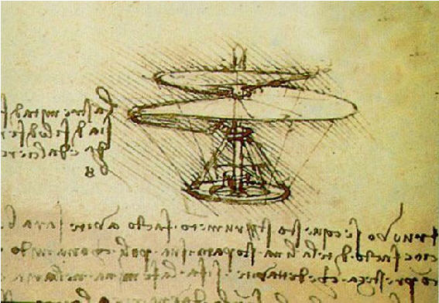
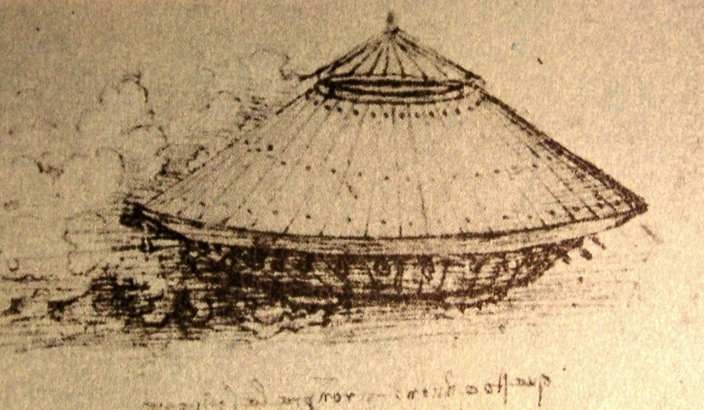

Slide 16
Renaissance Literature
Renaissance writers began to write for self-expression and to portray the individual.
This becomes the foundation for modern writers.
Writers also wrote to advise others. Niccolò Machiavelli wrote The Prince in which he advises rulers on how to gain and keep power.
He says that a ruler must be willing to trick his enemies and his own people for the good of the state.

Slide 17
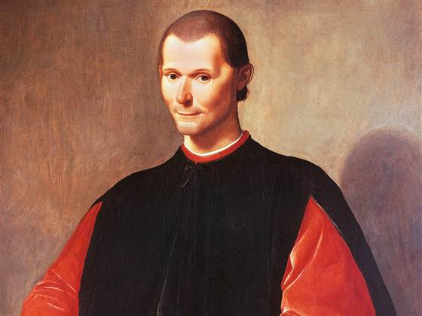

Slide 18
The Renaissance Moves North
By the mid 1400s (15th century) the Renaissance had spread from Italy and reached northern Europe.
As the movement spread north so too did the artistic techniques.
Writers were critical of the Christian church and began to push for reforms, mainly in education.
One such writer was Thomas More of England. In 1509 he wrote a book called Utopia. It was a depiction of an ideal society.

Slide 19
The Elizabethan Age
By the mid-1500s (16th century) the Renaissance had reached England.
This period was named for Queen Elizabeth I who ruled from 1558-1603.
She helped develop English art and literature.
The most famous of the Elizabethan writers was William Shakespeare.
He was born in 1564 in Stratford-upon-Avon.
He used classical Greek stories as his model and inspiration.

Slide 20
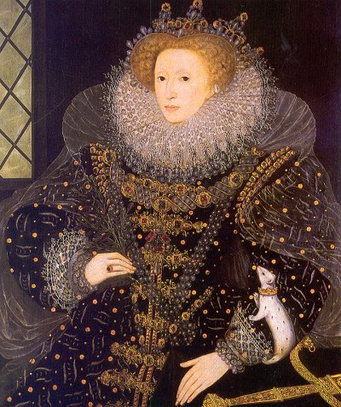

Slide 21
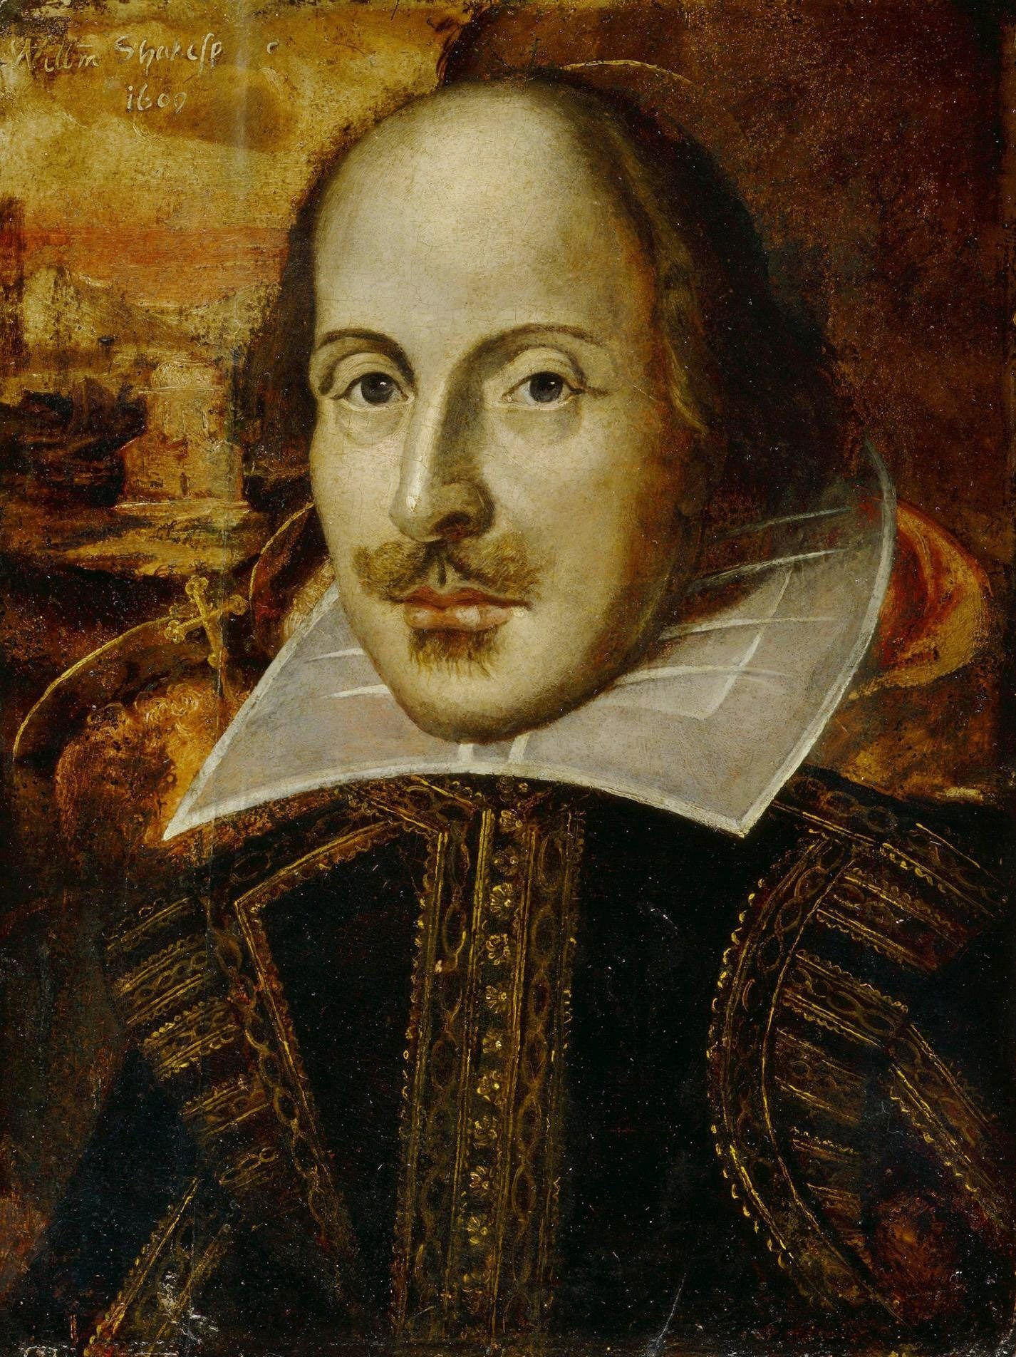

Slide 22
The Printing Press
The printing press was invented in China. They had even invented movable type but it was impractical because there are too many Chinese characters.
By the 13th century the printing press had arrived in Europe from China but it was still a slow process to create a book.
In 1440 Johann Gutenberg, a German craftsman, created a new type of printing press.
He used movable type and the old style printing blocks to quickly produce books.
His first printed book was the Bible in 1455. It became the first book ever printed with movable type.

Slide 23
The printing press allowed hundreds of copies of one book to be produced. This made books cheaper which meant more people could buy them.
Because more people were buying the books the information they held spread throughout Europe.

Slide 24
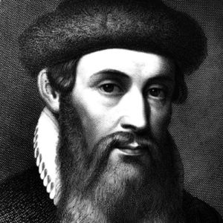

Slide 25
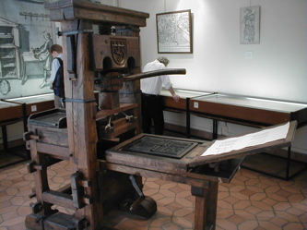

Slide 26
